Slide 1
Precision in size XL
PH series planetary gear units (sizes 9 – 12).
Compact. Rigid. Low-backlash. Energy-efficient.

Slide 2
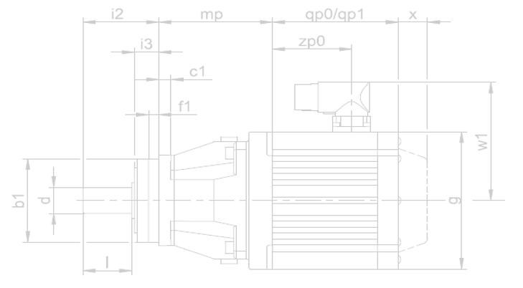
More PERFORMANCE for your machine!
PH
PHQ
Space-saving!
Length reduction up to 100 millimeters.
Higher rigidity.
Lower mass inertia.
Lower weight.
Up to 20% more torque.
Leverage the benefits of direct attachment!
No motor adapter.
Compact design.
Large transmission-ratio range.
Maximum drive dynamics.
Ready-to-install drive solution.
L
L
The most compact planetary geared motors on the market

Slide 3
More PERFORMANCE for your machine!
Greater torque!
Up to 11% greater acceleration torque.
Up to 18% greater nominal torque.
Up to 50% greater tilting torque.
Very high tilting stiffness.
Particularly flexible in use with a ratio range of 12 to 600!

Slide 4
Maximum GEARING QUALITY!
High-quality housing and gearing.
Optimized smooth operation.
Exceptionally constant speed.
High torques.
Boosted by Quattro power!
Innovative 4-planet system.
Maximum torsional stiffness.
For maximum torque.
The most compact planetary geared motors on the market

Slide 5
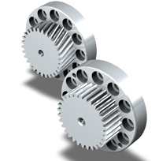
More PERFORMANCE for your machine!
High force for maximum power density.
Can be combined with rack and pinion drives of the ZTR and ZTRS series.
Exceptionally resilient.
Excellent for feed axes of machine tools.
Reduced radial runout ≤ 10 μm.

Slide 6
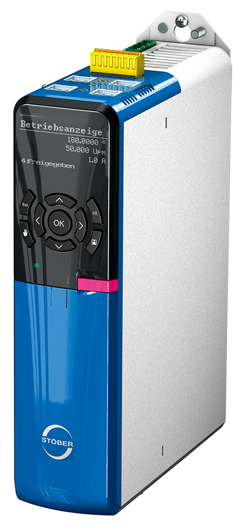
Safety in the system with a redundant brake!
Two brakes are better than one!
High quality planetary gear unit + synchronous servo motor with holding brake.
Electrically actuated "ServoStop" spring-loaded brake in the motor adapter.
Diverse-redundant system in accordance with EN ISO 13849-1.
Very safe thanks to SD6 drive controller, SE6 safety module and integrated safe brake management.
2-brake solution!

Slide 7
Efficiency and design.
Consistently efficient.
High efficiency in combination with synchronous servo motors.
Suitable for all industries where precision, economy and efficiency play a role.
Consistently designed.
Compatible interfaces for all STOBER motors and adapters.
High-quality appearance: Flowing contours, smooth surface texture.
Optimal efficiency values!
The biggest in their performance class!

Slide 8
The preferred partner for perfect motion.
Operating internationally. With the charm of a family business.
Practical system solutions for drives and automation since 1934.
15,283 possible combinations of gear units and motors.
Numerous one-of-a-kind technology highlights and project-related adjustments.
Expert support during drive configuration and commissioning included.
International availability and global service.

Slide 9
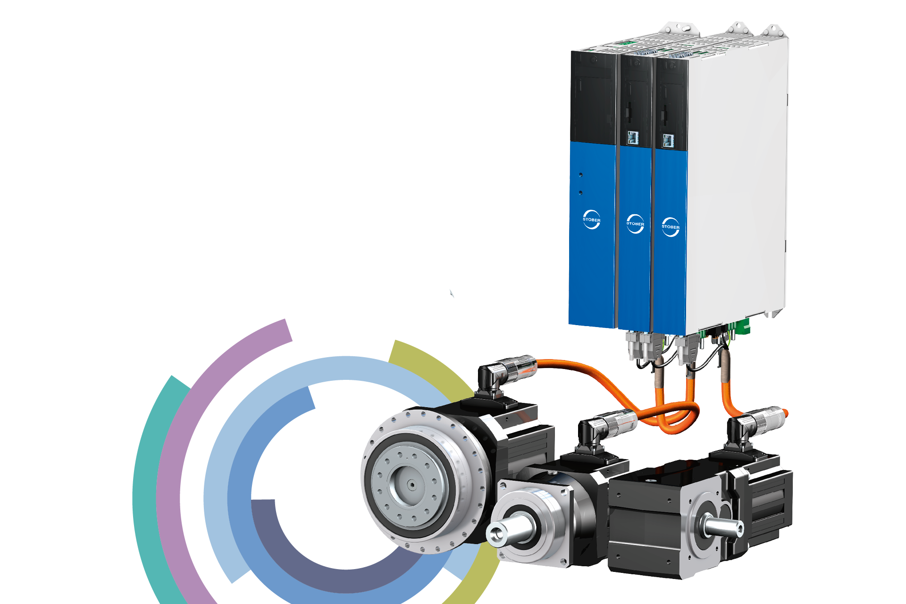
STOBER system advantages
Benefit from the advantages of the STOBER drive system made up of
gear units
motors
drive controllers and cables
For quick success and demanding motion. In any industry. For any application.

Slide 10
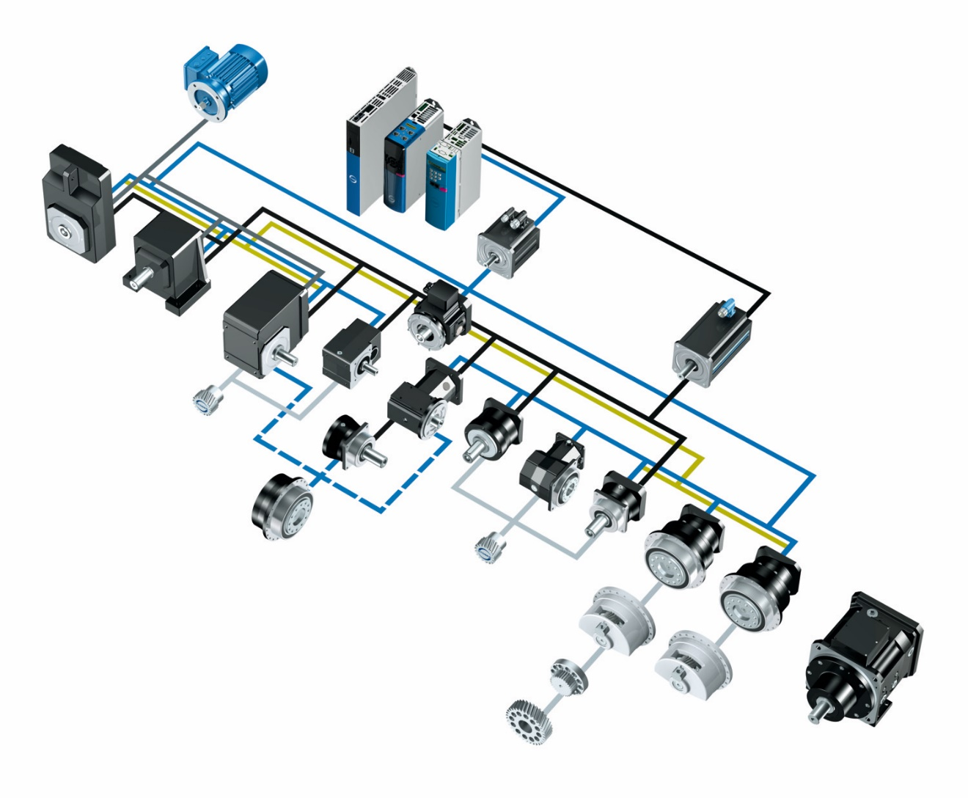
PERFECTLY ADAPTED to your individual requirements
All options are at your disposal!
Versatile machine design.
Exceptional variety of combinations and options.
Largest possible combination of gear units and motors with direct attachment.
Variable adapter designs.
The right configuration for any requirement!
Notes:
Unique interface technology for connecting motors of various sizes. STOBER motor adapters…
...are available in many different specifications, including a ServoStop variant with integrated brake.
...can be combined with standard or backlash-reduced gear units.
...in the large version with an extra-large motor plate can be connected to the most compact STOBER gear units with motors in large designs—a unique selling point!

Slide 11
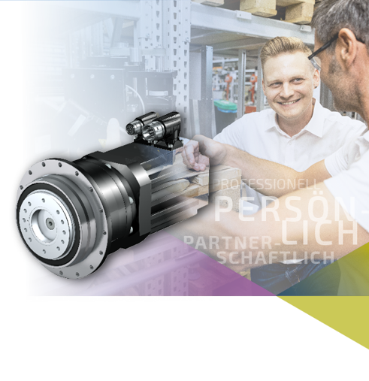
MORE THAN JUST A GEARBOX
MORE.
We bring more to the table!
Collaborative partnership.
Professional consultation designed around your needs.
Comprehensive assistance – from design configuration to commissioning and more.
Optimal solution for each individual application scenario.
THAN JUST A GEARBOX.

Slide 12
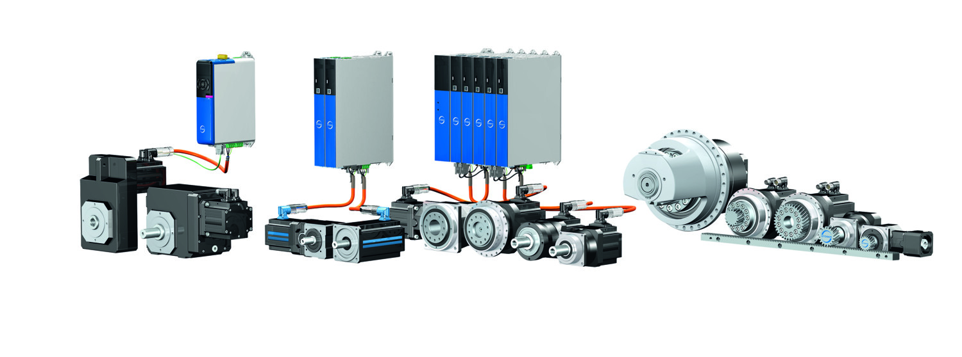
Thank you!
At home in the world of demanding motion.

