Slide 1
Elimination of Safety Factor S_{B}
J. Kübler, 30.03.2022

Slide 2
What is the safety factor S_{B}?
The safety factor S_{B} is calculated as follows for Stöber gearmotors:
S_{B} = M_{2acc} / M₂₀ Where M_{2acc} is the acceleration torque of the gearbox and M₂₀ is the holding torque of the motor converted to the gearbox output.
Defined was a safety factor of
S_{B} ≥ 1.3 This took into account the acceleration capability of the servomotors.
This resulted in the effect that, particularly in the case of motors with relatively steeply falling rated torque characteristics, these combinations did not appear in the catalog and thus also not in the online configurator despite a load characteristic value S ≥ 1.0.
Particularly large motors with windings for high speeds often have steeply sloping rated torque characteristics.

Slide 3
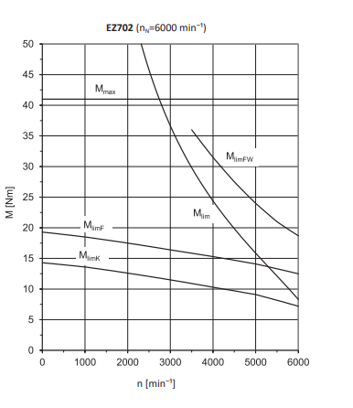
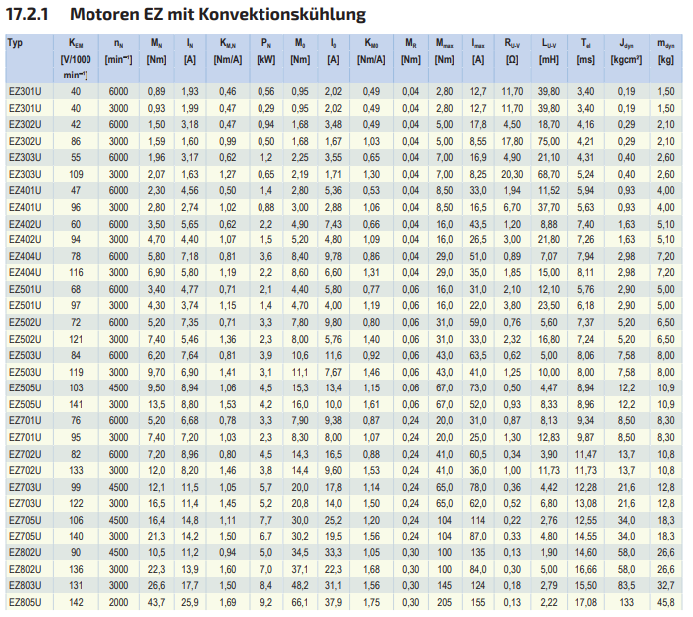
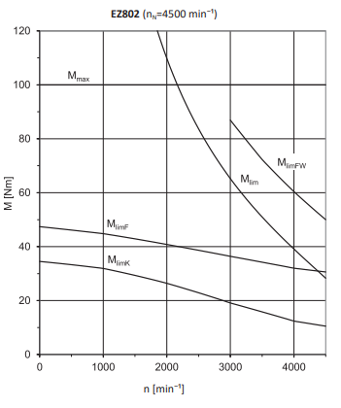
Examples of motor characteristic curves

Slide 4
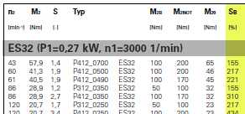
Application of the S_{B}-Factor
Parameter C03 is still the parameter for the maximum torque of the motor in the current DS!

Slide 5
Effect on the performance overviews with EZ motors
Geared Motor Line | # combinations with S_{B} ≥ 1,3 | # combinations without S_{B} ≥ 1,3 | Of which combinations with EZ2…
C_EZ | 1628 | 2121 | 12
F_EZ | 567 | 744 | 3
K_EZ | 1337 | 1640 | 0
PK_EZ | 873 | 949 | 0
PHK_EZ | 837 | 899 | 0
PHQK_EZ | 692 | 754 | 0
PE_EZ | 198 | 217 | 19
P_EZ | 657 | 759 | 36
PH_EZ | 475 | 507 | 13
PHQ_EZ | 366 | 396 | 0
PHV_EZ | 22 | 26 | 0
Total | 7652 | 9012 | 83
1277 new combinations without the new added EZ2… combinations!!!!

