Slide 1
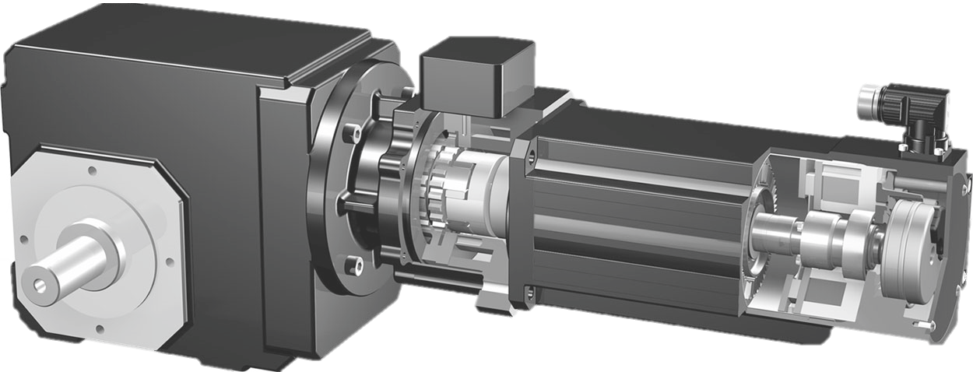
Design of gravity-loaded axes
What does ServoStop / MB- adapter mean?
ServoStop / MB- adapter is a motor adapter which includes a brake made by the Company MAYR. This additional brake combined with the motor brake allows to have a redundant brake system, which is often needed for gravity- loaded axes with possible danger to persons
Notes:
Base for the motoradapter is the ROBA- Topstop, but with a special interface suitable for direct assembling onto different STOBER-gearboxes

Slide 2
Design of gravity-loaded axes
What differs the new version from the old one?
The old version was a special shortened version, which is why, however, the procurement of the special parts took more time.
Now the new version are made of standard parts and this effects in reliable delivery times
Notes:
So sometimes also the delivery time to the customer was exceed

Slide 3
Design of gravity-loaded axes
What means „gravity- loaded axes“?
Vertical axes
Swivelling axes with an excentrical load (offset)
Notes:
SDI?
Hier Planetengetriebe

Slide 4
Design of gravity-loaded axes
What has to be considered?
First of all, a danger assessment must be done by the customer.
Based on that assessment the danger has to be classified and so laws and special rules are having to be considered
The STOBER calculation based on legal requirements and a work instruction which is intended for internal use only.
Sizing calculations for gravity- loaded axes with possible danger to persons may only be carried out by the Systems Support Department.
Notes:
SDI?
Hier Planetengetriebe

Slide 5
Design of gravity-loaded axes
Possibilities of drive selection
443234_KAT_ServoStop
Drive selection of gravity-loaded axes with ServoStop by considering the legal requirements and STOBER internal rules
Notes:
Without danger to persons, it‘s often used for machine when a tool and or the work piece is expensive, so that nothing becomes damaged

Slide 6
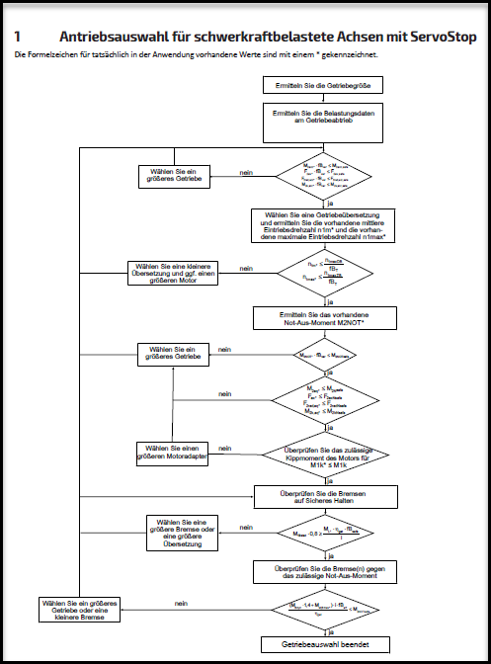
Design of gravity-loaded axes
Calculation guide
Evaluation of all relevant application data
Calculation with ServoSoft with single and double weight load
Determine the existing M2NOT* emergency stop torque
Check each individual brake for safe holding
Check the gearbox against emergency stop torque when both brakes are applied at the same time
Gear teeth calculation with mean speed and max. torque by considering the double load
Bearing lifetime calculation by considering equivalent torque (single load) and mean speed
Check tilting moment of motor at MB
Check the max. perm. motor braking torque at MB
Formal documentation

Slide 7
Design of gravity-loaded axes
1. Customer Query
2. SERVOsoft
6./7. GetBer KissSoft
3. Calculation acc. to catalog
2. SERVOsoft
6./7. GetBer KissSoft
8. Calculation acc. to catalog
4./5. Braketool
Selection finished
Notes:
Flow Chart

Slide 8
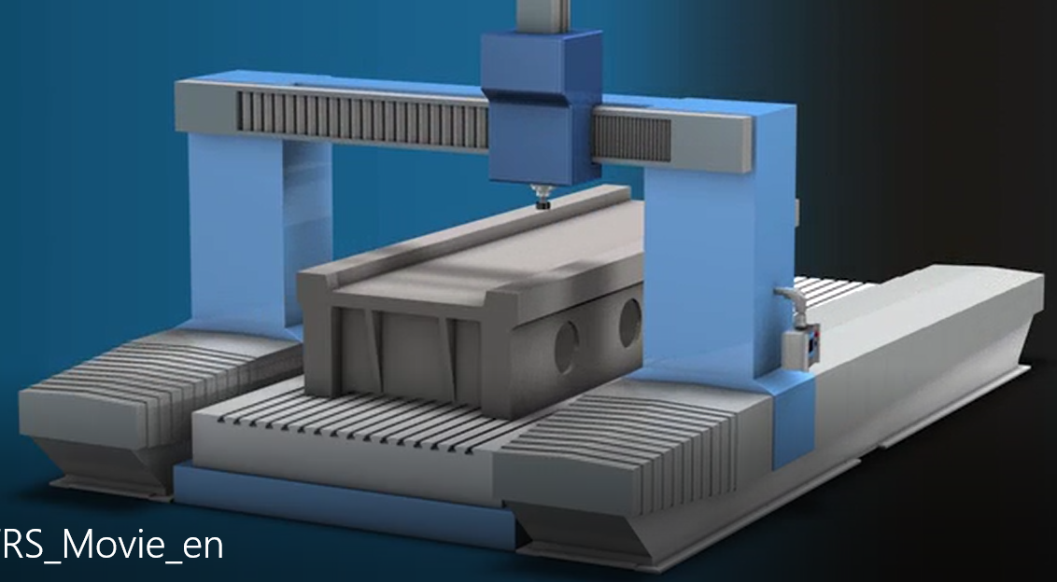
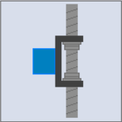
Design of gravity-loaded axes
Ask the customer for the required application data
For ServoSoft and gear calculation
Mass to move in vertical direction (single weight load)
Possible process forces
Motion profile with motion law used for acceleration and deceleration
Required motor series and manufacturer
For rack and pinion applications
Module m
Number of teeth Z
Helix angle ß
Force application point x2
For ball screw applications
Diameter and length of ball screw drive
pitch
Definition which element rotates, which moves linearly?
Via coupling, belt drive or gearbox bearing as fixed bearing

Slide 9
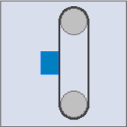
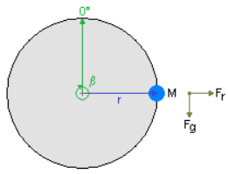
Design of gravity-loaded axes
Ask the customer for the required application data
For ServoSoft and gear calculation
Traction drive applications (e.g. belt- or chain drives, conveyors)
Diameter drive wheel
Diameter driven wheel
Preload of the belt
Rotary axes with unbalanced load (e.g. swivelling table)
Inertia of the rotating parts
Mass
Offset
Start angle

Slide 10
Design of gravity-loaded axes
Ask the customer for the required application data
For bearing lifetime calculation
Dimensional drawing of the mounting situation for information of
Customer bearing or use of the gearbox bearing
Mounting position of C, F, K und P(H)_K gearboxes
For K and P(H)_K side of output shaft (3 or 4) and rotation direction
For calculation of the brake
For motor brake, is redundancy demanded?
According to the standard, a safety factor SH≥1.0 is required for each brake if there must be redundancy. Which value does the customer want?
According to the standard, a safety factor SH≥1.3 is required if only one brake is needed by considering the risk assessment. Which value does the customer want?
For Third Party motors: min. und max. brake torque (tolerances) Motor mass moment of inertia?
Notes:
The safety factors are defined according to standard DIN EN ISO 13849-1 and so it is valid all over the world

Slide 11
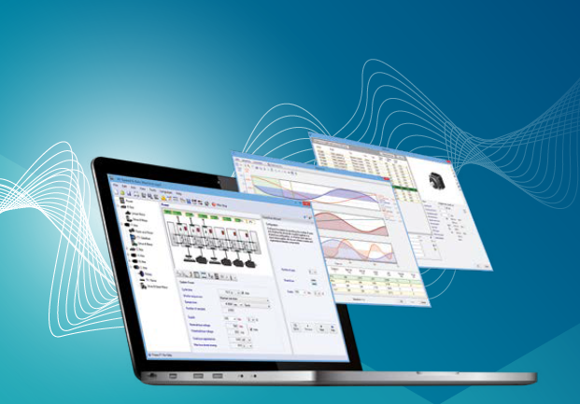
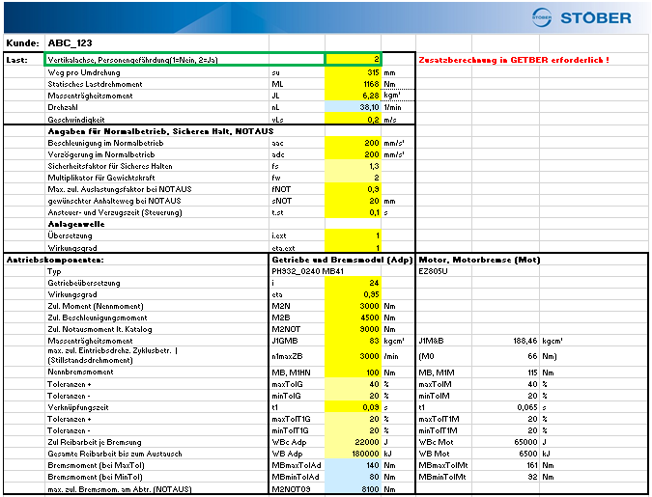
Design of gravity-loaded axes
Calculation with ServoSoft with single and double load
Standard calculation with single weight load
Select the components
Dimension the gearbox generously
Dimension the motor normal
Second calculation with double weight load
Copy axis and double the mass
Gearbox must be still ok
Motor with brake has to be only dimensioned für single weight load
Since no brake calculation is possible in ServoSoft, therefore we use the internal STOBER brake tool

Slide 12
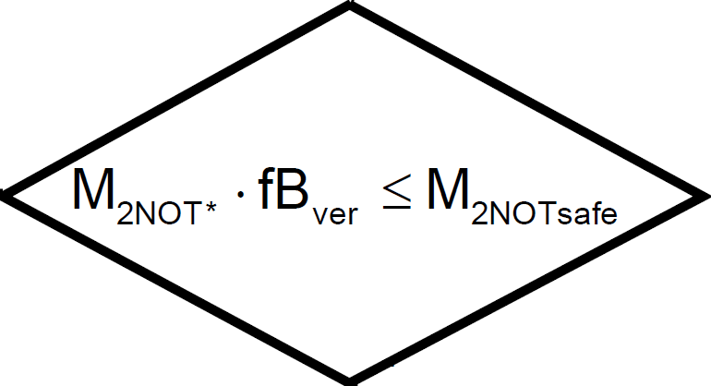
Design of gravity-loaded axes
Determination of Emergency-off torque M_{2NOT}*
Copy axis and enter Max-Stop (SERVOsoft Version)
Calculate M_{2NOT} according to the catalog (Catalog Version)
Check both to M_{2NOTsafe}
Notes:
Verweis auf Servosoft

Slide 13
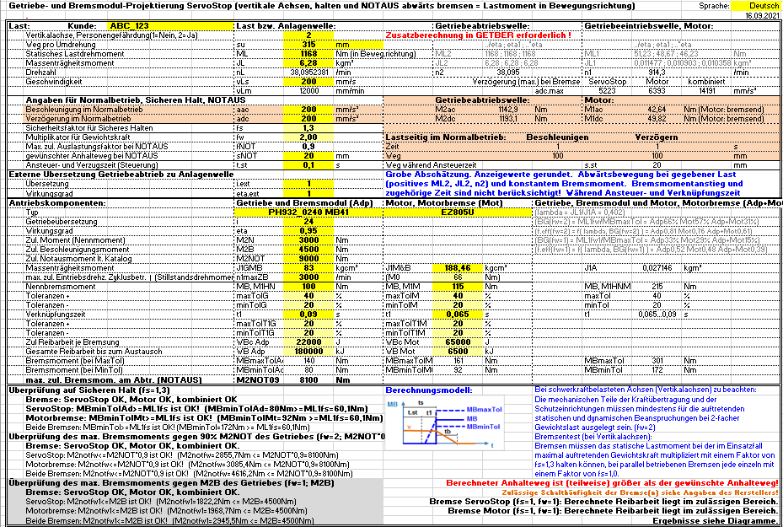
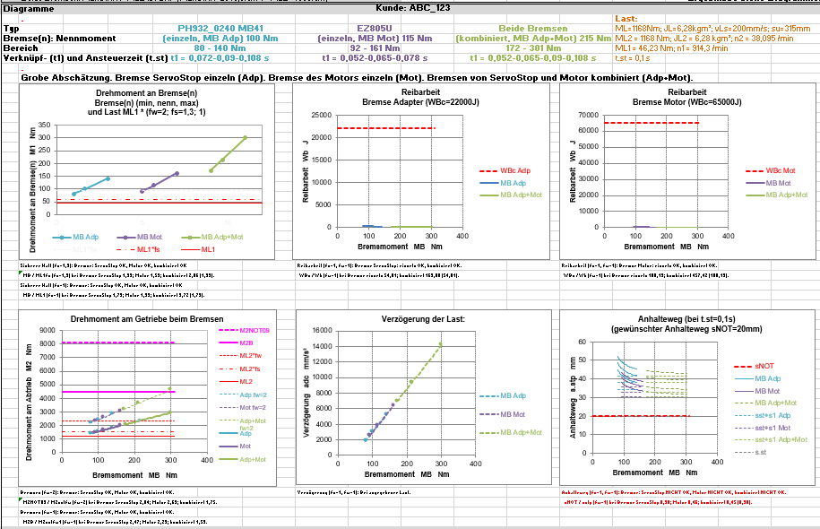
Design of gravity-loaded axes
Check each individual brake for safe holding
Calculate with single weight load
Using the safety factors according to the standard or with the higher factors given by the customer
Check each individual brake for safe holding, by considering the “ - tolerance” and the requested safety factor fB_{safe}

Slide 14
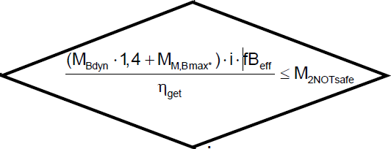
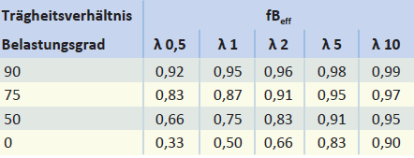
Design of gravity-loaded axes
Check the gearbox against emergency stop torque when both brakes are applied simultaneously
Both brakes are applied at the same time
Consideration of the +tolerances
Calculation of the stat. reaction at the output
Comparison with the Emergency-off torque
For planetary gear units G3 max. 60% utilization
For standard gear units C, F und K max. 90% utilization
Notes:
Toleranz der PMB +100%

Slide 15
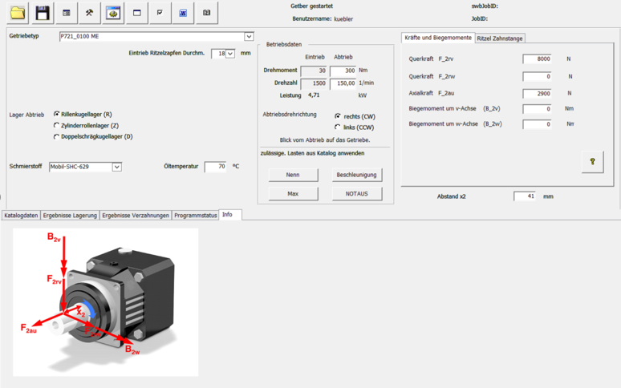
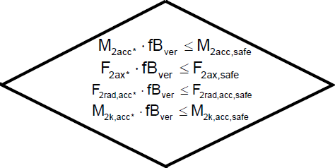
Design of gravity-loaded axes
Gear teeth calculation with max. torque at double load and mean speed
Calculation with max. output torque at double weight load of ServoSoft
Calculation with mean speed of ServoSoft
All gear teeth parts must have safety factor foot ≥ 1,1
All gear teeth parts must have safety factor pitting ≥ 1,03 haben

Slide 16
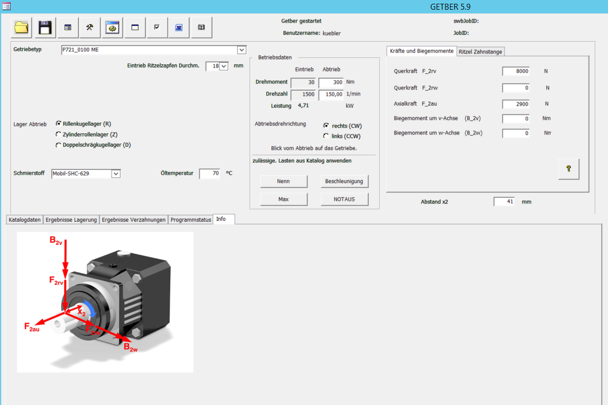
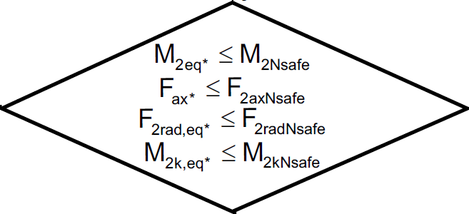
Design of gravity-loaded axes
Bearing lifetime calculation with equivalent moment and mean speed
Calculation with equivalent output torque of single weight load of ServoSoft
Calculation with mean speed of ServoSoft
When the gearbox bearing is used for the subsequent mechanics:
calculation with equivalent forces of ServoSoft
calculation with the force application point x₂
When the subsequent mechanics is supported by the customer
In both cases must be L_{h}≥30.000h
Notes:
Discussion with R+D department about 20000h

Slide 17
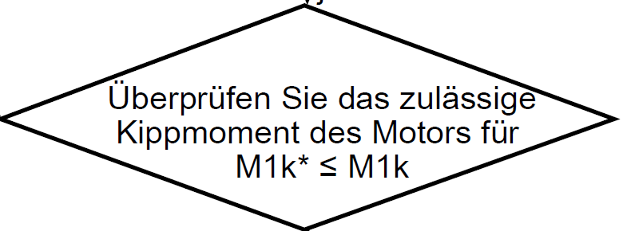
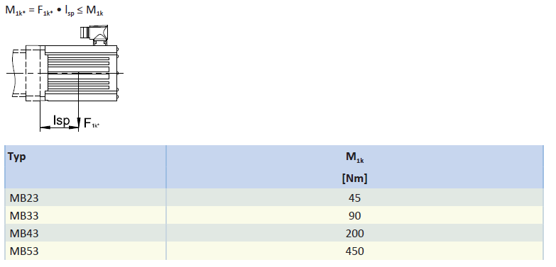
Design of gravity-loaded axes
Check tilting moment of motor at MB
Only required for horizontal mounted motor
Determine motor weight force, add acceleration / deceleration in case of moving drives.
Assume half of overall length as the center of gravity
Calculation according to catalogue and comparison with permissible values
M1k = 10,9 x 9,81 x 263,5/2 ≤ M1k
14,09 Nm ≤ 45Nm

Slide 18
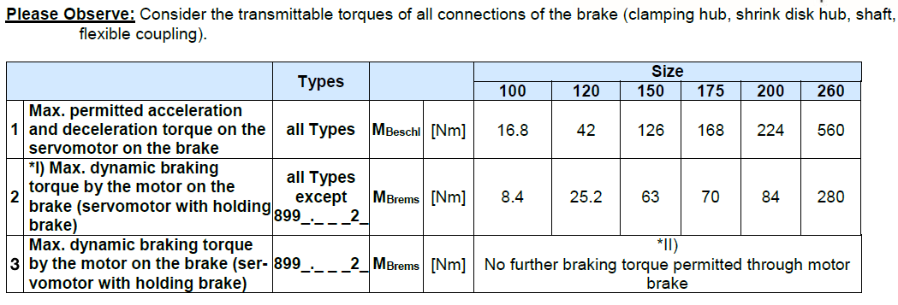
Design of gravity-loaded axes
9. Check the max. perm. motor braking torque at MB
The reason for these values are the single parts or the screwed connections of the MB- adapter.
That means not only the gearbox is the limiting component but sometimes the MB- adapter itself.
Notes:
Shown in the MAYR operating manual

Slide 19
Design of gravity-loaded axes
10. Formal documentation
Documentation of all calculations with mail history customer
If requested, we can create a confirmation letter
Creating a text module for SAP offer and AB and make available to colleagues in the OD

