Slide 1
The STOBER System
At home in the world of demanding motion.

Slide 2
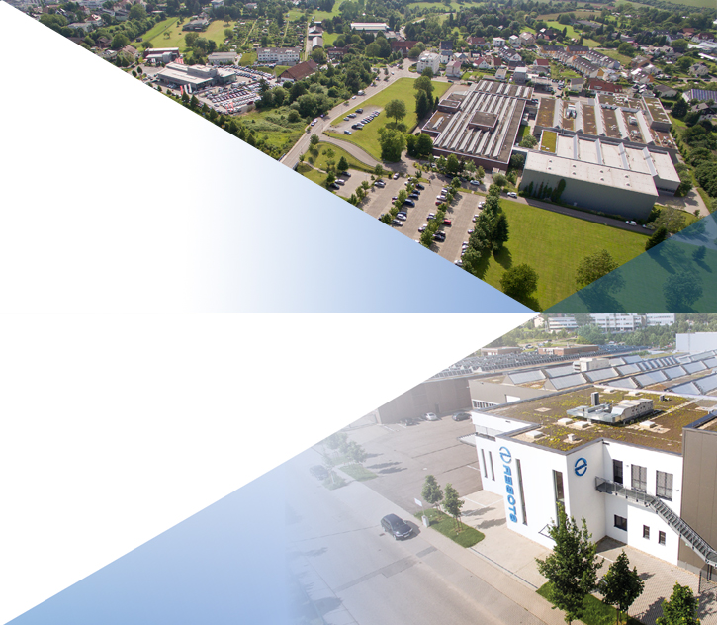
The preferred partner for perfect motion.
Operating internationally. With the charm of a family business.
Founded in 1934
Headquarters in Pforzheim, Germany
Shareholders: Andreas Thiel and Patrick Stöber
CEO: Rainer Wegener
Employees: 1000
Total turnover: 160 million euros
Production area: 40,000 m²
STOBER motion is smooth, fast, precise, and reliable. ​

Slide 3
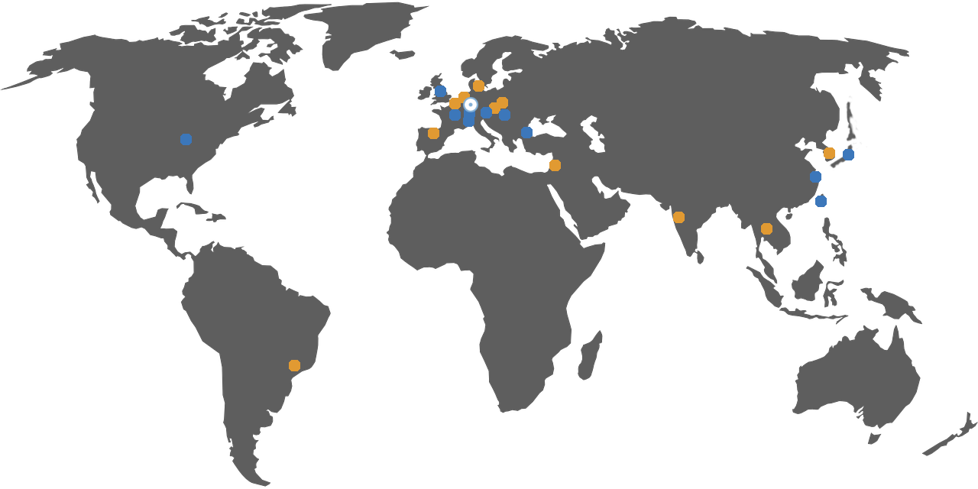
Working together. Worldwide. Successfully.
12 locations worldwide.
GERMANY, Pforzheim
AUSTRIA, Laakirchen
CHINA, Taicang City
FRANCE, Caluire-et-Cuire
HUNGARY, Cegléd
ITALY, Milano
JAPAN, Tokyo
SWITZERLAND, Remetschwil
TAIWAN, Taichung City
TURKEY, Istanbul
UK, Staffordshire
USA, Maysville, KY
13 partners worldwide.
BELGIUM, VDP Industries b.v.b.a , Nazareth ATB Automation , Sint-Pieters-Leeuw
BRAZIL,
Automotion LTDA, Boituva – SP
CZECHIA,
REM-Technik s.r.o., Brno
DENMARK,
Delta Elektronik A/S, Taastrup
INDIA,
Fluro Engineering Pvt Ltd, Mumbai
ISRAEL,
Contel Automation & Control Ltd, Kiryat - Arieh Petach-Tikva
KOREA,
DAE KWANG STOEBER CO. LTD., Seoul
NETHERLANDS,
ATB Automation, Mijdrecht
POLAND,
DEMERO - Automation Systems, Wroclaw
PORTUGAL,
Brotomatic S. L., Vitoria-Gasteiz
SLOVAKIA,
REM-Technik s.r.o., Brno
SPAIN,
Brotomatic S. L., Vitoria-Gasteiz
THAILAND,
PMP Precision Motion Products Co. Ltd, Samutprakarn

Slide 4
What we stand for.
Our values:
We are STOBER.
Connected.
Committed.
Compassionate.
THE BIG PICTURE
We think in terms of integrated solutions.
DEDICATION
We give our all for our mutual success.
INNOVATION
Innovation is what drives us.
QUALITY
Quality is in our genes.
TEAMWORK
We embrace Teamwork.
RESPONSIBILITY
Sustainable growth is our top priority.

Slide 5
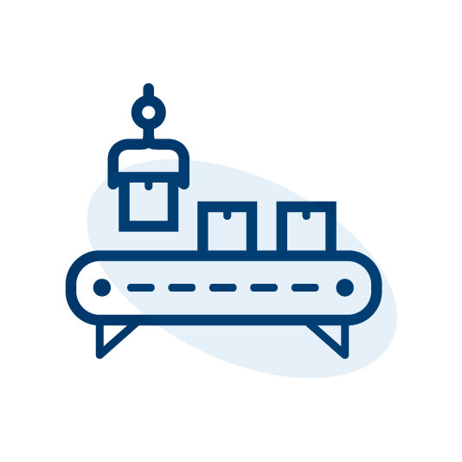
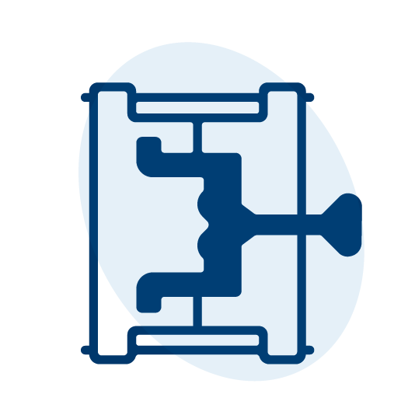
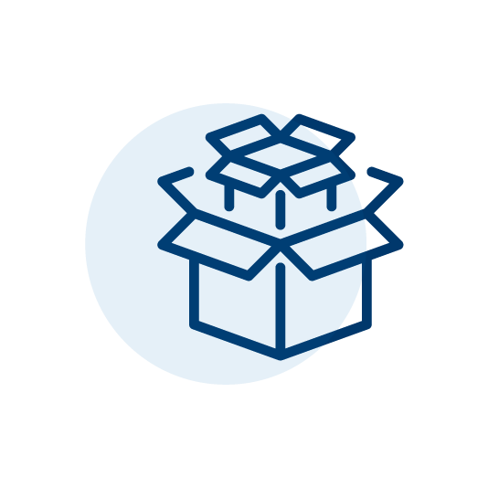
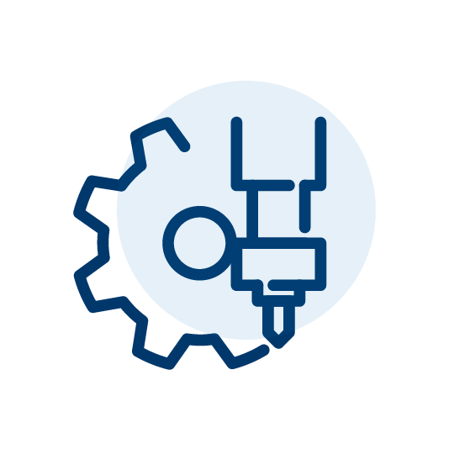
A perfect match – the drive system for your plant!
AUTOMATION & ROBOTICS
The right drive solution for every axis. Compact and powerful, for dynamic applications.
PLASTIC MACHINES
Solutions with a high power density and energy-efficiency, for productive, resource-saving machines.
PACKAGING MACHINES
Compact drive solutions for a productive, energy-efficient and flexible packaging method.
MACHINE TOOLS
Precise, flexible and powerful drive system for maximum economy and performance.

Slide 6
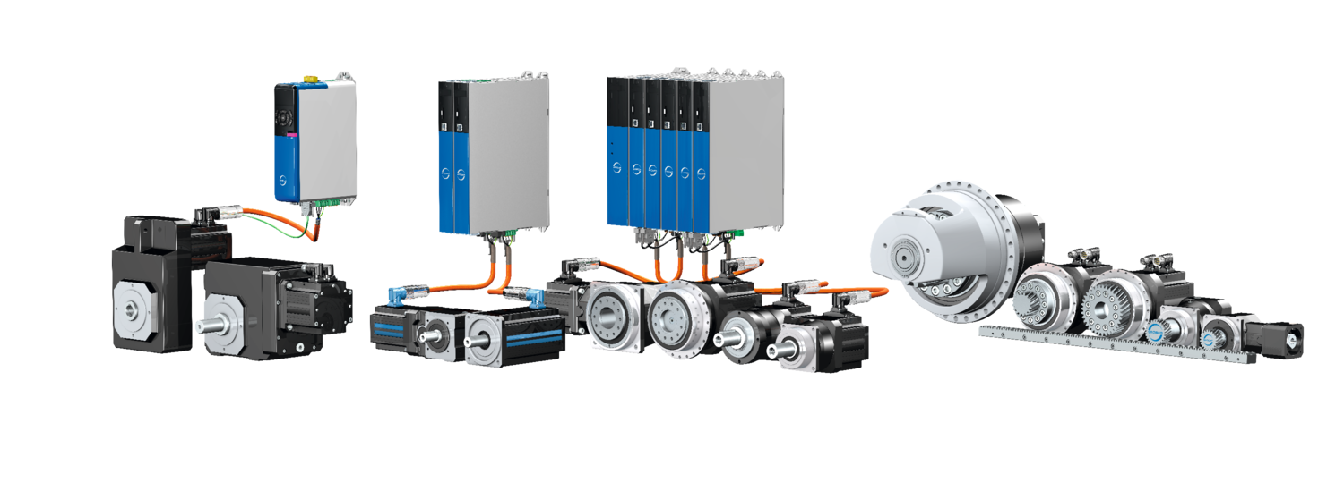
The advantages of the system.

Slide 7
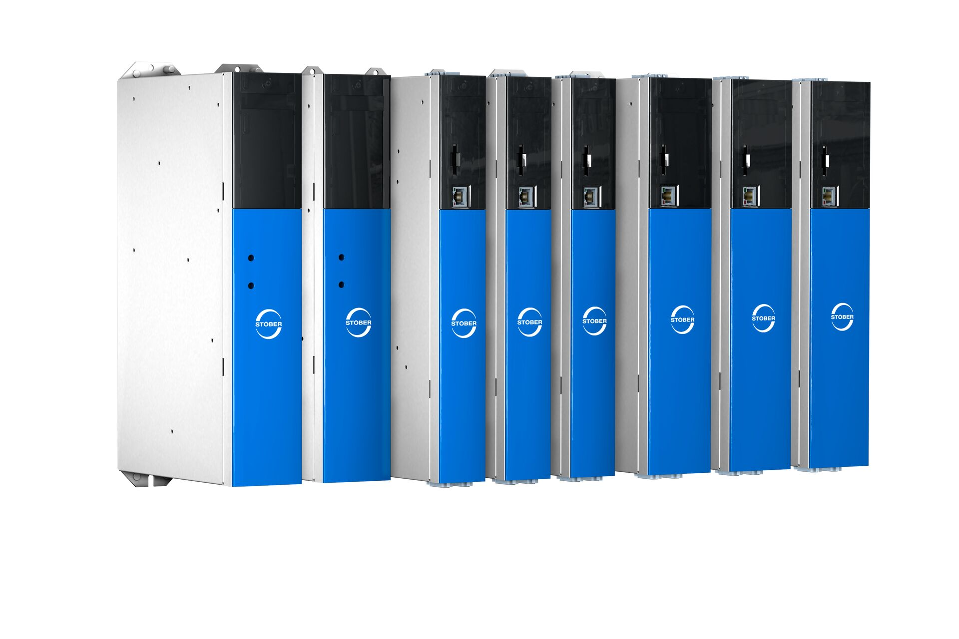
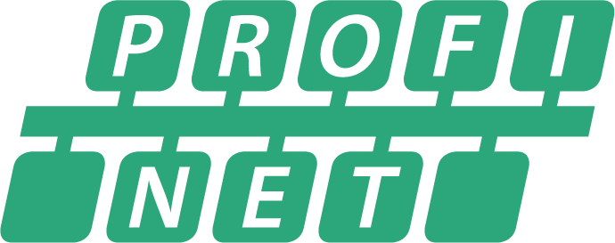
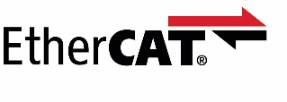
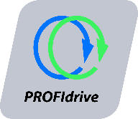
Drive controllers of the latest generation.
Compact. Directly attachable. For the highest dynamics.
Every drive solution has its
own unique character. And we have the matching drive controllers!
Tailor-made for every drive task – the combinable SC6, SI6 and SD6 series!

Slide 8
Synchronous servo geared motors with direct attachment.
Compact synchronous servo geared motors ...
Without a motor adapter.
Smaller installation space.
Low weight.
Maximum drive dynamics.
Less heating.
Increased power density.
Ready-to-install drive solution.
More PERFORMANCE for your machine!

Slide 9
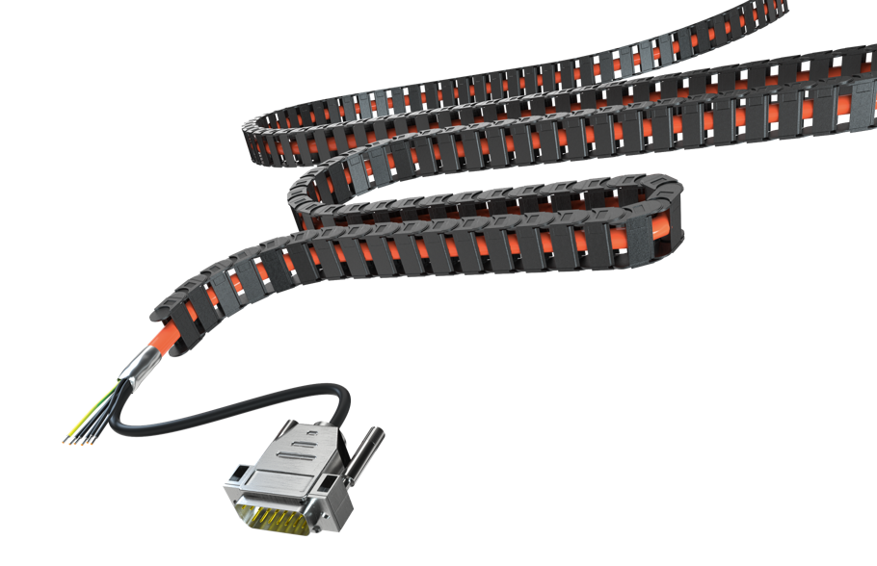
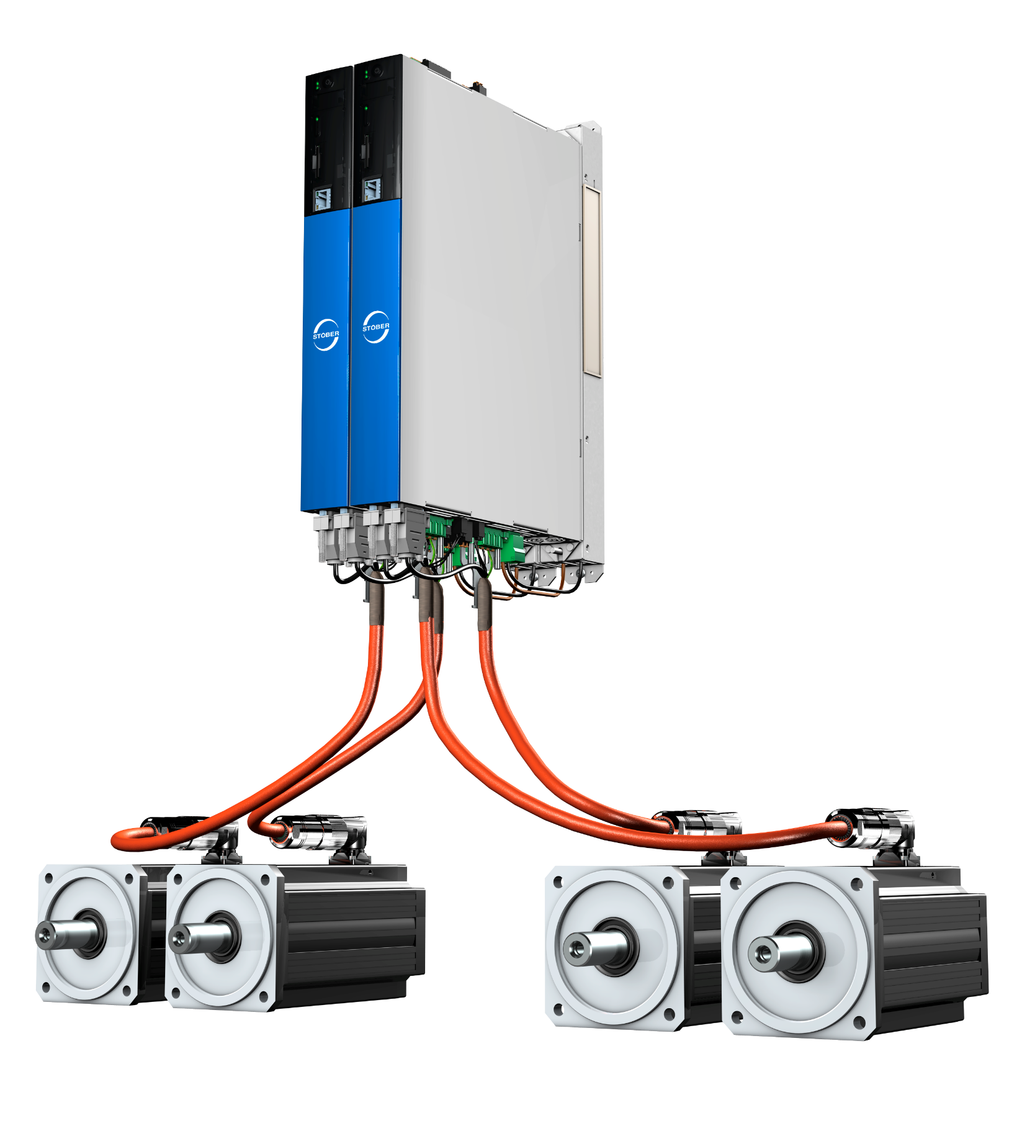
Connected at a distance.
One cable, up to 100 meters.
The new STOBER hybrid cable connects motors and drive controllers reliably up to 100 meters. With future-proof HEIDENHAIN EnDat® 3.
Elimination of expensive, bulky chokes.
Shortened installation times.
Fewer sources of error during installation.
Significantly reduced material and installation costs.
You save time, space and money.

Slide 10
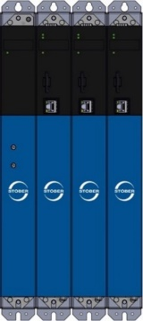
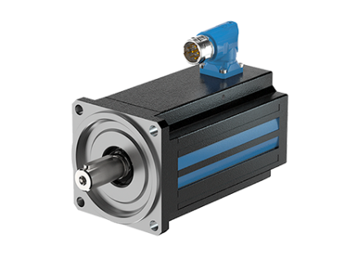
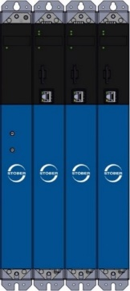
The Lean Approach!
SC6 SI6
SC6
SI6
with power supply and Quick DC-Link
LM STOBER Lean-Motor
2 - 4 axes
5 - 6 axes
6+ axes
Excellent price/performance ratio.
Nearly all movement tasks.
Saves space in the control cabinet and in the machine.

Slide 11
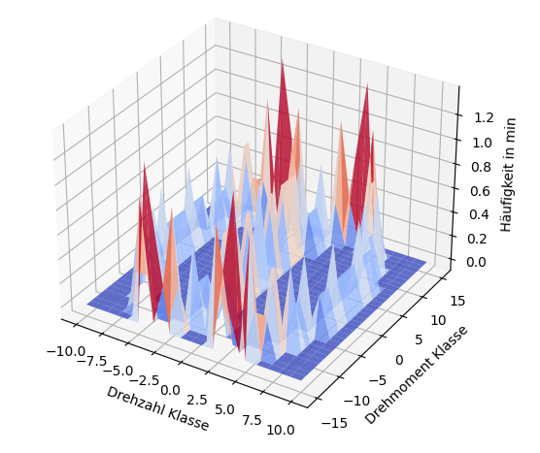
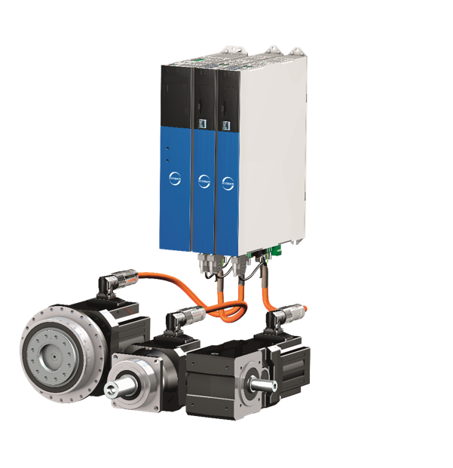
STOBER Virtual Lifetime.
Condition Monitoring. Predictive Maintenance. Drive Optimization.
Monitor the geared motors of the drive system.
Calculate the service life using a model-based analysis method.
Detect the actual load situation of the system.
Increase quality and profitability.
STOBER Virtual Lifetime – the feature for Predictive Maintenance of your geared motors.
For a long, efficient service life!

Slide 12
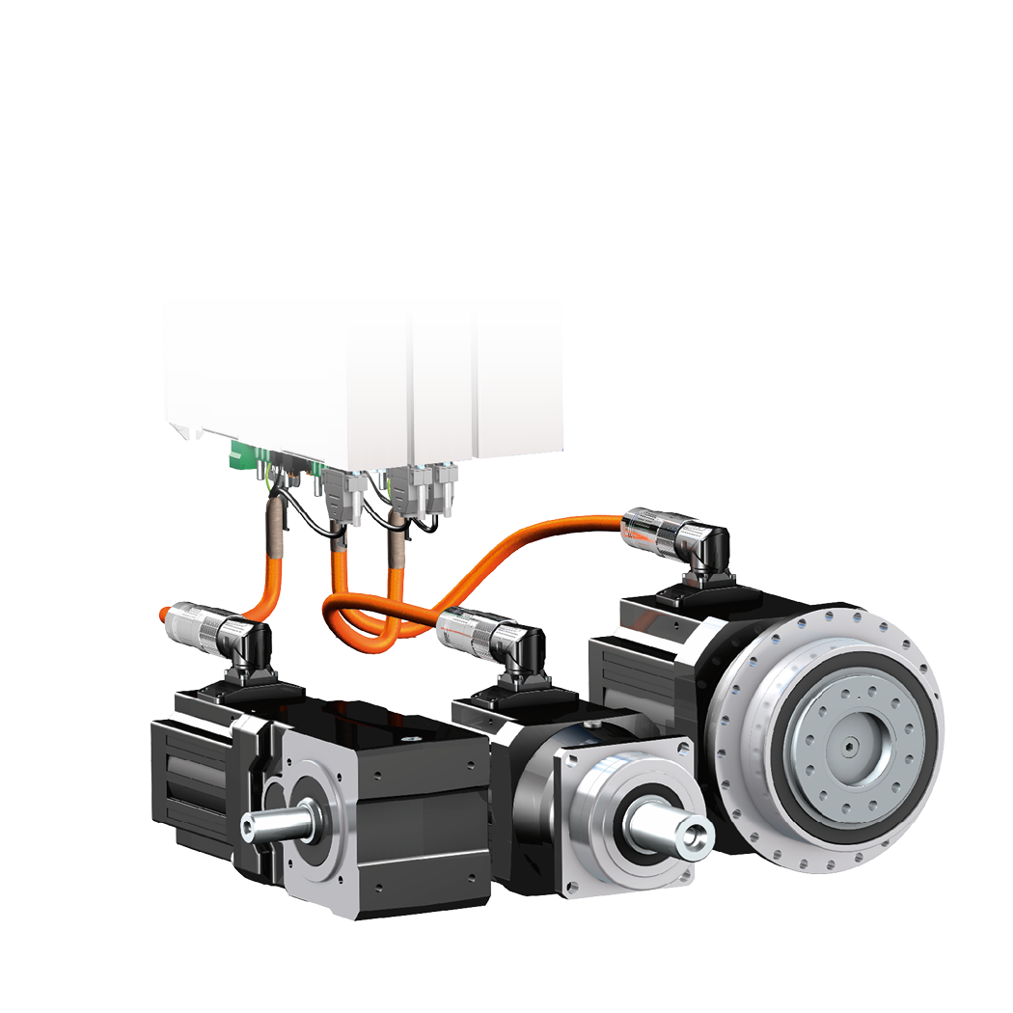
A perfect match!
Synchronous servo geared motors for your system.
Compact design thanks to direct attachment.
High torque. Lower mass inertia. Maximum drive dynamics.
Ready-to-install drive solution from a single source.
Exceptional variety of combinations and options!
Simple plug and play, pin-compatible.
Fast, straightforward commissioning.
Be it B&R, Siemens, Beckhoff, Bosch Rexroth, Kollmorgen or Rockwell/Allen-Bradley – we have the perfect match for any controller!

Slide 13
At home in the world of demanding motion.

