Slide 1
Planetary Gear Units Generation 3
What are the differences to Generation 2?
Notes:
These slides give you tips, background and additional information on P G3

Slide 2
Planetary Gear Units Generation 3
Stronger
Faster
More compact
Notes:
These slides give you tips, background and additional information on P G3

Slide 3
New Design
G2
G3
Notes:
These slides give you tips, background and additional information on P G3
Design optimization / standardization
Same input-side interface for P and PH
→ Use of same motor adapters
→ Use of same motor flanges for direct mounting

Slide 4
Improvement according to state-of-the-art technology
Planetary gear units which are improved:
P3 to P9
PA3 to PA8
not a seperate series anymore. Only as an option with “reduced backlash“ (valid for all A-series)
PH(A)3 to PH(A)8
PHQ(A)4 to PHQ(A)8
Notes:
These slides give you tips, background and additional information on P G3
P2 remains unchanged, but is also gets the generation number 3.
This means an approx. 15% increase of acceleration torque for same drive selection (including shock factor) by a new derating of 15% at Zh>=1000 cycles/h.

Slide 5
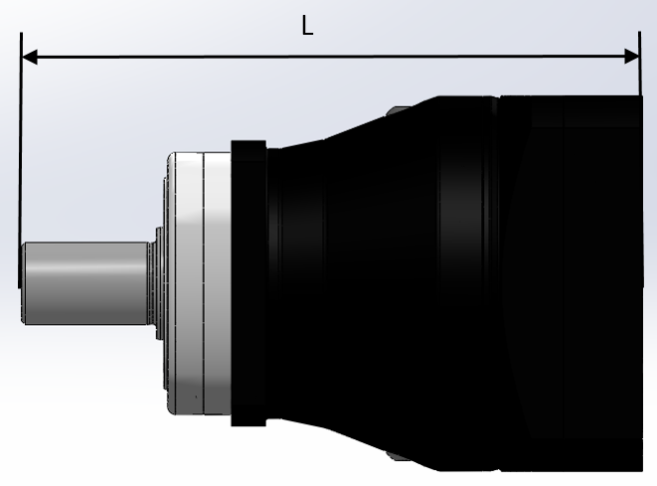
Reduced length (P)
 | G2 ME | G3 ME | Reduction | G2 MEL | G3 MEL | Reduction
 | L [mm] | L [mm] | [mm] | L [mm] | L [mm] | [mm]
P221 - P231 | 109,5 | 109,5 | 0,0 | 129,0 | 129,0 | 0,0
P222 - P232 | 141,5 | 141,5 | 0,0 | 161,0 | 161,0 | 0,0
P321 - P331 | 153,0 | 145,5 | 7,5 | 159,3 | 147,0 | 12,3
P322 - P332 | 173,5 | 163,0 | 10,5 | 193,0 | 182,5 | 10,5
P421 - P431 | 174,0 | 165,5 | 8,5 | 185,5 | 178,5 | 7,0
P422 - P432 | 218,5 | 202,5 | 16,0 | 224,8 | 204,0 | 20,8
P521 - P531 | 217,0 | 210,5 | 6,5 | 233,0 | 223,0 | 10,0
P522 - P532 | 263,5 | 239,5 | 24,0 | 275,0 | 252,5 | 22,5
P721 - P731 | 268,0 | 264,5 | 3,5 | 293,0 | 287,5 | 5,5
P722 - P732 | 318,0 | 302,5 | 15,5 | 334,0 | 315,0 | 19,0
P821 - P831 | 318,0 | 311,5 | 6,5 | 334,0 | 320,5 | 13,5
P822 - P832 | 376,5 | 356,5 | 20,0 | 401,5 | 379,5 | 22,0
P921 - P931 | 396,0 | 380,5 | 15,5 | - | - | -
P922 - P932 | 476,0 | 463,5 | 12,5 | 492,0 | 472,5 | 19,5
Overall length has been reduced
Notes:
These slides give you tips, background and additional information on P G3
No MEL adapter at P9

Slide 6
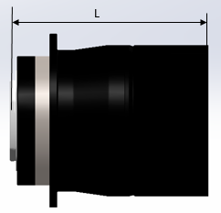
Reduced length (PH(Q))
Overall length has been reduced
 | G2 ME | G3 ME | Reduction | G2 MEL | G3 MEL | Reduction
 | L [mm] | L [mm] | [mm] | L [mm] | L [mm] | [mm]
PH321 - PH331 | 102,5 | 98,5 | 4,0 | 108,8 | 100,0 | 8,8
PH322 - PH332 | 119,0 | 116,0 | 3,0 | 138,5 | 135,5 | 3,0
PH(Q)421 – PH(Q)431 | 120,0 | 113,5 | 6,5 | 131,5 | 126,5 | 5,0
PH(Q)422 – PH(Q)432 | 164,5 | 150,5 | 14,0 | 170,8 | 152,0 | 18,8
PH(Q)521 – PH(Q)531 | 134,0 | 132,0 | 2,0 | 150,0 | 144,5 | 5,5
PH(Q)522 – PH(Q)532 | 180,5 | 161,0 | 19,5 | 192,0 | 174,0 | 18,0
PH(Q)721 – PH(Q)731 | 164,0 | 161,0 | 3,0 | 189,5 | 184,0 | 5,5
PH(Q)722 – PH(Q)732 | 214,0 | 199,0 | 15,0 | 230,0 | 211,5 | 18,5
PH(Q)821 – PH(Q)831 | 218,0 | 218,0 | 0,0 | 234,0 | 236,0 | -2,0
PH(Q)822 – PH(Q)832 | 277,0 | 263,0 | 14,0 | 303,0 | 286,0 | 17,0
Notes:
These slides give you tips, background and additional information on P G3
The length comparison to the geared motors of the G2 is in progress and will be published together with the
with the catalog „Synchron Servogetriebemotoren EZ“ zum 01.01.2020.

Slide 7
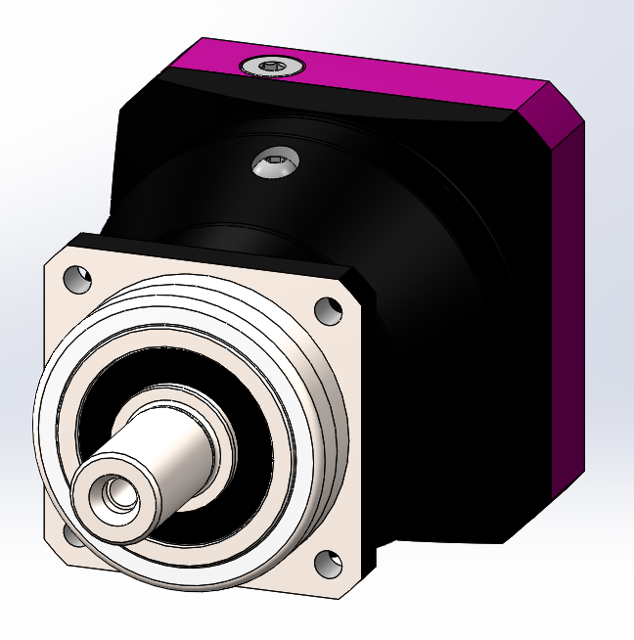
Comparison of square dimensions of motor adapter flanges
Partially changed square dimensions due to design changes and standardization
BG | Motor shaft d_{max} x l_{max} | Square dimension G2 | Square dimension G3
 | [mm] | [mm] | [mm]
P231/P232/P332 / PH332 | 14x30 | 55 | 55
P331/P432 / PH331/PH432 | 19x40 | 72/75 | 75
P431/P532 / PH431/PH532 | 24x42 | 98/100 | 100
P531/P732 / PH531/PH732 | 32x50 | 115 | 120
P731/P832 / PH731/PH832 | 38x61 | 144/145 | 150
P831/P932 / PH831/PH942/PH1042 | 48x80 | 190 | 204
P931 | 60x85 | 225 | 230
Notes:
These slides give you tips, background and additional information on P G3
This change has already been implemented in the last few months in Generation 2 gearboxes
with two-part adapter (gearbox cover + motor adapter flange),
so no more difficulties are expected.
With one-piece adapter this was not possible yet and therefore it must be checked on possible interference contour.
Information: During the changeover to the larger square dimensions of the G2,
interference contours with the machine design only occurred in very few cases.

Slide 8
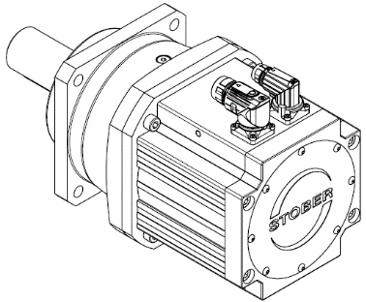
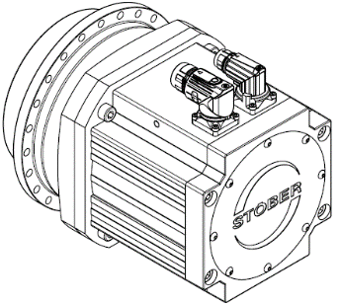
Comparison direct mounting – square dimensions
Gearbox size G2 /G3 | Square dimension Direct mounting- same motor size |  |  |  | Square dimension Direct mounting – next larger motor size
 | [mm] G2 | [mm] G3 | Δ | Motor | [mm] G2 | [mm] G3 | Motor
P322/P332 | 72 | 72 | 0 | EZ3
P321/P331 | 72 | 72 | 0 | EZ3 | 98 | 98 | EZ4
P422/P432 | 72 | 72 | 0 | EZ3 | 98 | 98 | EZ4
P421/P431 | 98 | 98 | 0 | EZ4 | 115 | 115 | EZ5
P522/P532 | 98 | 107 | 9 | EZ4 | 115 | 115 | EZ5
P521/P531 | 115 | 115 | 0 | EZ5 | 145 | 145 | EZ7
P722/P732 | 115 | 126 | 11 | EZ5 | 145 | 145 | EZ7
P721/P731 | 145 | 158 | 13 | EZ7 | 190 | 190 | EZ8
P822/P832 | 145 | 158 | 13 | EZ7 | 190 | 190 | EZ8
P821/P831 | 190 | 214 | 24 | EZ8
P922/P932 | 190 | 214 | 24 | EZ8
PH321/PH331 | 72 | 72 | 0 | EZ3 | 98 | 98 | EZ4
PH421/PH431 | 98 | 107 | 9 | EZ4
PH521/PH531 | 115 | 126 | 11 | EZ5
PH721/PH731 | 145 | 158 | 13 | EZ7
PH821/PH831 | 190 | 214 | 24 | EZ8

Slide 9
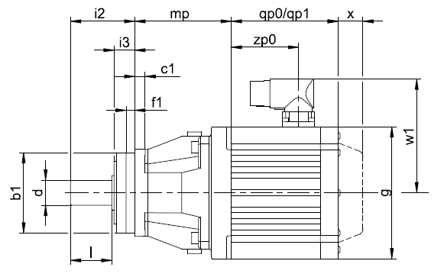
Comparison of direct mounting overall length
 | i2+mp |  | Reduction
 | G2 | G3 | [mm]
P221 - P231 EZ3 | 97,5 | 97,5 | 0,0
P222 - P232 EZ3 | 129,5 | 129,5 | 0,0
P321 - P331 EZ3 | 121,5 | 116,5 | -5,0
P321 - P331 EZ4 | 118,0 | 113,0 | -5,0
P322 - P332 EZ3 | 161,5 | 151,0 | -10,5
P421 - P431 EZ4 | 135,0 | 136,5 | 1,5
P421 - P431 EZ5 | 137,5 | 136,0 | -1,5
P422 - P432 EZ3 | 187,0 | 173,5 | -13,5
P422 - P432 EZ4 | 183,5 | 170,0 | -13,5
P521 - P531 EZ5 | 169,0 | 168,5 | -0,5
P521 - P531 EZ7 | 175,0 | 171,5 | -3,5
P522 - P532 EZ4 | 224,5 | 210,5 | -14,0
P522 - P532 EZ5 | 227,0 | 210,0 | -17,0
P721 - P731 EZ7 | 210,0 | 212,5 | 2,5
P721 - P731 EZ8 | 225,0 | 222,5 | -2,5
P722 - P732 EZ5 | 270,0 | 260,5 | -9,5
P722 - P732 EZ7 | 276,0 | 263,5 | -12,5
P821 - P831 EZ8 | 249,0 | 253,5 | 4,5
P822 - P832 EZ7 | 318,5 | 304,5 | -14,0
P822 - P832 EZ8 | 333,5 | 314,5 | -19,0
P922 - P932 EZ8 | 407,0 | 405,5 | -1,5

Slide 10
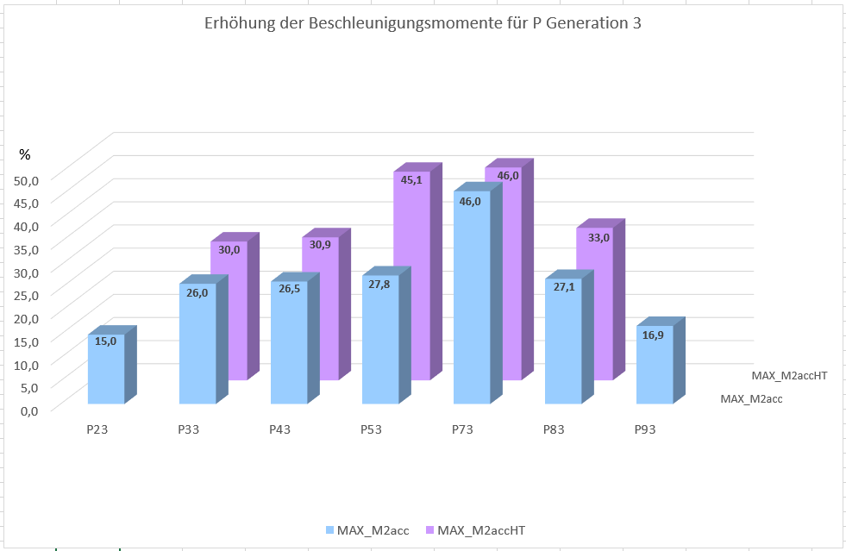
Increase in acceleration torque P Gear Units
Increase in acceleration torque by up to 46 % with standard backlash and reduced backlash
Notes:
These slides give you tips, background and additional information on P G3
Increase in acceleration torques due to
Improved gearing quality
State-of-the-art materials, hardening processes
State-of-the-art precision machines
New innovative manufacturing process for hollow gear toothing (power skiving) in one machine clamping - no reclamping errors
Optimized gear widths
Reduced backlash even higher gear quality →even higher acceleration torques
M2acc is the value for the standard backlash
M2accHT is the value for the reduced backlash

Slide 11
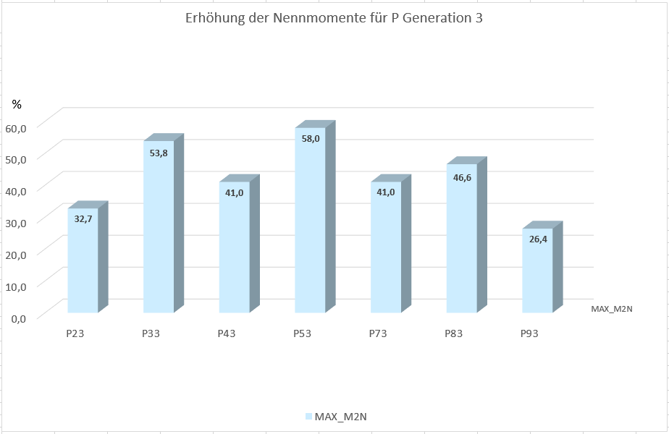
Increase in nominal torque P Gear Units
Increase in nominal torque by up to 58 %, mainly with 2-stage Gear Units
Notes:
These slides give you tips, background and additional information on P G3
Increase of nominal torques due to
changed calculation base according to the latest knowledge and current state of the art.

Slide 12
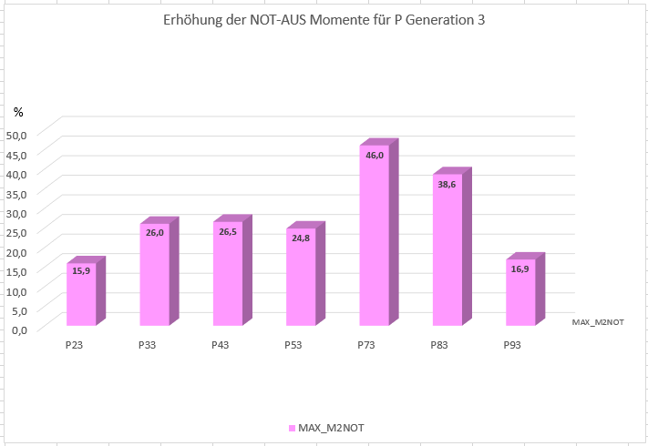
Increase in emergency-off torque P Gear Units
Increase in emergency-off torque by up to 46 %
Notes:
These slides give you tips, background and additional information on P G3
Increase in emergency-off torques due to
Improved gearing quality
State-of-the-art materials, hardening processes, nitrided housing at reduced backlash
State-of-the-art precision machines
New innovative manufacturing process for hollow gear toothing (power skiving) in one machine clamping - no reclamping errors
Optimized gear widths

Slide 13
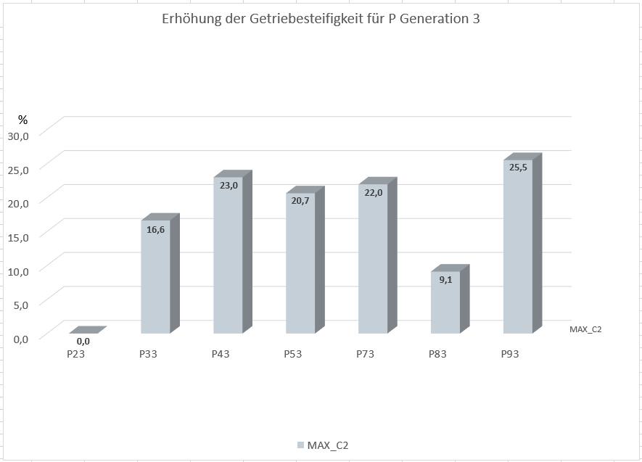
Increase in torsional stiffness P Gear Units
Increase in torsional stiffness by up to 25.5 %
Notes:
These slides give you tips, background and additional information on P G3
Increase in torsional stiffness through
Shortened overall length
Increased toothing widths at the output stage

Slide 14
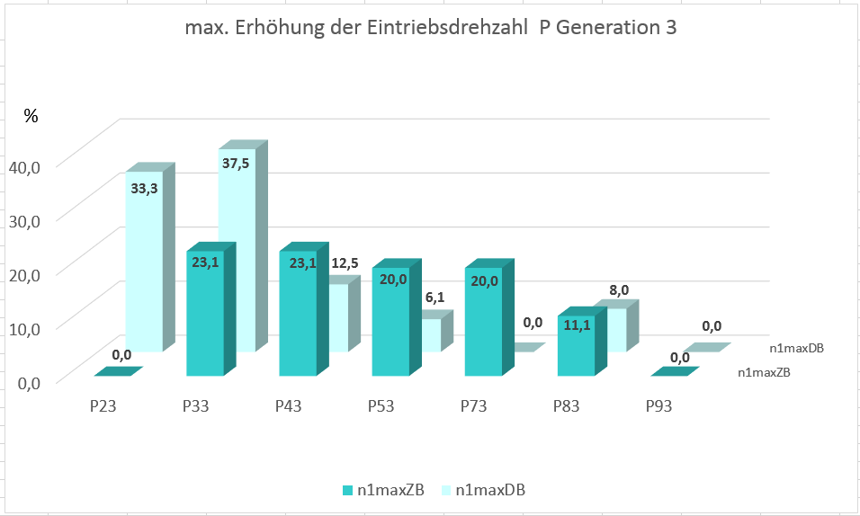
Increase in input speed P Gear Unit
Increase in input speed
n_{1maxZB} by up to 23.1 %
n_{1maxDB} by up to 37.5 %
Notes:
These slides give you tips, background and additional information on P G3
Increase of the input speeds through
Changed bearing arrangement for 2-stage backlash reduced gearboxes
Narrower teeth at the input stage of 2 stage gearboxes
Extensive test field trials

Slide 15
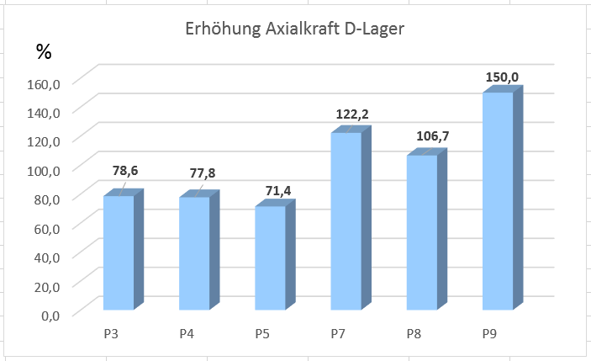
Increase in axial force for option D reinforced bearings
For only axial loads, the values could be increased by up to 150%
Notes:
These slides give you tips, background and additional information on P G3
With the option "D" (double angular contact bearing), we have a
backlash-free bearing for high radial and axial load.
This bearing arrangement is suitable especially when high loads are simultaneously applied in radial and axial direction,
e.g. rack and pinion drives.
The calculation of only axial loads, like our competitors do in their catalogs shows up to 150% higher values.

Slide 16
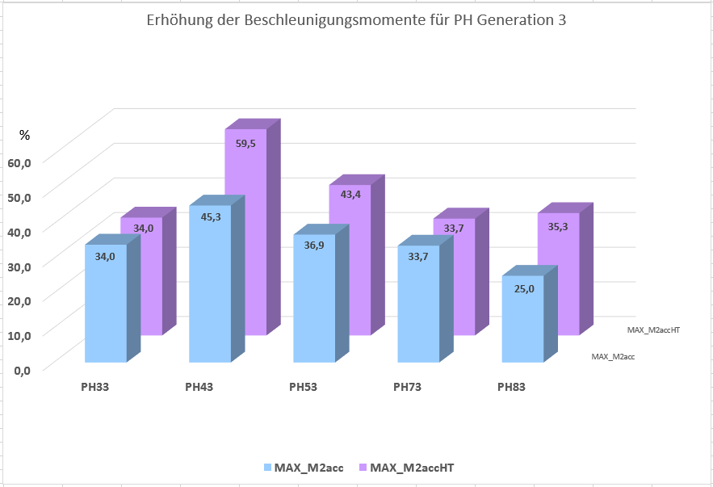
Increase in acceleration torque PH Gear Units
Increase in acceleration torques by up to 45,3 % with standard backlash and up to 59,5 % with reduced backlash
Notes:
These slides give you tips, background and additional information on P G3
Increase in acceleration torques due to
Improved gearing quality
State-of-the-art materials, hardening processes, nitrided housing at reduced backlash
State-of-the-art precision machines
New innovative manufacturing process for hollow gear toothing (power skiving) in one machine clamping - no reclamping errors
Optimized gear widths
Reduced backlash even higher gear quality →even higher acceleration torques
M2acc is the value for the standard backlash
M2accHT is the value for the reduced backlash

Slide 17
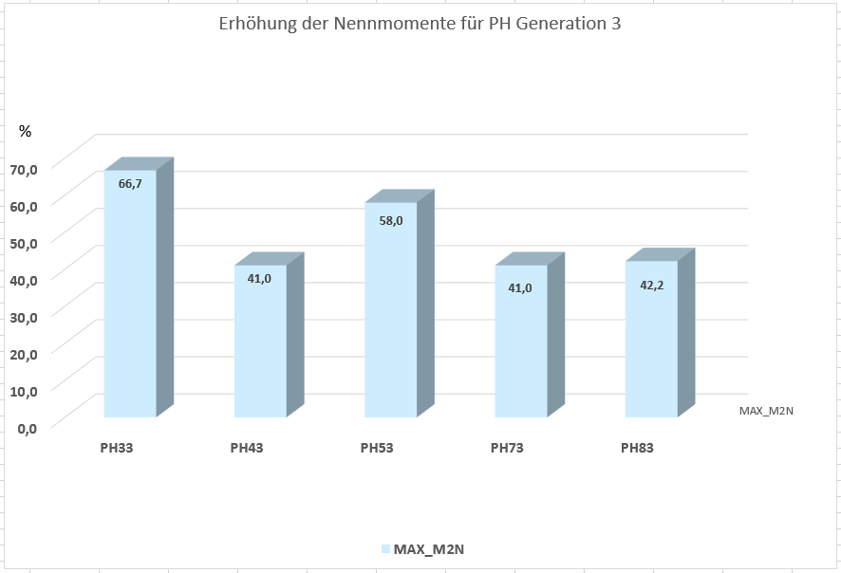
Increase in nominal torque PH Gear Units
Increase in nominal torques by up to 66,7 %
mainly for 2-stage Gear Units
Notes:
These slides give you tips, background and additional information on P G3
Increase in nominal torques due to
changed calculation bases according to the latest knowledge and current state of the art.

Slide 18
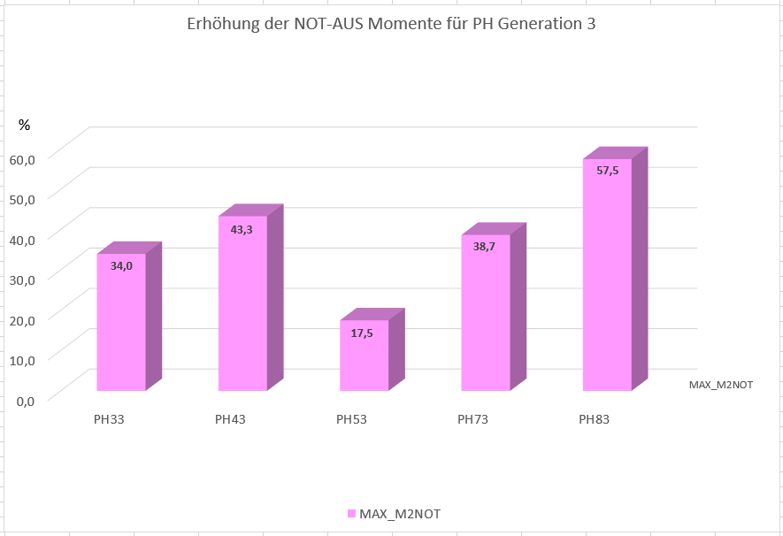
Increase in emergency-off torque PH Gear Units
Increase in emergency-off torques by up to 57,5 %
Notes:
These slides give you tips, background and additional information on P G3
Increase of the emergency-off torques due to
Improved gearing quality
State-of-the-art materials, hardening processes, nitrided housing at reduced backlash
State-of-the-art precision machines
New innovative manufacturing process for hollow gear toothing (power skiving) in one machine clamping - no reclamping errors
Optimized gear widths

Slide 19
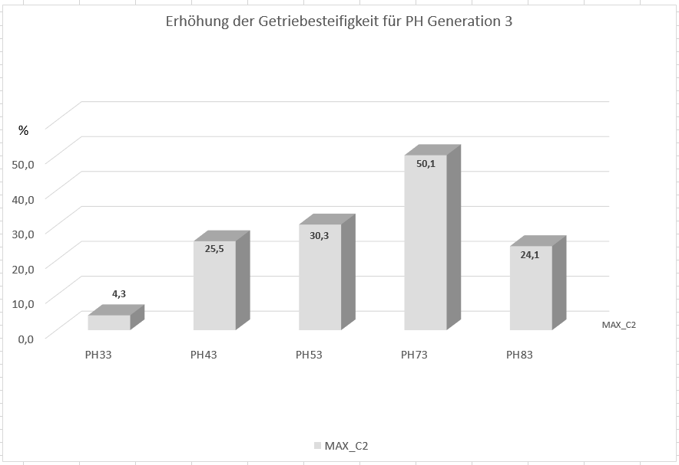
Increase in torsional stiffness PH Gear Units
Increase in torsional stiffness by up to 50,1 %
Notes:
These slides give you tips, background and additional information on P G3
Increase in torsional stiffness due to
Shortened overall length
Increased toothing widths at the output stage

Slide 20
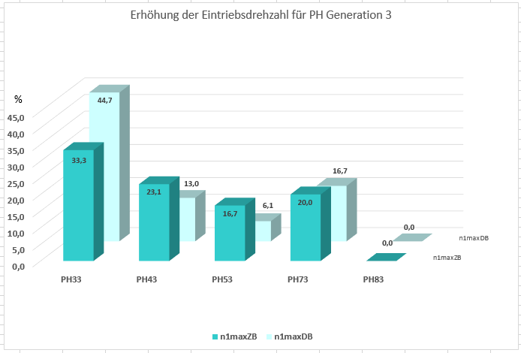
Increase in input speed PH Gear Unit
Increase in input speed
n_{1maxZB} by up to 33,3 %
n_{1maxDB} by up to 44,7 %
Notes:
These slides give you tips, background and additional information on P G3
Increase in input speeds due to
Changed bearing arrangement for 2-stage backlash reduced gearboxes
Narrower teeth at the input stage of 2 stage gearboxes
Extensive test field trials

Slide 21
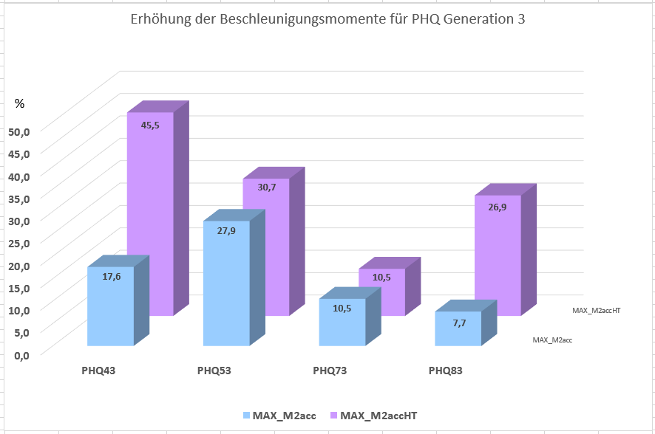
Increase in acceleration torque PHQ Gear Units
Increase in acceleration torques by up to 27,9 % with standard backlash and up to 45,5 % with reduced backlash
Notes:
These slides give you tips, background and additional information on P G3
Increase in acceleration torques due to
Improved gearing quality
State-of-the-art materials, hardening processes, nitrided housing at reduced backlash
State-of-the-art precision machines
New innovative manufacturing process for hollow gear toothing (power skiving) in one machine clamping - no reclamping errors
Optimized gear widths
Reduced backlash even higher gear quality →even higher acceleration torques
M2acc is the value for the standard backlash
M2accHT is the value for the reduced backlash

Slide 22
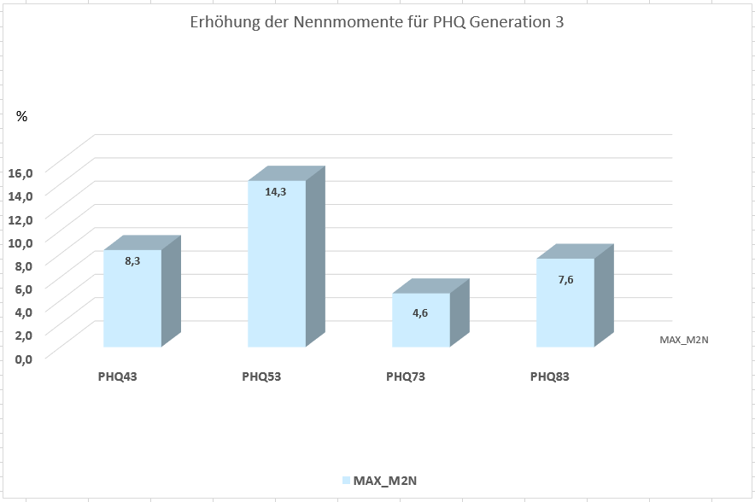
Increase in nominal torque PHQ Gear Units
Increase in nominal torques by up to 14,3 %
mainly at 2-stage Gear Units
Notes:
These slides give you tips, background and additional information on P G3
Increase in nominal torques due to
changed calculation bases according to the latest knowledge and current state of the art.

Slide 23
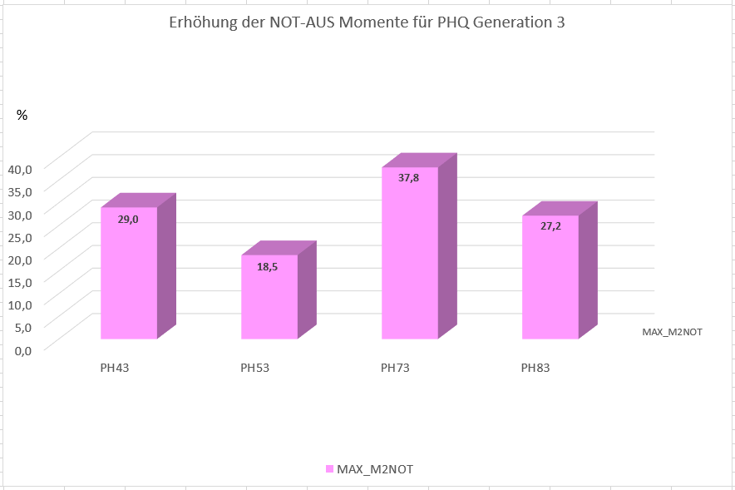
Increase in emergency-off torque PHQ Gear Units
Increase in emergency-off torques by up to 37,8 %
Notes:
These slides give you tips, background and additional information on P G3
Increase in emergency-off torques due to
Improved gearing quality
State-of-the-art materials, hardening processes, nitrided housing at reduced backlash
State-of-the-art precision machines
New innovative manufacturing process for hollow gear toothing (power skiving) in one machine clamping - no reclamping errors
Optimized gear widths

Slide 24
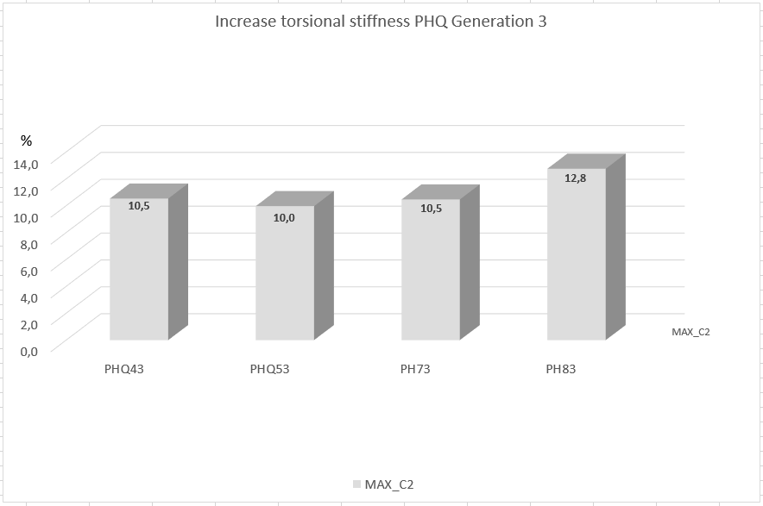
Increase in torsional stiffness PHQ Gear Units
Increase in torsional stiffness by up to 12,8 %
Notes:
These slides give you tips, background and additional information on P G3
Increase of torsional stiffness due to
Shortened overall length
Increased toothing widths

Slide 25
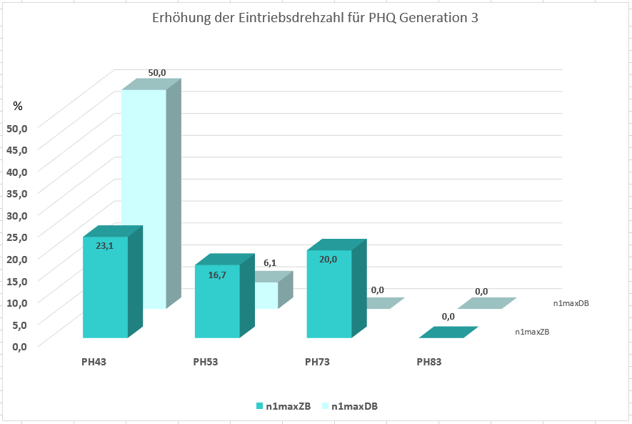
Increase in input speed PHQ Gear Unit
Increase in input speed
n_{1maxZB} by up to 23,1 %
n_{1maxDB} by up to 50 %
Notes:
These slides give you tips, background and additional information on P G3
Increase in input speeds due to
Changed bearing arrangement for 2-stage gearboxes
Latest technical calculations
Changing the calculation of the drive selection to standard applications by introducing an operating factor for increased cycle operation.

Slide 26
Reinforced bearings otion „V“ for PH3 – PH5
Increase in axial shaft load up to 34.9% and radial up to 39.5%
Notes:
These slides give you tips, background and additional information on P G3
The reinforced bearing option for PH3 to PH5 gearboxes results in increased values of almost 40%.

Slide 27
Geometric data
The mechanical interfaces at the output are nearly 100% compatible to the G2.
With the exception of the P2, all G3 gearboxes have become significantly shorter. For size P2, it was not possible to reduce the overall length. Therefore we don’t expect collisions with the machine contour.
However, in general we recommend an interference contour check based on the new 3D volume models.
You will get this
together with the offer from our order department
if you configure the product with our STÖBER Configurator https://configurator.stoeber.de/de-DE/?shop=SAT
Notes:
These slides give you tips, background and additional information on P G3
Small modifications at PH(Q), see next 2 slides

Slide 28
Small modifications at the PH(Q) – dimension b2 is canceled
Due to design changes and standardization
Notes:
These slides give you tips, background and additional information on P G3

Slide 29
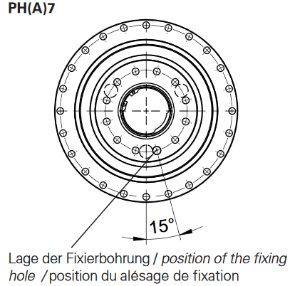
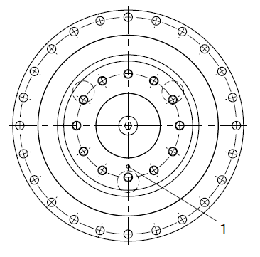
Small modifications at the PH(Q) – fixing hole is canceled
G3 no longer has a fixing hole, it is replaced by an additional threaded hole.
G2
G3
To define the position of the planet gears in future all planet carriers are getting a mark (boring)
Notes:
These slides give you tips, background and additional information on P G3
At PH(Q) gearboxes, the fixing bore s2 in the flanged shaft (planet carrier) is replaced by a thread. The additional thread increases the transmittable torque of the screw connection. Because the fixing hole for reversing operation was the position orientation for the planets in the gearbox, all PH(Q) gearboxes of the G3 now are having a marking in the form of a small bore.
If you need the fixing hole you can simply drill one of the threads to the dimensioned thread depth.

Slide 30
Type Code
Gear Unit Type | Size | Generation | Number of Stages | Housing Design | Shaft Design | Bearing Design | Backlash | Ratio Code | Input Option
P | 4 | 3 | 1 | S | G | S | S | 0050 | ME
PH | 4 | 3 | 1 | S | F | S | S | 0050 | ME
Varianten:
P |  |  |  | S | G | S | S |  | ME(L)
 |  |  |  | X | P | D | R |  | MF(L)
 |  |  |  |  |  | Z |  |  | MB
PH |  |  |  | S | F | S | S |  | ME(L)
 |  |  |  | X |  | V | R |  | MF(L)
 |  |  |  |  |  |  |  |  | MB
Option
Changed Type Code
Special
Higher generation number
Optionally reduced backlash
The “A“ for reduced backlash was eliminated
The bearing option “R“ for P Gear Units became changed to “S“.
New bearing option reinforced bearings “V“ for PH3/4/5
Exception:
PH9 & PH10 and PHQ9-PHQ12 retain their old type code. They will get the new generation number and type code after revision
Notes:
These slides give you tips, background and additional information on P G3

Slide 31
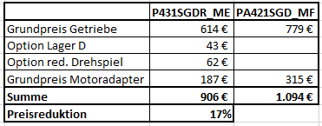
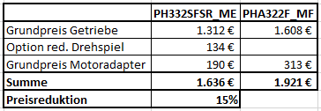
Cost reduction with low-backlash gearboxes
Significant cost reduction by standardization of components and the additional possibility to use the ME adapter for backlash-reduced gears.
Example:
P by up to 17%, PH by up to 15%.
Notes:
These slides give you tips, background and additional information on P G3
Base price gearbox remains the same Option reduced backlash + 10% base price gearbox

