Slide 1
PROFIdrive + PROFIsafe
Technical Meeting 2021 Part 2
7th december
For internal use only!
No release for public presentation.

Slide 2
Agenda
PROFIdrive
Requirements
Adjustment and Usage
Commissioning / Live Demo
Questions / discussion
Before we start, please give me a feedback with the hand symbol if you have experience with PROFIdrive or you have tried to use the examples from last meeting 16.11.

Slide 3
Questions about Part 1 on 16th november ?

Slide 4
Perhaps missing functions/features at the moment ?
PROFIdrive has just begun in 2021 so perhaps there are missing features:
Missing telegramms like 102 or 105 for torque limiting.
Missing support of digital inputs for measureing the axisposition (Posi Latch functionality)
Missing support of outputs for position-dependent control of processes (e.g. CAM Switch)
High accuracy position control inside drive, named DSC (Dynamic Servo Control) at Siemens.
Please give us feedback if feature is needed for your customers application.
Tell us the buying power of the customer for the needed feature.
We will collect this information.

Slide 5
PROFIDrive – Requirements
1. Drive Controller SI6 or SC6 (SD6 does not support PROFIdrive nor PROFIsafe)
2. At least Firmware V6.5-D (July 2021)
3. TIA Portal 15 or newer
(no additional Siemens software with costs necessary)
Controlled via open source Siemens blocks from Drive_Lib_S7 or
via PLCopen conform programming with technology objects possible.
4. No special Siemens PLC necessary to start with technology objects.

Slide 6
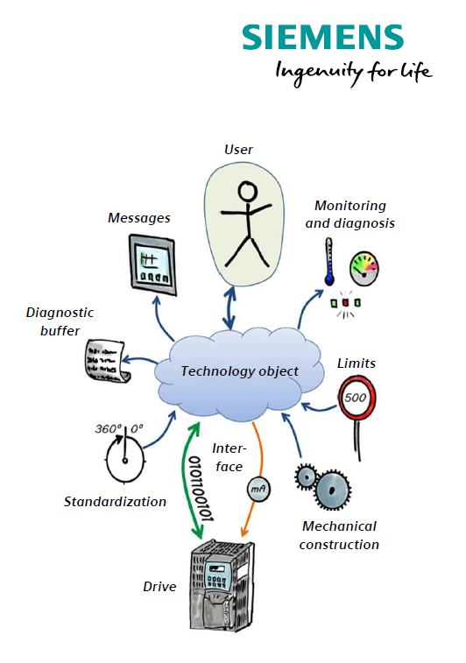
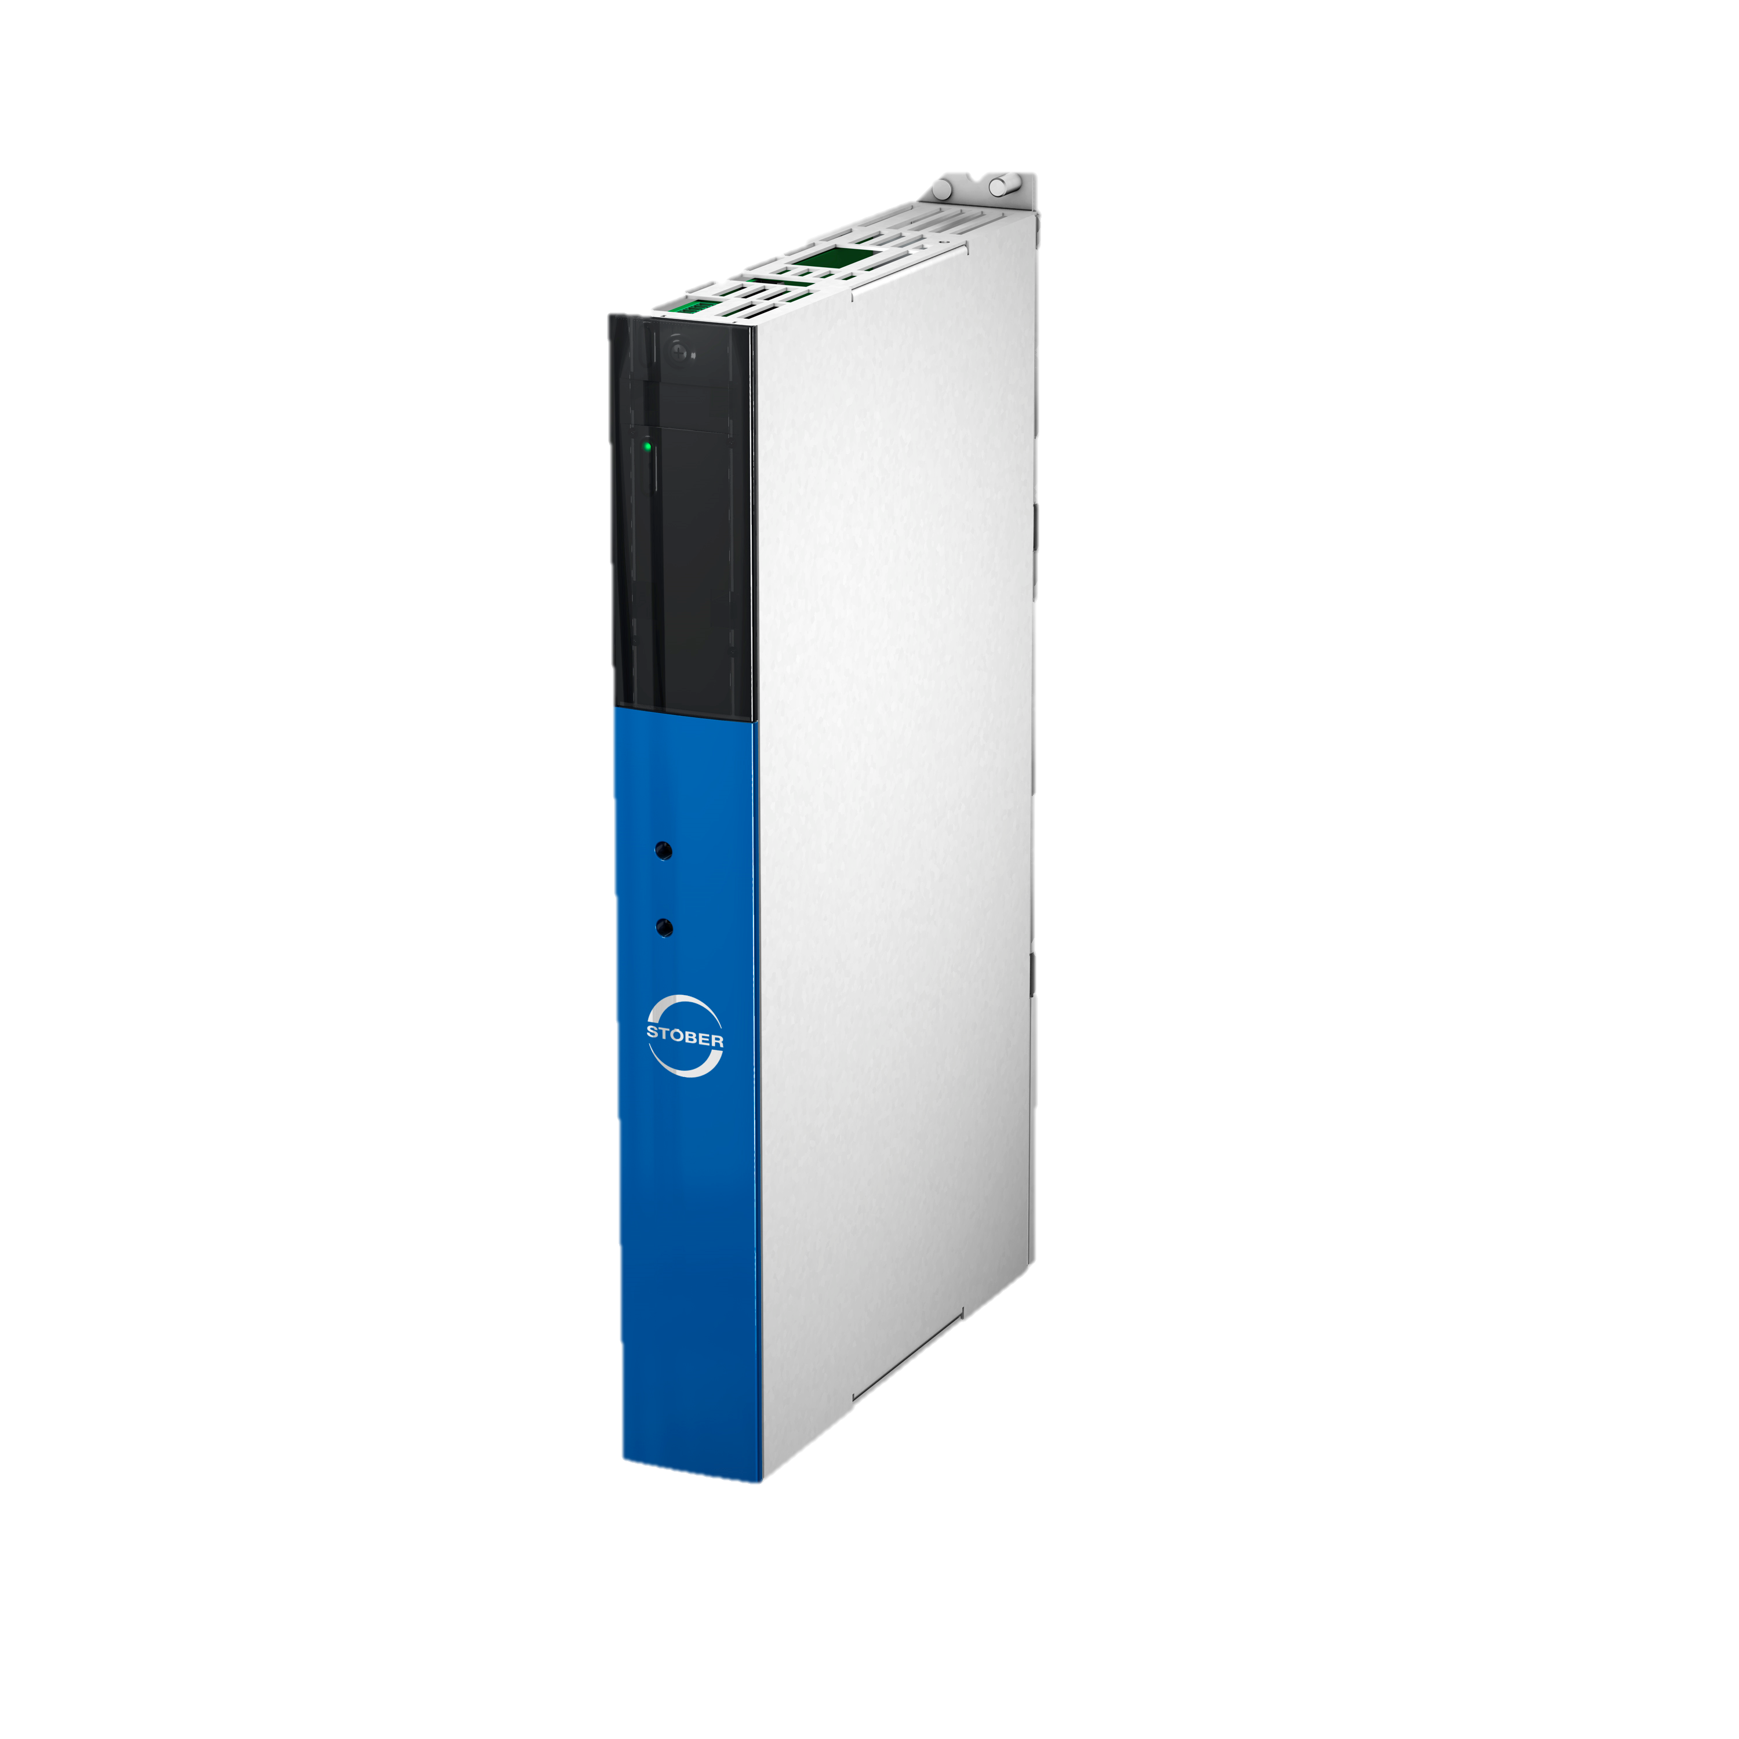
Decide between DriveLib and Technology Object
1
2
DriveLib
Technology Objects
+ both ways are described in PROFIdrive manual and both are included in our TIA examples
+ With Drive Lib only drive based solutions possible
+ With Technlogy Objects drive based and controller based solutions possible

Slide 7
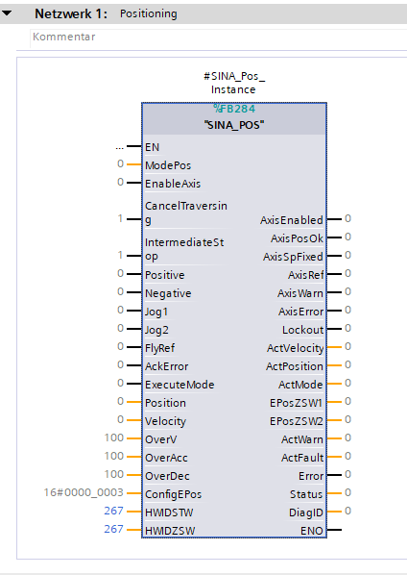
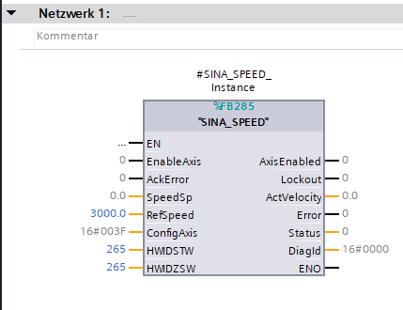
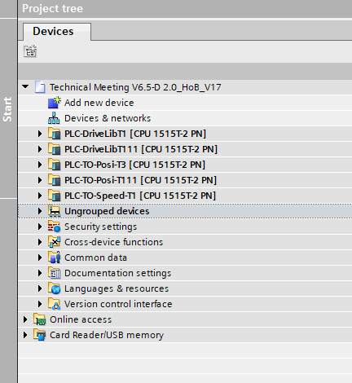
PROFIdrive – DriveLib
TIA Portal Examples
PLC-DriveLibT1
PLC-DriveLibT111
SINA_SPEED (only Telegram 1)
SINA_POS (only Telegram 111)
Proven technology( >10 years available)
Historically conditioned
Opensource module from Siemens
Drivebased Solution
low-cost PLC is sufficient
Best control accuracy
Not suitable for transformations or controller based solution

Slide 8
PROFIdrive – DriveLib
Speed control with speed reference AC1 / SINA_SPEED
SINA_SPEED (only telegram 1)
Proven technology( >10 years available)
Historically conditioned
Opensource module from Siemens
V6.5-D available as of July 2021
For all applications without positioning.
Pumps, fans, agitator, conveyor belt....
SINA_SPEED

Slide 9
PROFIdrive – DriveLib
Drive based position control AC3 / SINA_POS
SINA_POS (only telegram 111)
Proven technology( >10 years available)
Historically conditioned
Opensource module from Siemens
V6.5-D available as of July 2021
Position control in drive controller, very good quality even with low cost PLC.

Slide 10
PROFIdrive – DriveLib
Live Demo
TIA Portal Examples
PLC-DriveLibT1
PLC-DriveLibT111
What do you need ?
1. TIA Projectarchive from Technical Meeting 2021
2. TIA Portal Example PLC-DriveLibT1 or PLC-DriveLibT111
3. PDF Documentation DriveLib
4. DS6 Application PROFIdrive with Firmware V6.5-D (or newer)
(or the example of Technical Meeting 2021)

Slide 11
Questions about DriveLib ?

Slide 12
Decide between DriveLib and Technology Object
1
2
DriveLib
Technology Objects
+ both ways are described in PROFIdrive manual and both are included in our TIA examples
+ With Drive Lib only drive based solutions possible
+ With Technlogy Objects drive based and controller based solutions possible

Slide 13
Quantity structure with TO
Number of axes and performance
Motion Control with SIMATIC S7-1500 /S7-1500 T-CPU
Identical standard motion control functionality in each CPU
Scalability in quantity structure and performance

Slide 14
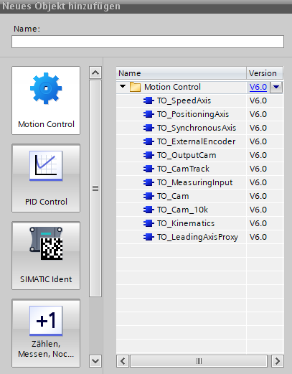
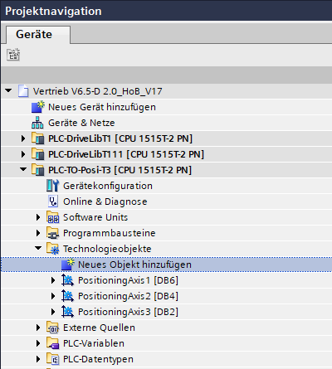
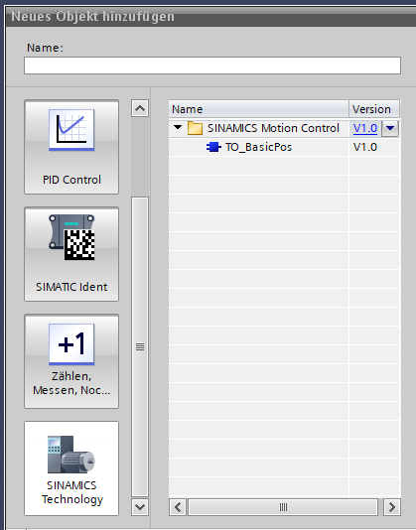
Where can you find the TO‘s?
TIA Portal Example
PLC-TO-Speed-T1
PLC-TO-Posi-T3
PLC-TO-Posi-T111

Slide 15
PROFIdrive – Technology Objects
TIA Portal Example
PLC-TO-Speed-T1
PLC-TO-Posi-T3
PLC-TO-Posi-T111
Controllerbased solution
suitable for all applications
Newest technology from siemens
Drivebased solution
TO_BasicPos (only Telegram 111)
Proven technology( >10 years available)
Historically conditioned
Opensource module from Siemens

Slide 16
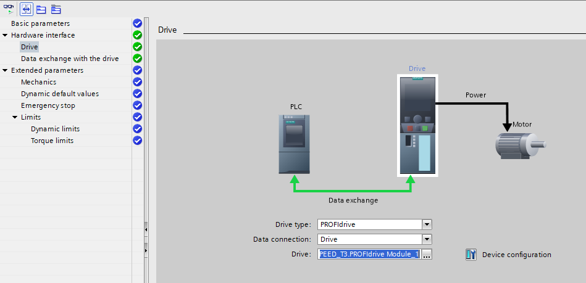
PROFIdrive – Possible usecases
Speed control with speed reference AC1
Technology Object „SpeedAxis“
(telegram 1, 2 or 3)
V6.5-D available as of July 2021
For all applications without positioning.
Pumps, fans, agitator, conveyor belt....
Technology Object „SpeedAxis“

Slide 17
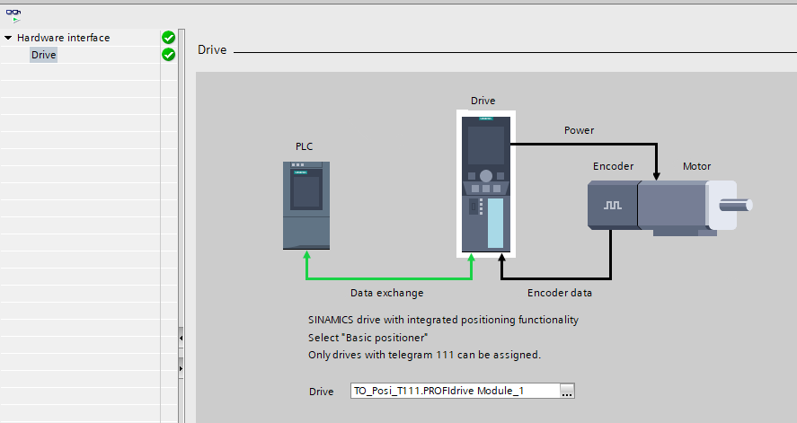
PROFIdrive – Possible usecases
Live Demo
Drive based Position control AC3
Technology Object „BasicPos“
(only telegram 111)
V6.5-D available as of July 2021
Position control in drive controller,
good position loop quality even with cheaper PLC.
Technology Object „BasicPos“

Slide 18
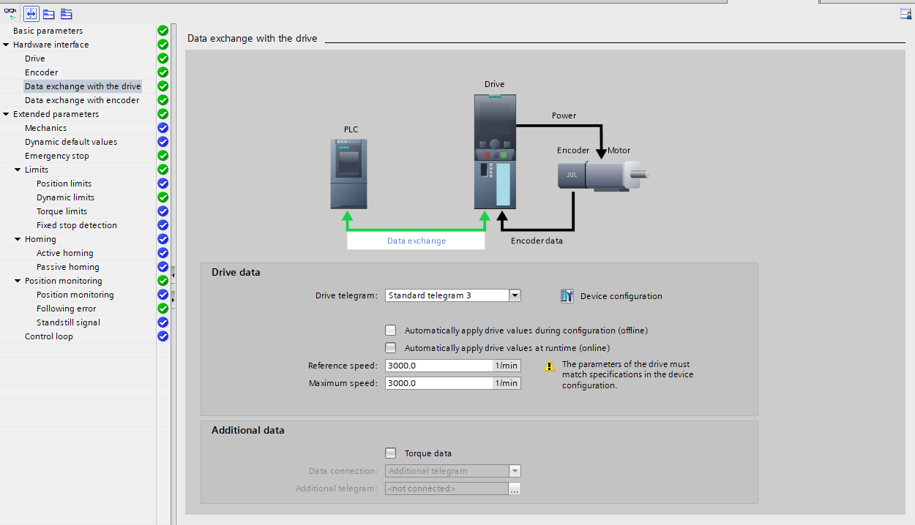
PROFIdrive – Possible usecases
Position control with speed reference AC4 without IRT (controller based)
Technology Object „PositioningAxis“
Technology Object „SynchronousAxis“
(telegram 3)
(also selectable without IRT)
V6.5-D available as of July 2021
For simple positioning.
Speed synchronous operation also possible.
Technologyobject PositioningAxis

Slide 19
PROFIdrive – Possible usecases
position synchronous mode
Position control with speed reference AC4 IRT
Technology object „PositioningAxis“
Technologieobjekt „SynchronousAxis“
Technology Object „Cam“
Technologieobject „Kinematics“
(telegram 3)
Best performance with IRT and T-CPU
Developmental version available as of July 2021
V6.5-F available as of March 2022
Position synchronization, cam plate,
interpolation, transformations.
Technologieobject PositioningAxis

Slide 20
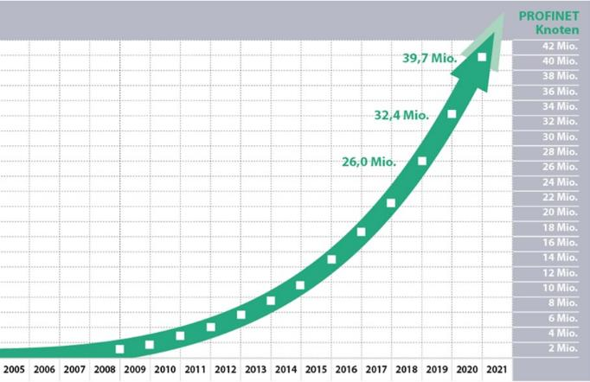
Market with potential
Siemens has opened up to 3.rd Party RT / IRT drive manufacturers.
This cooperation is wanted by Siemens and the market is growing strongly.

Slide 21
Thank you for your attention !

