Slide 1
PROFIdrive
Technical Meeting 2022
Spring Edition
For internal use only!
No release for public presentation.

Slide 2
Agenda
PROFIdrive
Entry and repetition topics from TM2021
Adjustment and Usage
AC4/Isochronous Real Time PROFINET - Live Demo
Questions / discussion
Before we start, please give me a feedback with the hand symbol if you have experience with PROFIdrive or you have tried to use the examples from last technical meeting in 2021

Slide 3
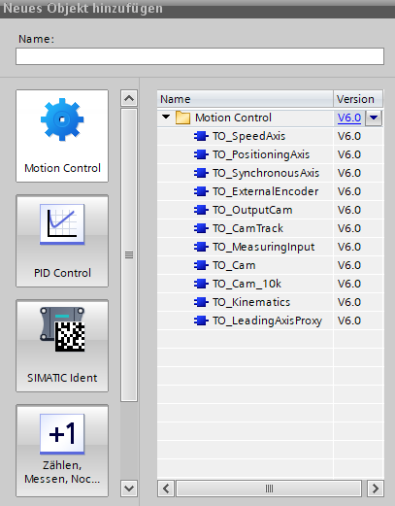
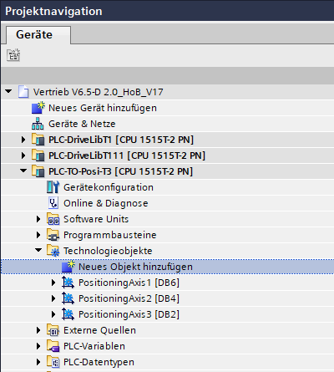
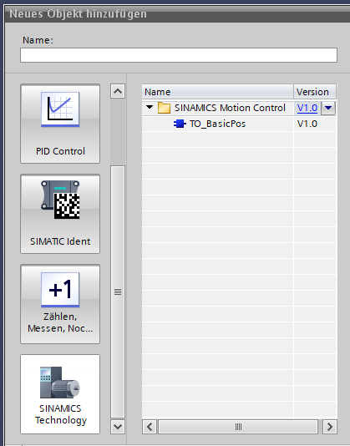
Where can you find the TO‘s?
Technical Meeting 2021
TIA Portal Example
PLC-TO-Speed-T1
PLC-TO-Posi-T3
PLC-TO-Posi-T111

Slide 4
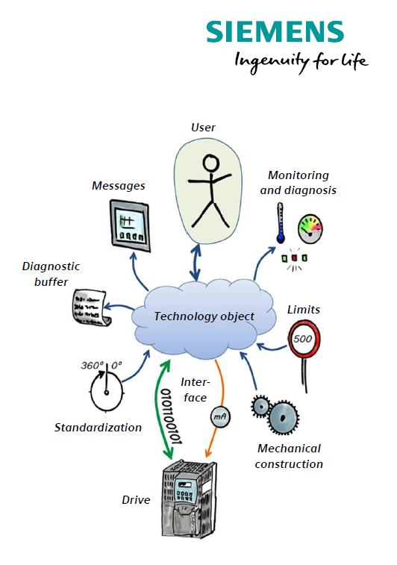
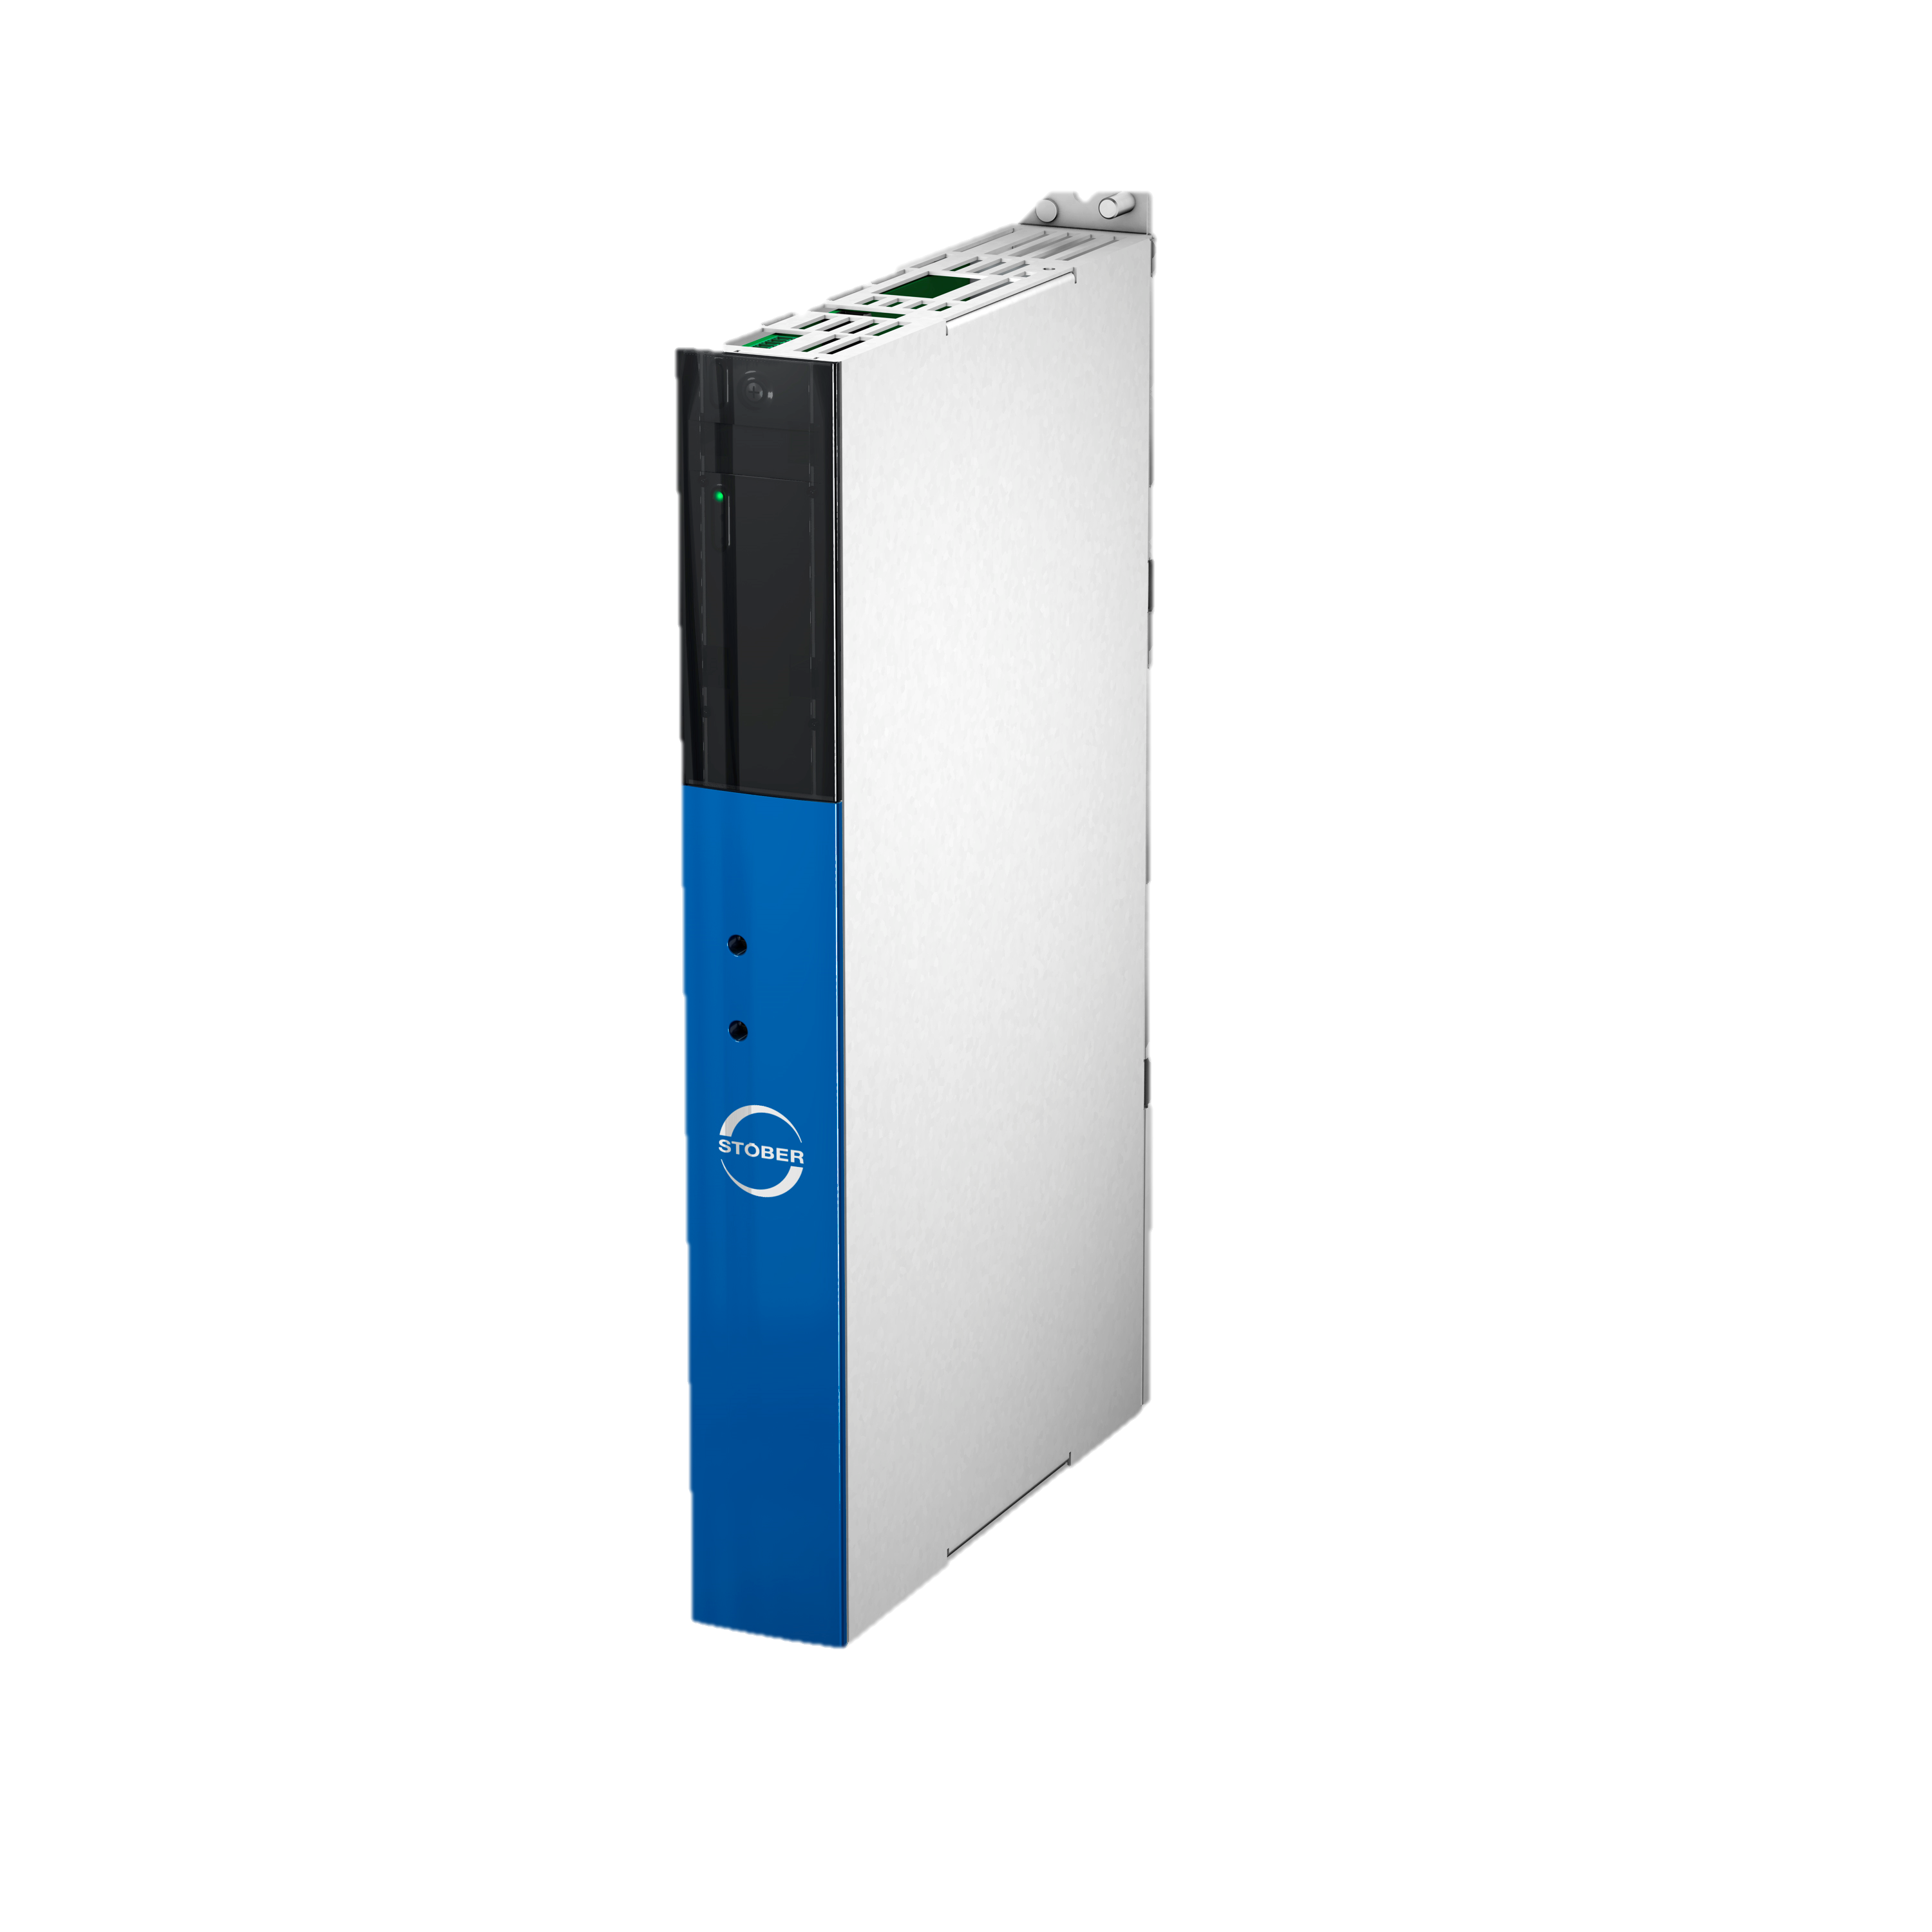
Decide between DriveLib and Technology Object
Technical Meeting 2021
1
2
DriveLib
Technology Objects
+ both ways are described in PROFIdrive manual and both are included in our TIA examples
+ With Drive Lib only drive based solutions possible
+ With Technlogy Objects drive based and controller based solutions possible

Slide 5
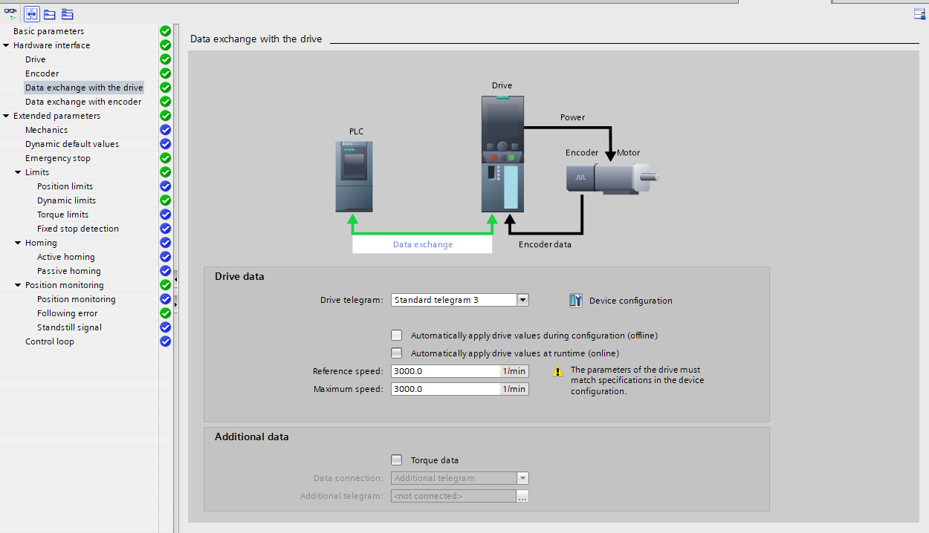
PROFIdrive – Possible usecases
Technical Meeting 2021
position synchronous mode
Position control with speed reference AC4 IRT
Technology object „PositioningAxis“
Technologieobjekt „SynchronousAxis“
Technology Object „Cam“
Technologieobject „Kinematics“
(telegram 3)
Best performance with IRT and T-CPU
Developmental version available as of July 2021
V6.5-F available as of March 2022
Position synchronization, cam plate,
interpolation, transformations.
Technologieobject PositioningAxis

Slide 6
Overview possibilities
Technical Meeting 2021
AC1 Speed control with speed reference
Technical Meeting 2021
AC3 Drive based Position control
Technical Meeting 2022
AC4 Position control with speed reference and IRT
Future…
AC4 Position control with speed reference, DSC and IRT

Slide 7
Structure of Communication modules in HW Manager
Technical Meeting 2021
Single / DoubleAxis
Device
Safety / No Safety
Module
Process Data Modules (since years)
M101–M107 all cons. 2W – 36W
(M111–M117 item cons. 2W – 36W)
Choice depending on the lenght
Content changeable
Safety Modul (LP, obsolete)
Safety Module (XP)
PROFIDRIVE Modules
Only available with Safety Device
New
Only available with Safety Device
New
Submodule
Telegram 1
Telegram 2
Telegram 3
Telegram 111
New
Defined content not changeable

Slide 8
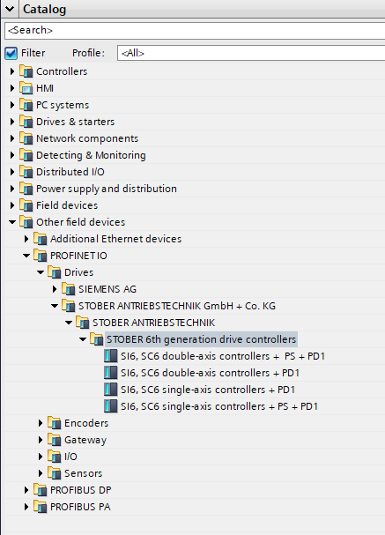
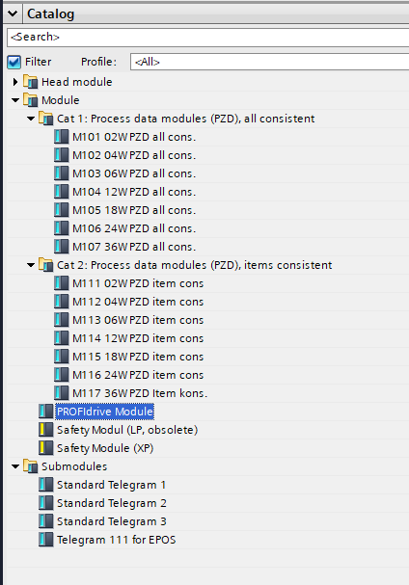
Possible Combinations in Hardwaremanager of Siemens
Technical Meeting 2021
Devices
Modules and Submodules
The formerly known
Process data modules can be used
instead of PROFIdrive Module
PROFIdrive Module
Allows the usage of
Submodules Telegram1 to 111.
PS: PROFISafe
PD1: PROFIdrive V1
(PD2 will include
Isochronous Real Time
functionality IRT)
Safety Modules can only be used with PROFIsafe Devices (PS)

Slide 9
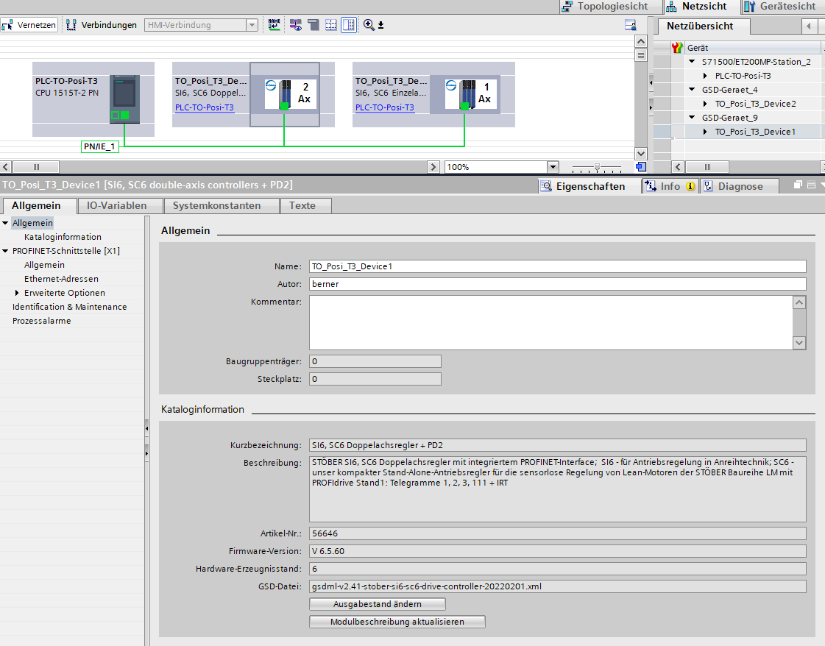
New GSD for V6.5-F or newer needed when using AC4
The new GSD file can be recognized by two characteristics:
PD2 (PROFIdrive V2) in the name
The version of the gsdml description has changed to V2.41 ( formely V2.34)
You can find the necessary files in the downloadcenter with search term „gsd“
→ Live demo HW catalog

Slide 10
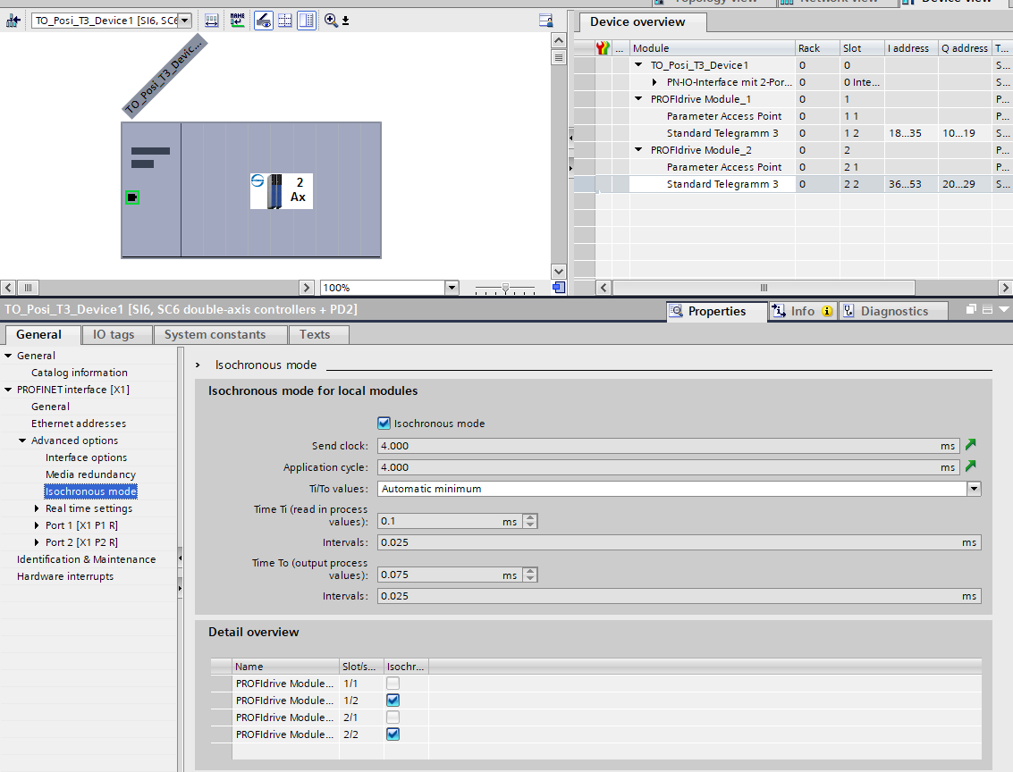
Setup IRT with PROFIdrive in TIA Portal 1 / 3
The activation of isochronous mode has to be done for each PROFIdrive slot and for the device himself…..

Slide 11
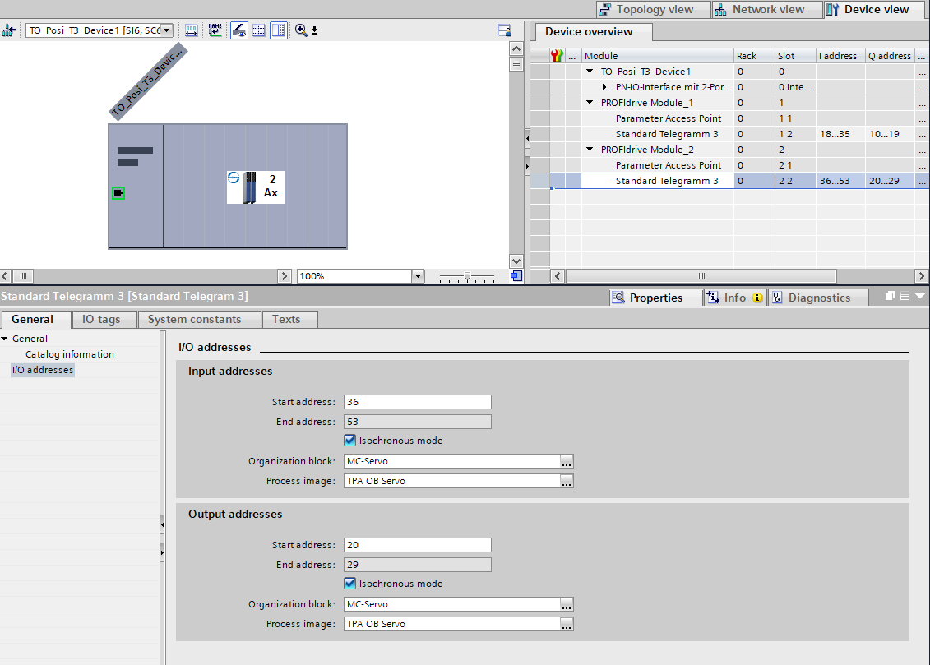
Setup IRT with PROFIdrive in TIA Portal 2 / 3
…and for each PROFIdrive slot with a standard telegram pluged in….

Slide 12
Topology is mandatory for IRT 3/3
…and connect all devices in the correct sequence in the topology view.

Slide 13
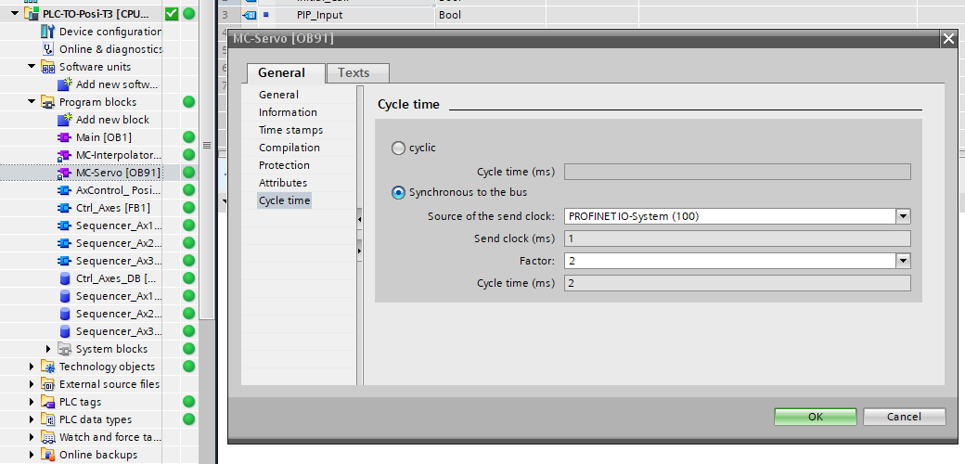
OB Servo adjustments
MC-Servos has to be synchronous to the bus and you can choose a factor to save PLC computing time.
→ Live demo isochronous parameters

Slide 14
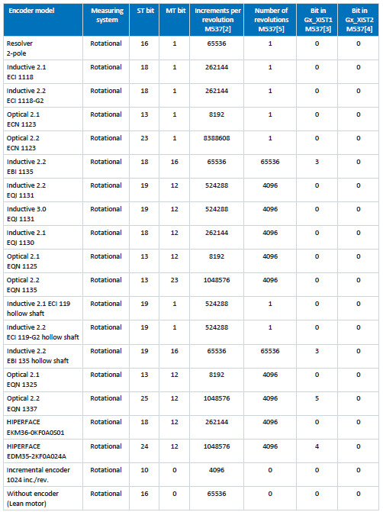
Setup Encoder configuration in TIA Portal 1/3
You can set the parameters for the encoder of the drive inside TIA portal manually. Please use the table of the PROFIdrive manual.

Slide 15
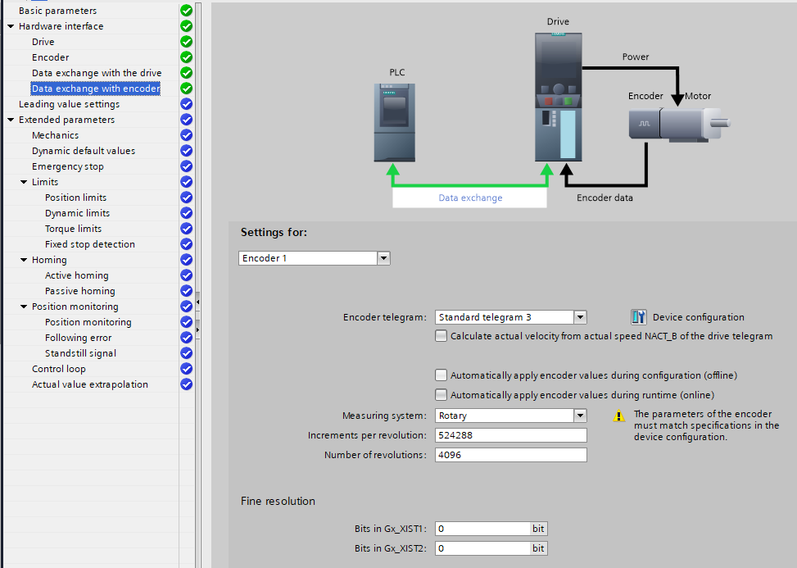
Setup Encoder configuration in TIA Portal 2/3

Slide 16
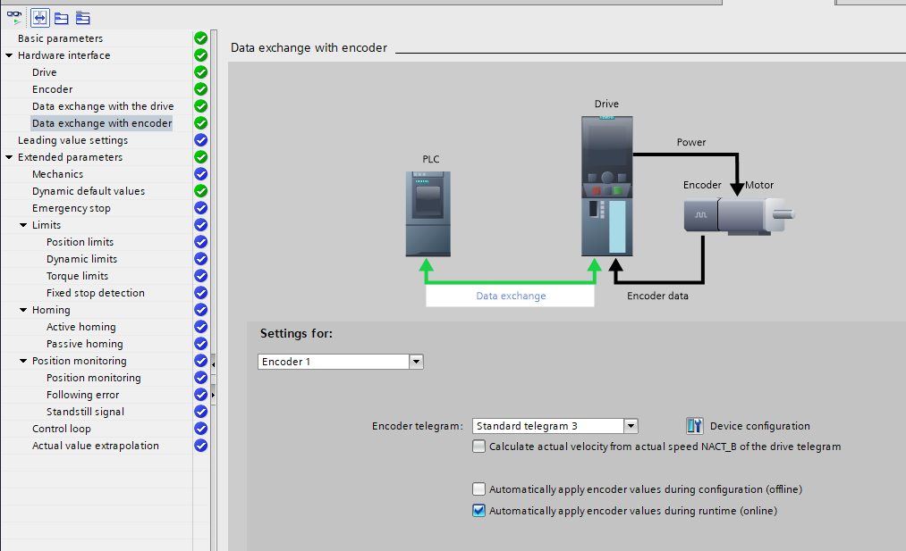
Setup Encoder configuration in TIA Portal 3/3
Use comfortable automatic encoder configuration in Function view

Slide 17
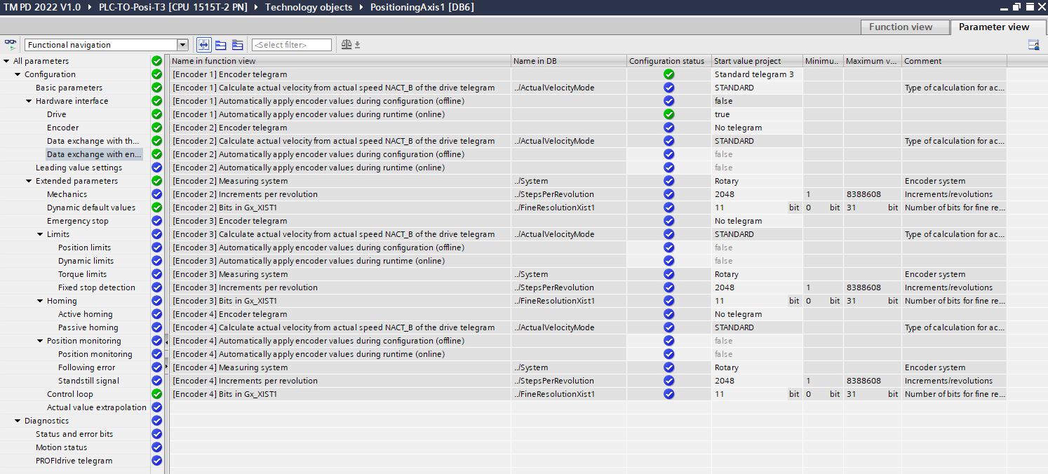
..perhaps you prefer the parameter view

Slide 18
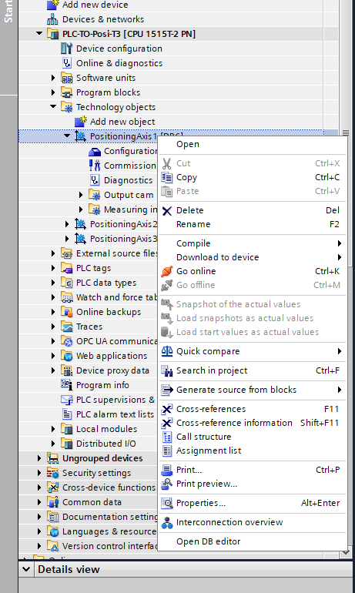
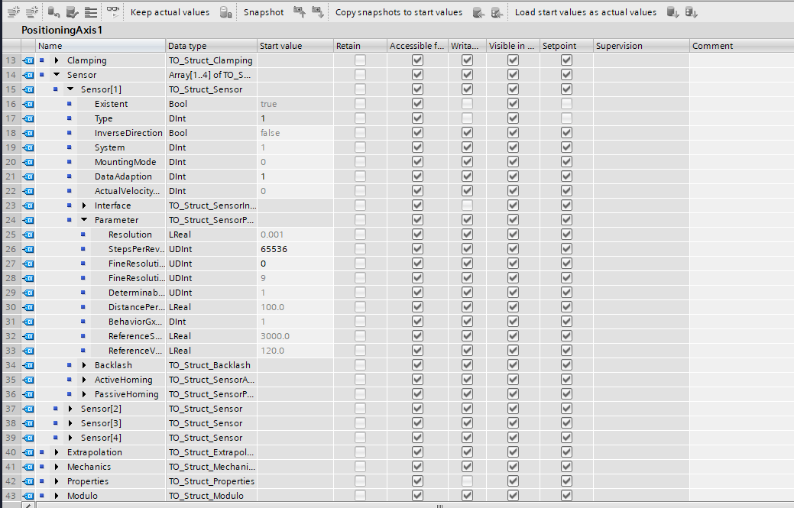
..or the detailed information inside the DB editor
→ Live demo TO DB editor

Slide 19
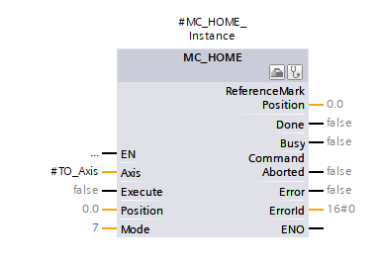
Homing in AC4
Homing procedure is in AC4 always in the PLC.
Drivebased homing methods are not possible.
For absolut encoders in the drive use Mode 7

Slide 20
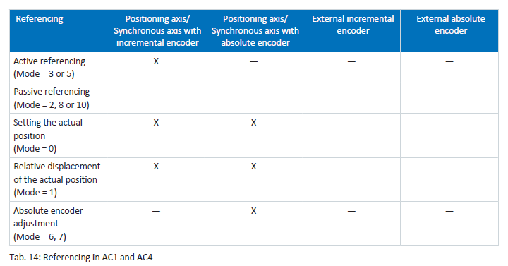
Siemens MC_Home supported methods with STÖBER
for detailed information have a look to the handbook STÖBER PROFIdrive
and the online help of Siemens for the MC_Home block

Slide 21
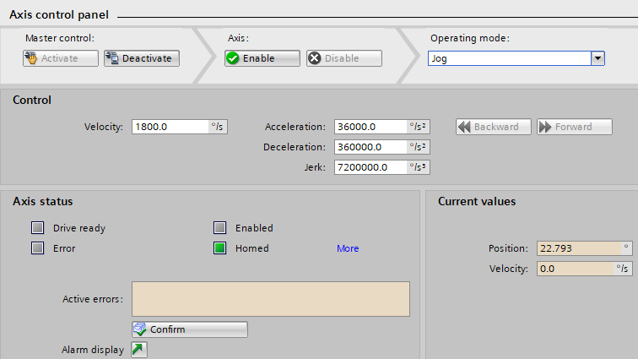
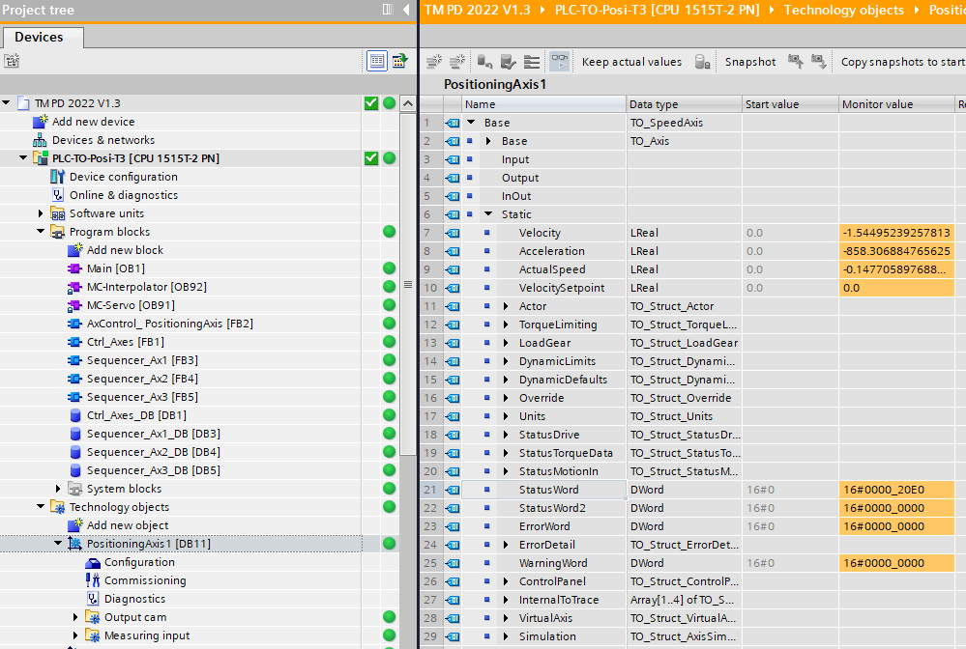
Homing status of (Absolute) Encoders
Check Homing status of axis
1. Commisioning side of TO – Axis control panel - Homed
2. DB of TO – StatusWord – Bit5
→ Live demo with restart of referenced axis

Slide 22
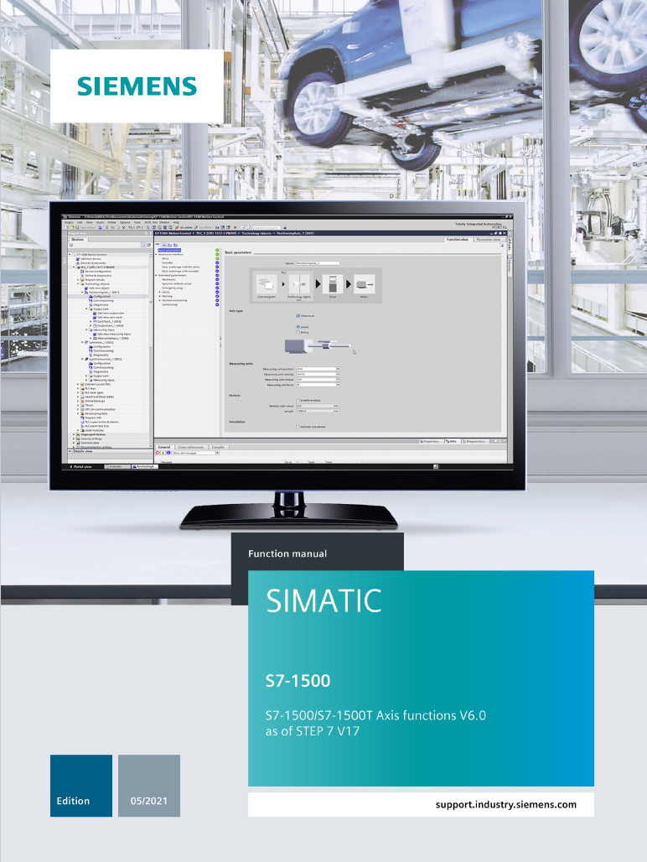
More information about TO Programming
~ 400 pages of information
s71500_s71500t_axis_function_manual_de-DE_de-DE. pdf
s71500_s71500t_axis_function_manual_en-US_en-US.pdf

Slide 23
When do you need a T-PLC ?
If your application needs:
Electronic cam
or
Position synchronous mode with 2 or more axes
or
Kinematic Transformation (robotic)
You need mandatory a T-PLC.
(and AC4 with PROFINET IRT)

Slide 24
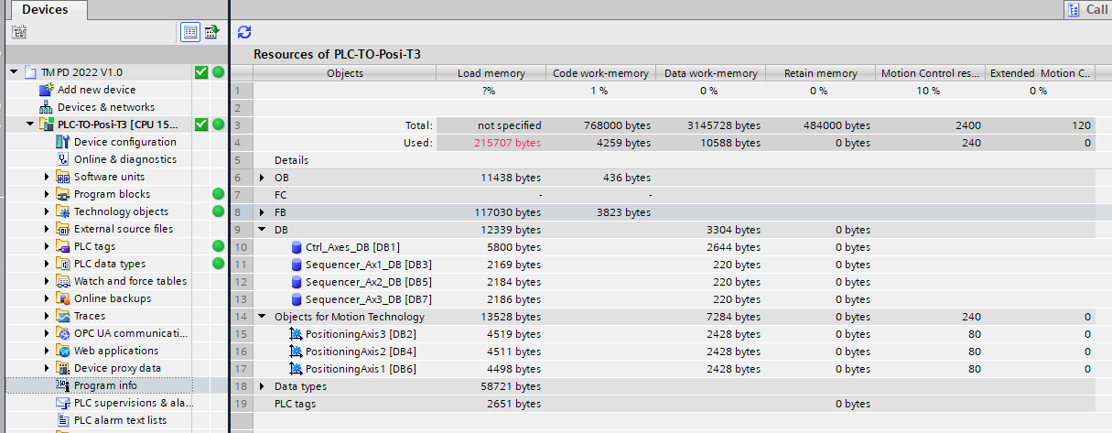
Used ressources

Slide 25
Live Demo
Hardwaremanager / Neccesary adjustments for IRT
Position Loop in the PLC with AC4
If you have questions, please give me a feedback with the hand symbol.

Slide 26
Questions about AC4 /IRT

