Slide 1
PS6A44 Supply modul

Slide 2
Sizes
Type | Size | ID No.
PS6A24 | Size 2 | 56650
PS6A34 | Size 3 | 56651
PS6A44 | Size 4 | 5050113

Slide 3
Technical datas
Electrical data | PS6A24 | PS6A34 | PS6A44
U1PU | 3 × 400 VAC, +32%/−50%, 50/60 Hz 3 × 480 VAC, +10%/−58%, 50/60 Hz
U2PU,ZK | √2 × U1PU
PN,PU | 10 kW | 20 kW | 50 kW
I1N,PU | 25 A | 50 A | 95 A
I1maxPU | I1N,PU × 180% for 5 s I1N,PU × 150% for 30 s
CN,PU | 5000 μF | 10000 μF | 20000 μF

Slide 4
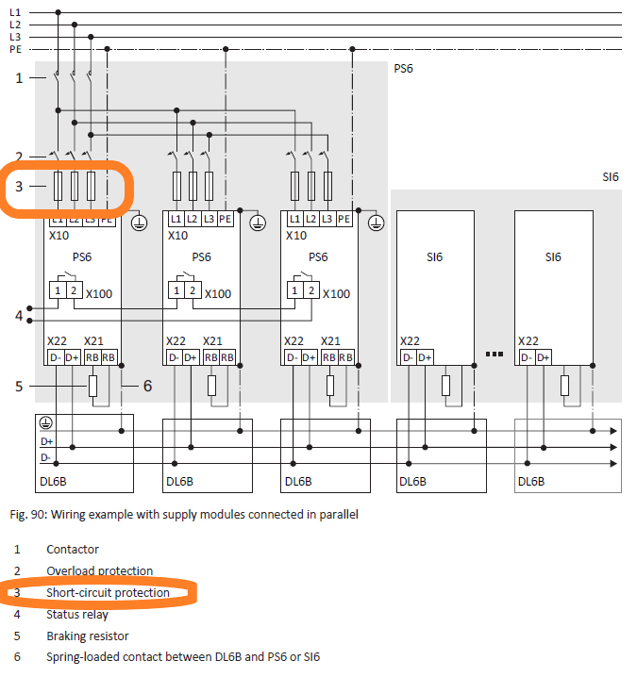
Special feature
In difference to the two smaller units, the PS6A44 has current measurement
The charging relay can interrupt the supply => Short circuit protection
This means that the fast fuses can be omitted
No parallel connection for PS6A44
Accessories: Quick DC-Link DL6B22 Terminal set ID: 5050112

