Slide 1
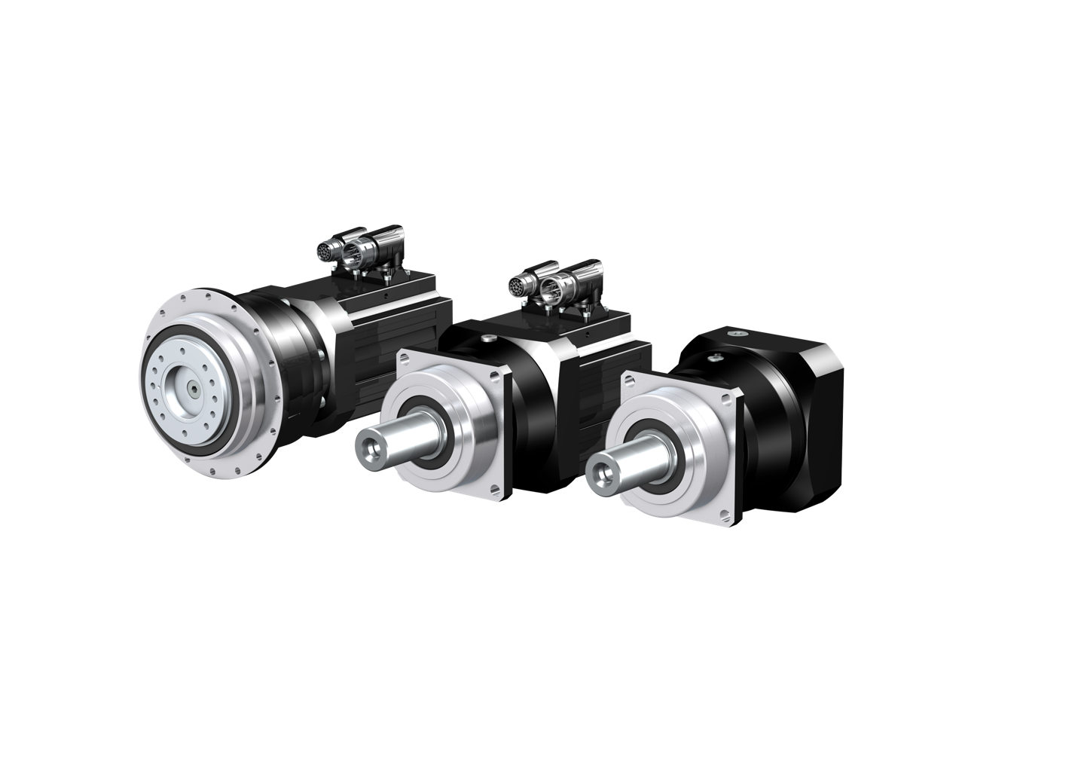
Planetary gear units from STOBER.
High-performance. Precise. Perfect fit.

Slide 2
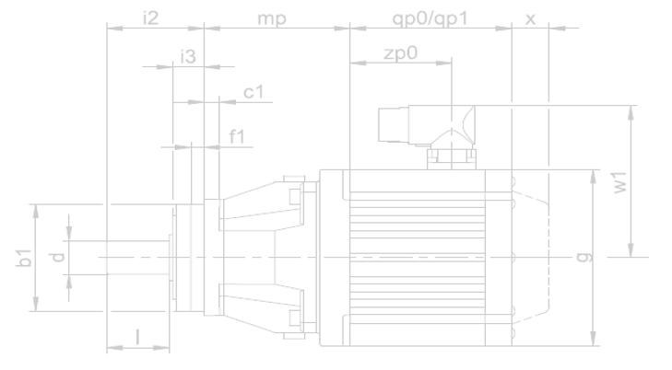
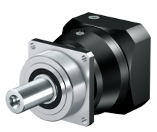
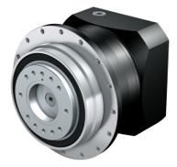
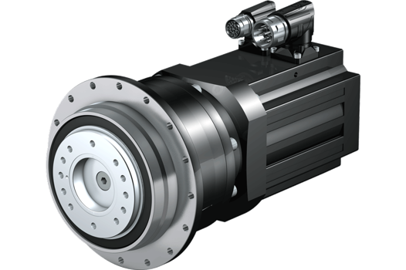
More PERFORMANCE for your machine!
P
Space-saving!
Smaller installation space.
Low weight.
High torque.
Leverage the benefits of direct attachment!
No motor adapter.
Low weight.
Maximum drive dynamics.
Power density improved by 65%.
Ready-to-install drive solution.
PH
L
L
The most compact planetary geared motors on the market
Notes:
Space-saving machine and installation concept thanks to an extremely compact design.
Maximum drive dynamics due to the very low mass moment of inertia in direct attachment. The elimination of a motor adapter guarantees maximum drive dynamics.

Slide 3
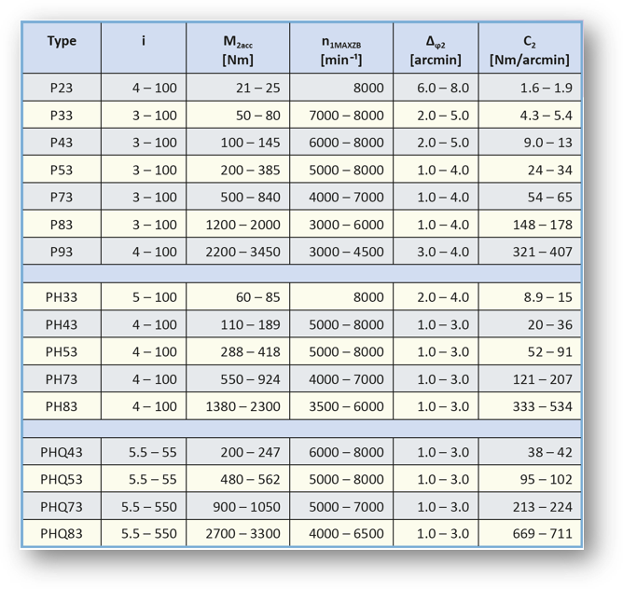
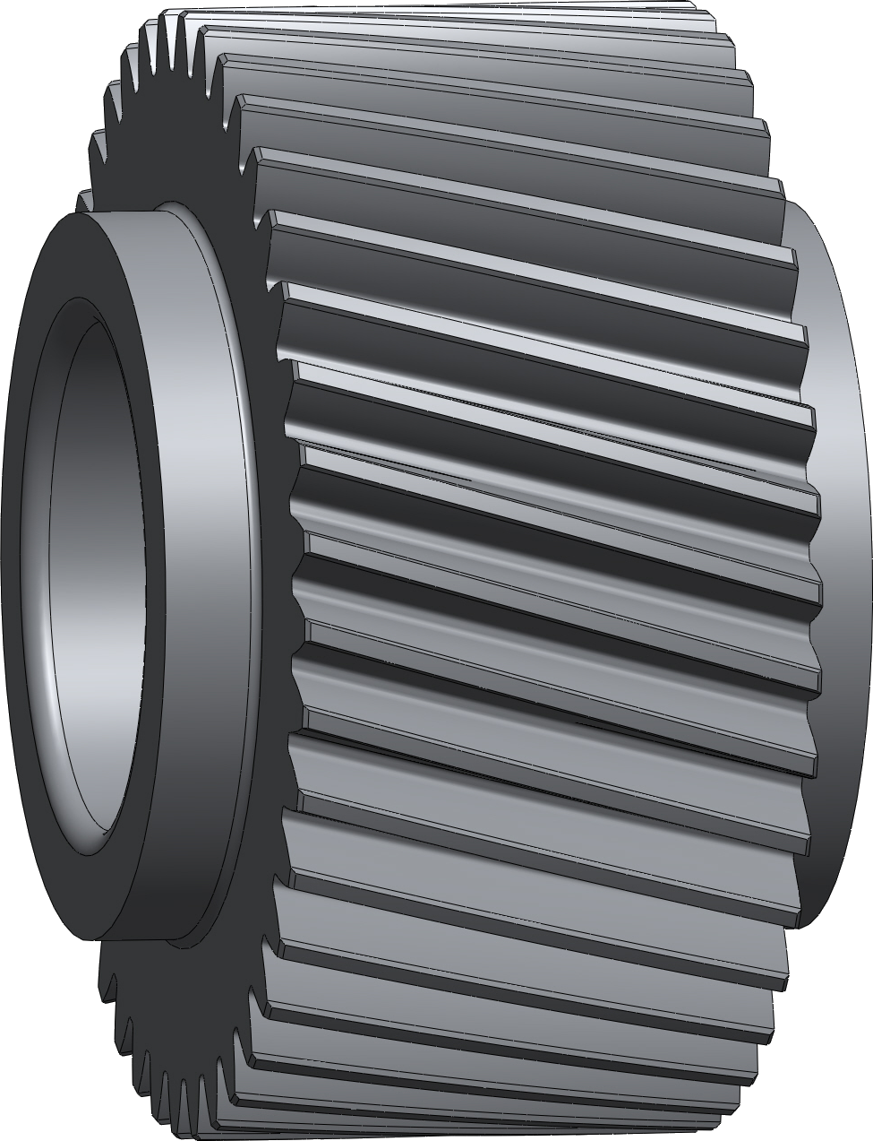
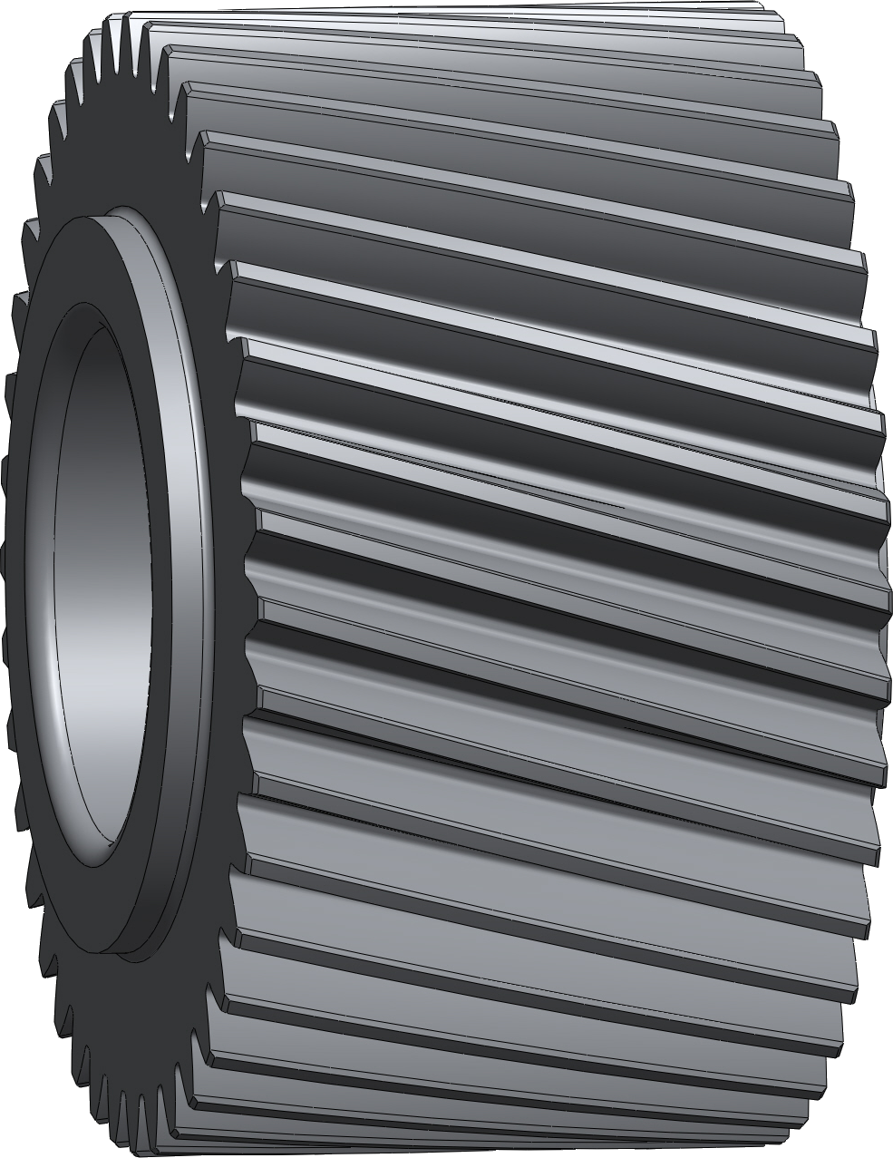
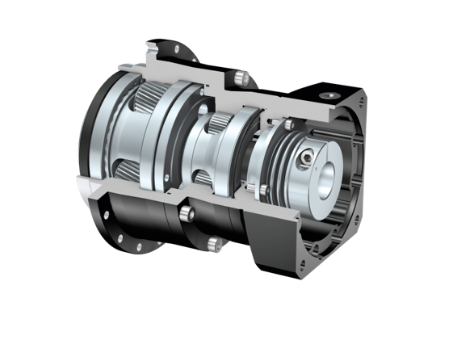
More PERFORMANCE for your machine!
Greater torque!
Greater torques with wider toothing.
Greater torques with nitride housing gearing (reduced backlash).
Notes:
The increased idler pin diameter and wider toothing in the output stage improve emergency-off torque as well as load capacity.

Slide 4
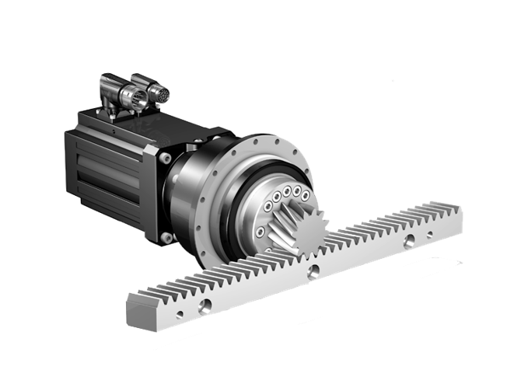
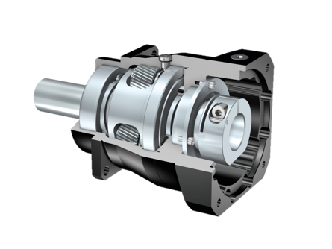
Greater PRECISION with planetary gear units from STOBER
Higher quality, greater precision!
Maximum positioning accuracy: Backlash as low as ≤ 1 arcmin.
High-quality housing and toothing.
High acceleration torques with maximum running accuracy and precision.
STOBER rack and pinion drives with a radial runout of ≤ 10 μm.
Highly precise with low backlash!
Notes:
High-quality housing and toothing with innovative production technologies
Deliver maximum positioning accuracy with minimal backlash as low as ≤ 1 arcmin.
Result in high acceleration torques while ensuring maximum running accuracy and precision
For example, STOBER rack and pinion drives, which have a radial runout of ≤ 10 μm.

Slide 5
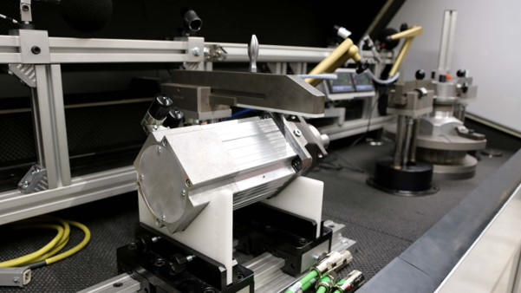
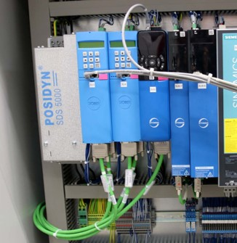
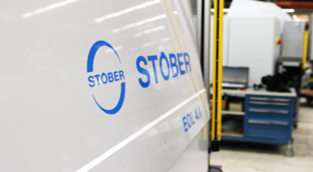
Quality guaranteed!
We put our planetary gear units to the test!
Specially developed and manufactured test benches with STOBER components.
Inspection and documentation of all figures and setting values, such as runnig noise or bearing pretension.
Separate test bench for checking the backlash to ensure the highest positioning accuracy.

Slide 6
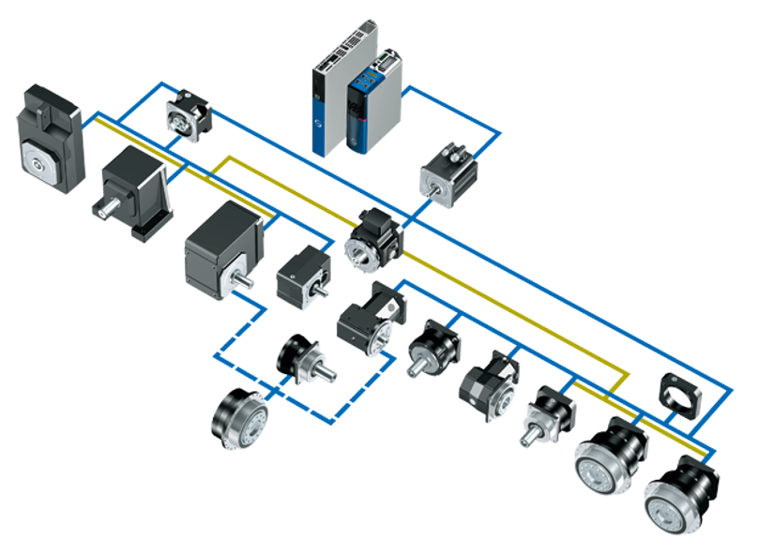
PERFECTLY ADAPTED to your individual requirements
All options are at your disposal!
Versatile machine design.
Exceptional variety of combinations and options.
Largest possible combination of gear units and motors with direct attachment.
Variable adapter designs.
SC6/SI6
SD6
ME
EZ/LM
F
C
MB
K
KL
KX
ME/MF
P
PE
KS
The right configuration for any requirement!
PH(Q)
P
PH/PHV
PHQ
Notes:
Unique interface technology for connecting motors of various sizes. STOBER motor adapters…
...are available in many different specifications, including a ServoStop variant with integrated brake.
...can be combined with standard or backlash-reduced gear units.
...in the large version with an extra-large motor plate can be connected to the most compact STOBER gear units with motors in large designs—a unique selling point!

Slide 7
Planetary gear units from STOBER
High-performance. Precise. Perfect fit.
The most compact planetary geared motors on the market.
Superior precision and performance.
Exceptional variety of combinations and options.
Extreme ruggedness.
Ready-to-install drive solutions for machine tool and packaging machines as well as automation and robotics applications.

Slide 8
Make it yours! STOBER Configurator
Your right drive and automation solution
Quick configuration with just a few clicks.
Filter, compare, save and share.
Download 3D models, dimensional drawings or technical data sheets.
Request a quote directly!
configurator.stober.com

Slide 9
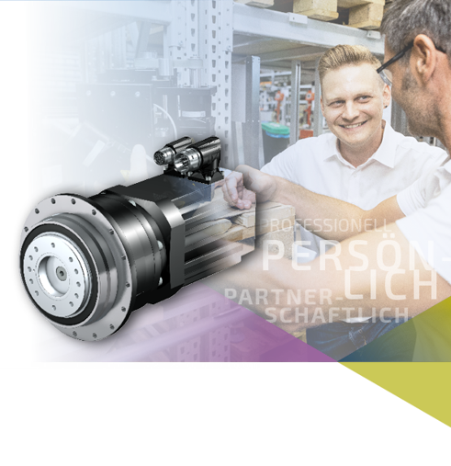
MORE THAN JUST A GEARBOX
MORE.
We bring more to the table!
Collaborative partnership.
Professional consultation designed around your needs.
Comprehensive assistance – from design configuration to commissioning and more.
Optimal solution for each individual application scenario.
THAN JUST A GEARBOX.

Slide 10
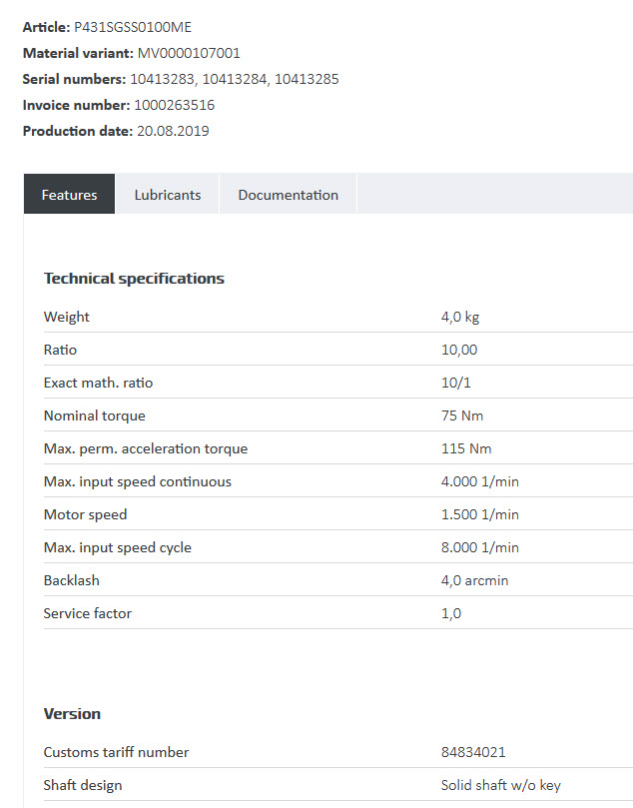
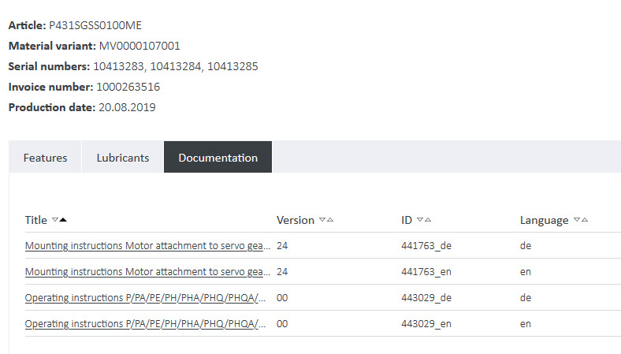
The STOBER PRODUCT ID CARD
All important information at a glance. Available at all times!
Operating and assembly instructions.
Spare parts lists.
Notes on technical features.

