Slide 1
TC6 drive controller

Slide 2
Sizes
Type | Size | Axis controller
TC6A062 | Size 0 | Double-axis controller
TC6A162 | Size 1 | Double-axis controller
TC6A261 | Size 2 | Single-axis controller

Slide 3
TC6 Interface
Analog inputs and TTL encoder simulation

Slide 4
TC6 for analog set value
IO interface for speed reference and encoder simulation
NO fieldbus interface
Safety function STO via terminal (SR6A)
Certified for PLe (Cat. 4) and SIL 3
Control modes for
Lean Motors LM
Synchronous Servo Motors (e.g., series EZ)
Asynchronous Motors (e.g., IE2 / IE3)

Slide 5
IO interface TC6
TC6
IO interface
±10 V set value
Resolution 12 Bit
TTL Encoder simulation as actual value
Signals: A, B, Zero
Maximum input frequency: 500 kHz
Digital outputs: ready
Digital inputs: enable and reset
Safety technology
Safety function STO via terminals (SR6A)
Axis A
Signal A
Incremental
A / B / 0
Signal B
Signal 0
Axis B
Signal A
Incremental
A / B / 0
Signal B
Signal 0
Ready A
Ready B
Digital IO
DI1: Enable A
DI2: Reset A
DI6: Enable B
DI7: Reset B
Analog Inputs
Analog input A
Analog input B

Slide 6
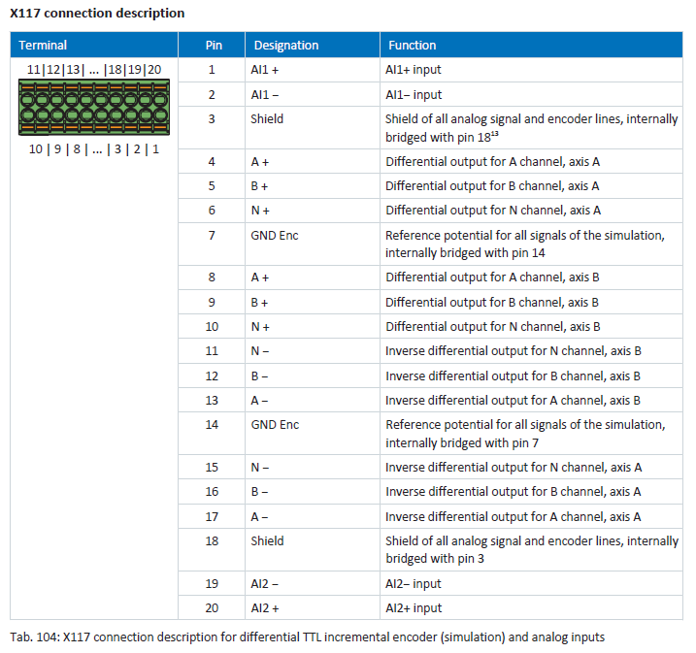
X117

