Slide 1
Connected at a distance. One cable, up to 100 meters.
The new one-cable solution from STOBER.

Slide 2
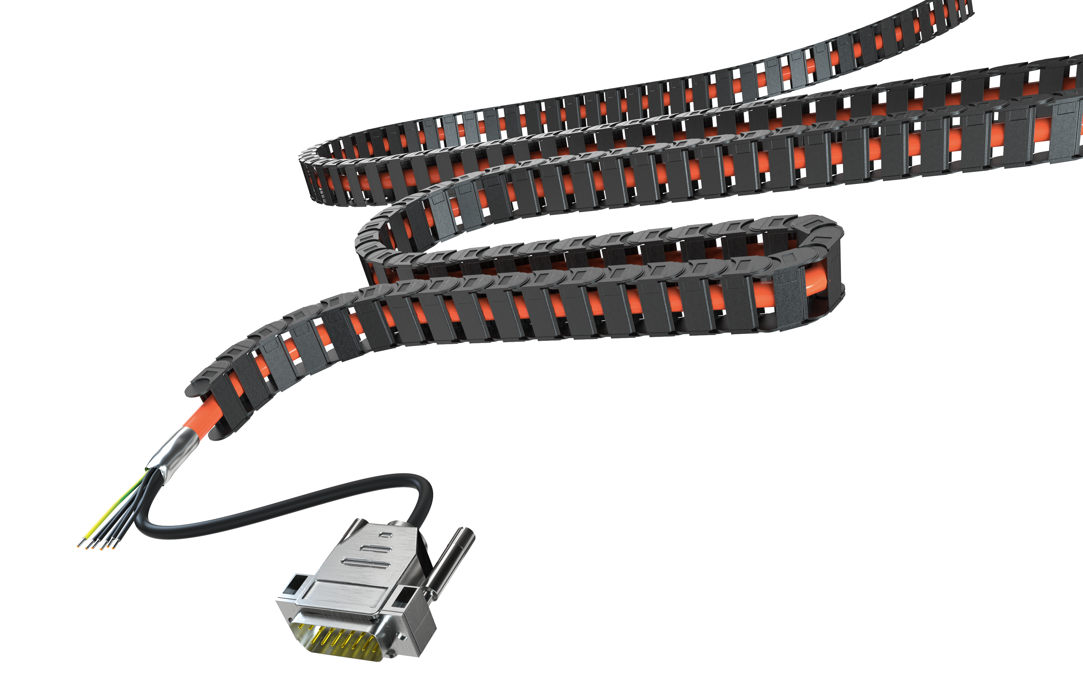
Connected at a distance: One cable, up to 100 meters
The new STOBER hybrid cable connects motors and drive controllers reliably up to 100 meters.
Future-proof HEIDENHAIN EnDat® 3.
For maximum quality during transmission, diagnosis, safety and performance.
A MUST for digital production.

Slide 3
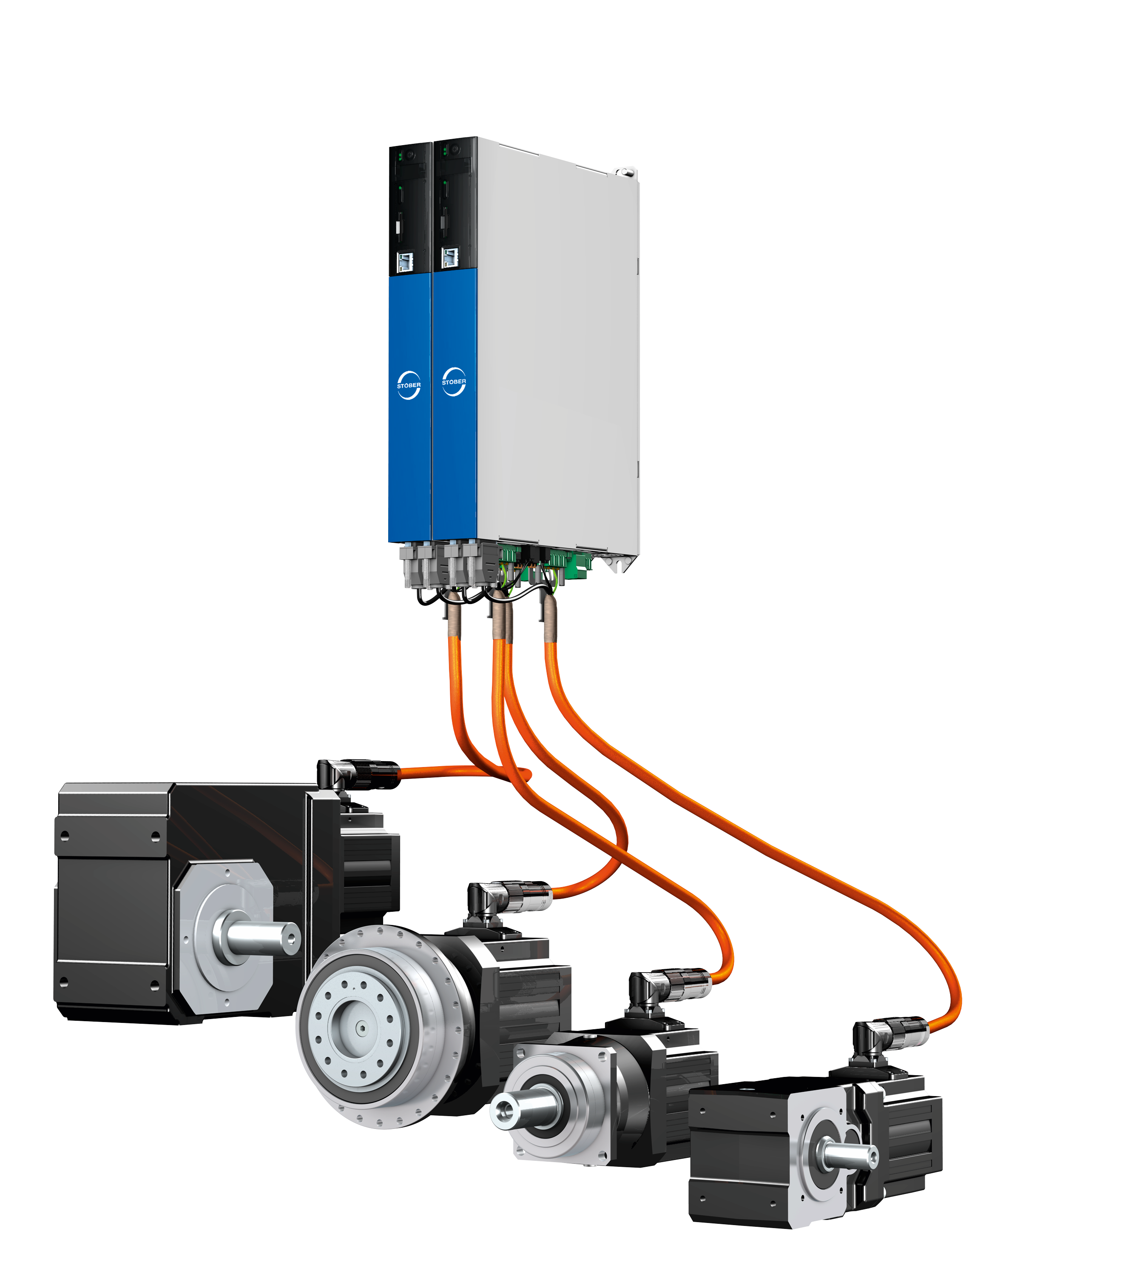
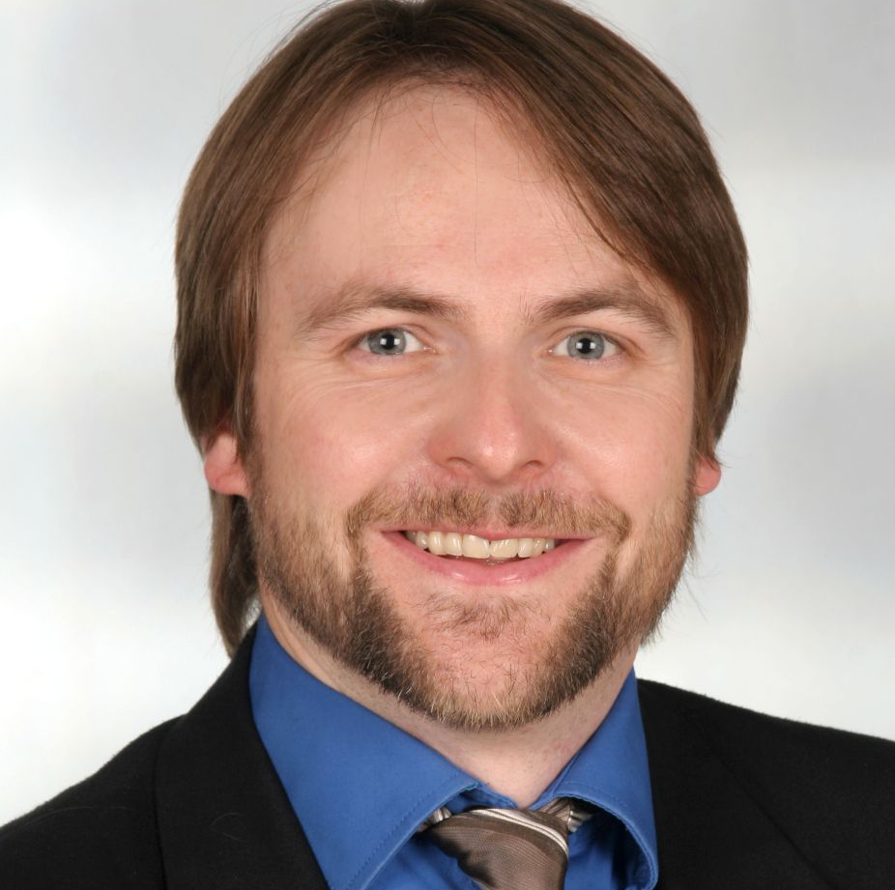
STOBER OCS: Maximum power in the system
The redesigned hybrid cable from STOBER connects
SC6 and SI6 drive controllers with
EZ and EZS synchronous servo motors. Can be combined with all STOBER gear units in direct attachment.
Maximum power in the system, engineered to work together.
"The system concept is crucial. Communication plays an especially important role here. The short paths in our organization create efficiency, effectiveness and precision"
– Dr. Florian Dreher, Head of Development and Purchasing for Motors

Slide 4
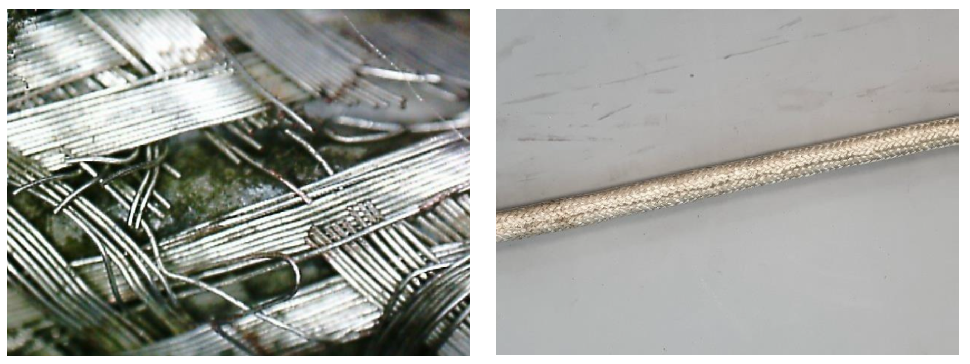
Rugged, flexible and error-free: No chokes up to 50 meters
Optimized for highly dynamic applications in drag chains
Numerous load tests in the lab.
Cable length of 50 meters
No chokes
The result: After 5 million cycles, signals are still read and evaluated flawlessly.
In comparison: Cables in the conventional design did not pass these tests.

Slide 5
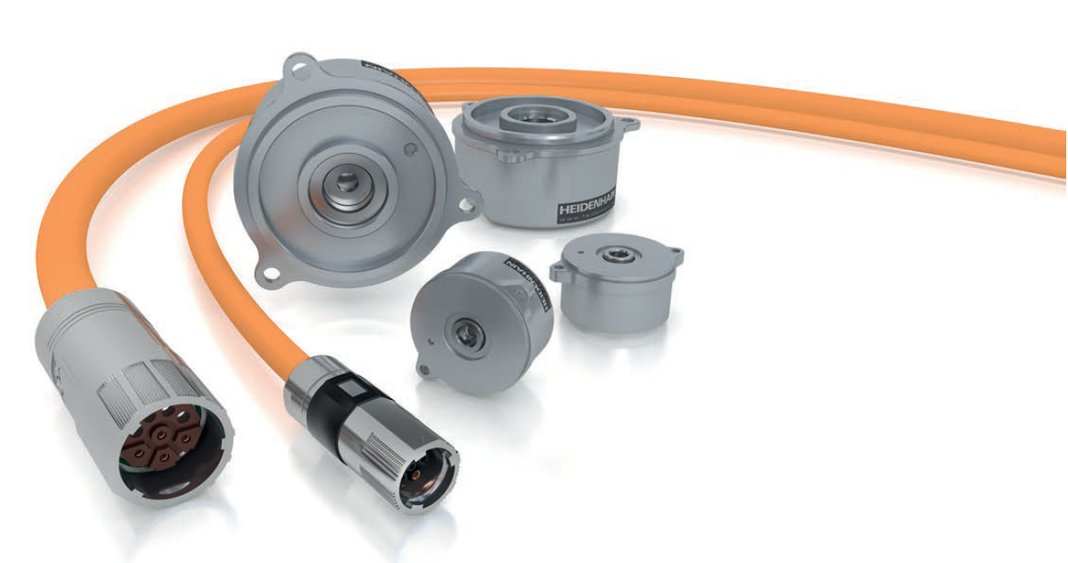
Future-proof and digital with HEIDENHAIN EnDat® 3
Inductive HEIDENHAIN EnDat® 3 encoder: EQI1131-E30-R2 in two-wire technology
Highly precise positioning:
19-bit resolution (524,288 position information values) single-turn
12-bit resolution (4,096 revolutions) multi-turn
Thermal motor monitoring; digital data transmission to the drive controller evaluating the data via EnDat® 3 protocol.
Convenient commissioning with the electronic nameplate.
Rugged design.
High transmission frequency.
High common mode tolerance.
Notes:
https://www.endat.de/de_EN/endat-3/

Slide 6
Save time, space and money!
50% fewer cables, a reduced number of plug connectors and the elimination of expensive, bulky chokes mean the following benefits:
Less hardware.
Lower cabling outlay.
Smaller drag chains.
Smaller control cabinet feed-through.
Simple installation in the blink of an eye.
Fewer sources of error during installation.
Reduced logistics expense.
Minimized failure risk.
More space in the control cabinet.
Significantly reduced material and operating costs.
Notes:
You shorten installation times, economize materials and space, design more compact systems and thus save money.

Slide 7
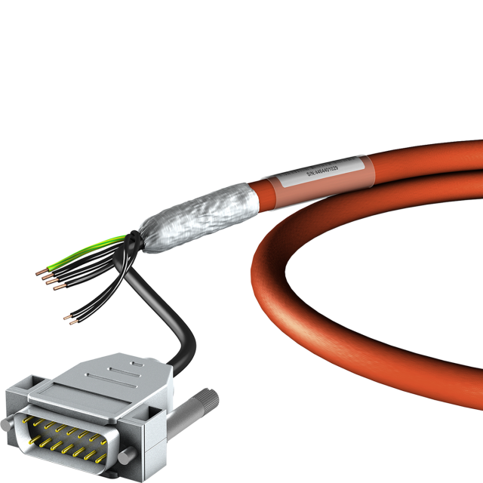
Technical highlights at a glance
Cable diameter and weight: Max. 14.7 mm (0.315 kg/m) or max. 16.8 mm (0.4 kg/m).
Bending radius: 10 × d_{out} (free to move).
Bending resistance: Min. 5 million cycles.
Acceleration: Max. 5 m/s² up to 20 m travel path.
Travel velocity: Max. 240 m/min.
Torsional stress: ± 30°/m.
Safety level: Up to SIL 2, PL d (cat. 3) in accordance with DIN EN 61800-5-2 and DIN EN ISO 13849.
Flammability: Flame-resistant and self-extinguishing in accordance with IEC 60332-1-2, UL758 cable flame test.
RoHS conformity: Free of hazardous substances in accordance with RoHS-2 Directive 2011/65/EU.
Design: UL758 (AWM) Style 21223 (sheath) and Style 10492 (core).
Sheath identification: Orange color (similar to RAL 2003) with "STÖBER" imprint.

