Slide 1
Technical Meeting
Group A: Monday, 16th May / Tuesday, 17th May 2022

Slide 2
Welcome
Name | Organisation
Bartłomiej Kuczyński | DEMERO Sp.j. (PL)
Daniel Stepien | DEMERO Sp.j. (PL)
Darius Nosiadek | DEMERO Sp.j. (PL)
Marcin Mrugała | DEMERO Sp.j. (PL)
Janne Tenkanen | EIE (FI)
Lars Saether | EIE (NO)
Matthias Frick | EIE (SE)
Jakkrit Leepongphan | PMP (TH)
Andreas Vieira | SAT
Günter Großmann | SAT
Heiko Berner | SAT
Johannes Kübler | SAT
Lutz Augenstein | SAT
Marc Brugger | SAT
Mario Mall | SAT
Matthias Eberle | SAT
Qi Wang | SAT
Roman Rybalkin | SAT
Ronja Neunecker | SAT
Thilo Dauth | SAT
Danlin Chen | STOBER China
Xuan (Jason) Yang | STOBER China
Brian Dunkley | STOBER DRIVES LTD. (UK)
Osamu Adachi | STOBER Japan
Jacob Chiu | STOBER Taiwan
James Wu | STOBER Taiwan
Alper Turan | STÖBER Turkey

Slide 3
Technical Meeting as TEAMS Meeting
TM in 3 Groups instead of one big Meeting
Fit´s better to the local time of all participants – Group A (Asia)
More Feedback
More Discussions
More flexibility in case of collision with other appointments

Slide 4
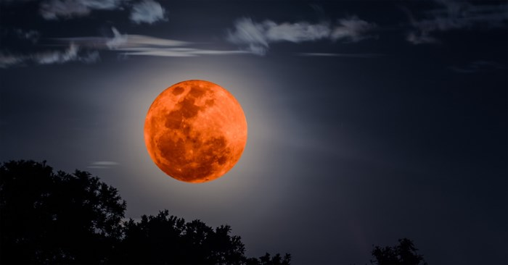

Slide 5
Agenda Technical Meeting - Group A
16th May 2022:
08:30 – 08:35 am Welcome Johannes Kübler
08:35 – 10:00 am PROFIdrive Heiko Berner
10:00 – 10:15 am Break All
10:15 – 11:15 am Drive Control Suite 6.5-F Lutz Augenstein
- Online Help
- Graphical Programming
- Predictive Maintainance
- Advanced SSI encoder evaluation
11:15 – 11:30 am Evaluation Market Feedback Johannes Kübler
11:30 – 12:00 am EZ-Motor News Roman Rybalkin (EZ2 / Con40 vs. Con58 / El. Name plate for Beckhoff Inverters)

Slide 6
Agenda Technical Meeting - Group A
17th May 2022:
08:30 – 09:00 am LM Optimization – Practical Example Lutz Augenstein
09:00 – 09:30 am High Speed Johannes Kübler Advantages of using motors with higher speed + gearboxes with higher ratio
09:30 – 09:45 am New geared motor combinations Johannes Kübler Elimination of factor s_{B}
09:45 – 10:00 am Break All
10:00 – 11:00 am Success Stories
11:00 – 11:30 am TwoSpeed Gearbox PS Thilo Dauth
New diagnostics via Bluetooth Connection to SensorShift
11:30 – 12:00 am Discussion / Feedback All

