Slide 1
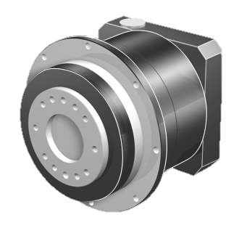
Discontinuation P(A) / PH(A) / PHQ(A)A Generation 2
Upgrade to Generation 3
Greater precision and performance!
More compact design to save space!
Attractive design!

Slide 2
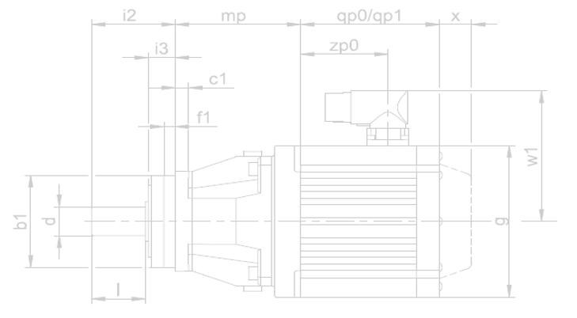
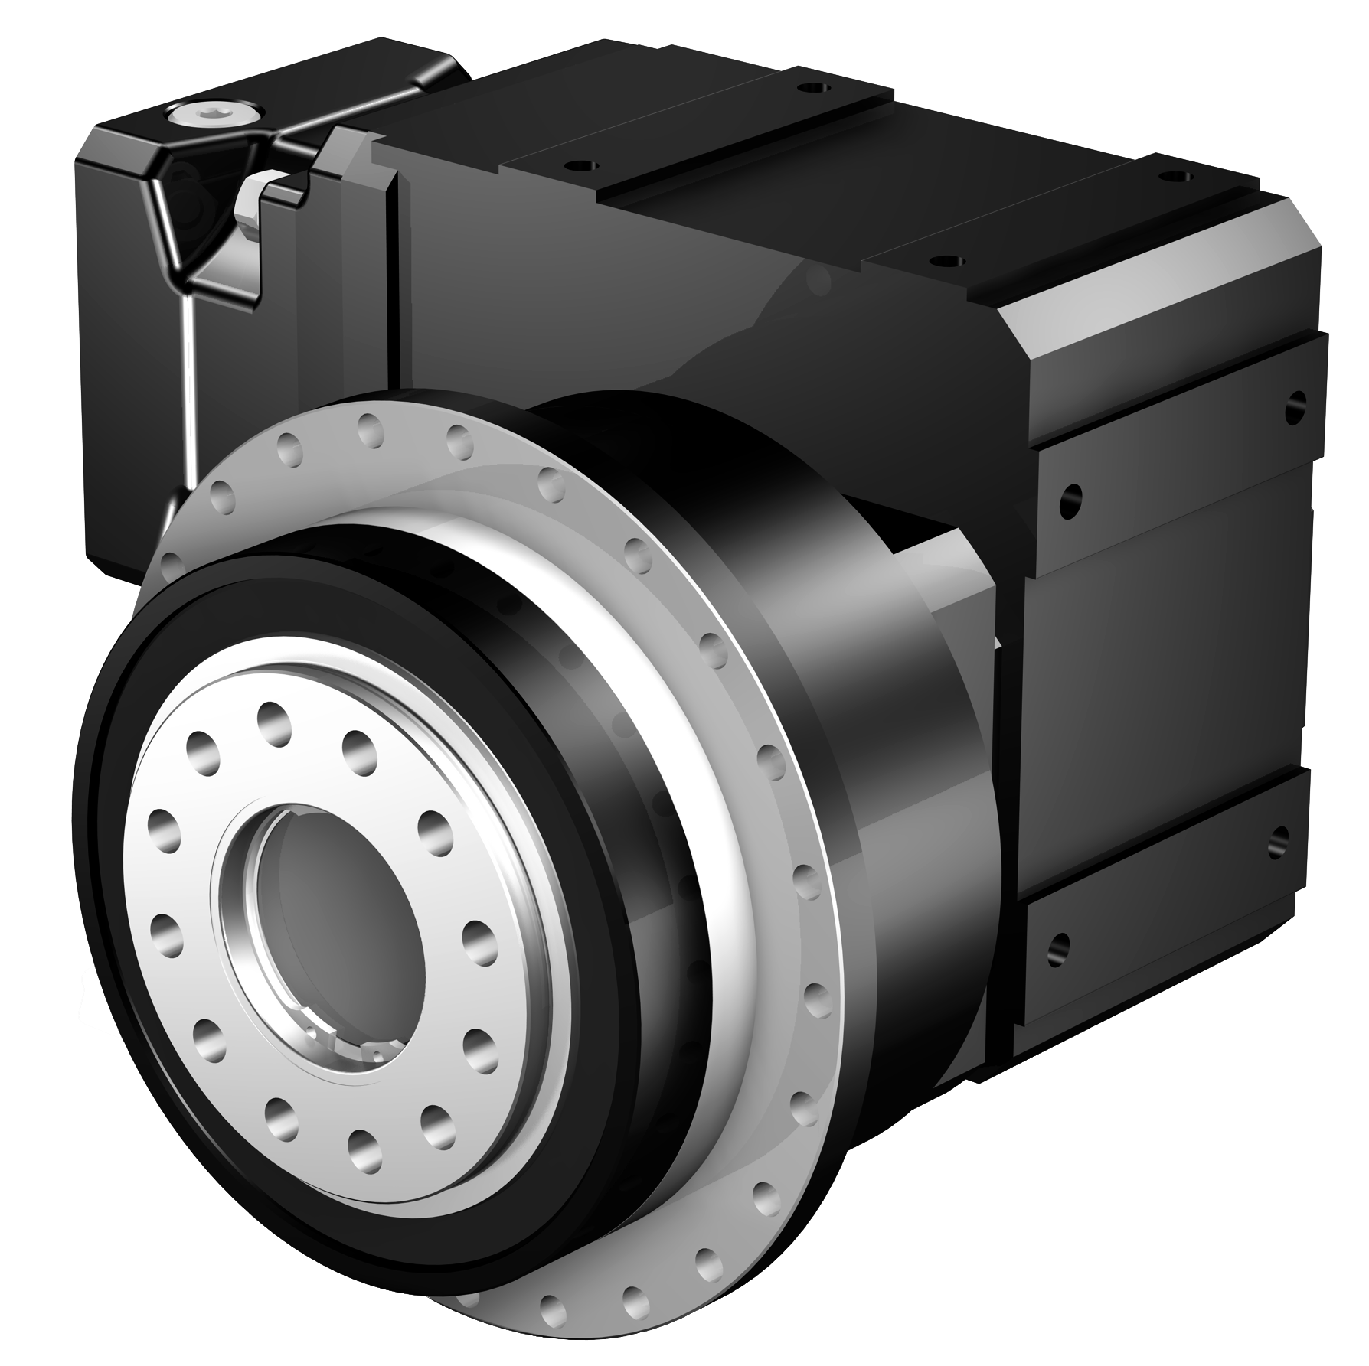
Discontinuation P(A) / PH(A) / PHQ(A)A Generation 2
Affected Product Groups
P22 – P92, PA32 – PA82, P22_KX – P92_KX, P52_K – P92_K
PH32 – PH82, PHA32 – PHA82, PH32_KX – PH82_KX, PH52_K – PH82_K
PHQ42 – PHQ82, PHQA42 – PHQA82, PHQ52_K – PHQ82_K
With all input options like EZ, LM, ED, EK, ME, MQ, MB, ….
Discontinuation date: 31st March 2022
Nothing is more constant than change!

Slide 3
Discontinuation P(A) / PH(A) / PHQ(A)A Generation 2
What is already done
Launch of Generation 3 from October 2019 to May 2020
Since April 2021 the discontinuation date is published in the Product Release Brief
Since September we are printing on all offers, order acknowledgements, delivery bills and invoices a hint about the discontinuation.
„Please note that this is a discontinued product generation. The gear unit you have selected will be discontinued on 31.03.2022. Orders after the discontinuation date may include price increases and will only be available through our service departments. We will be pleased to make you an offer for the current generation, which is compatible on the output side and has improved performance.”
Since August 01st 2021 prices are 10% increased
Discontinuation letter as official sales information is written and will be published this year.
Help us with the change to Generation 3

Slide 4
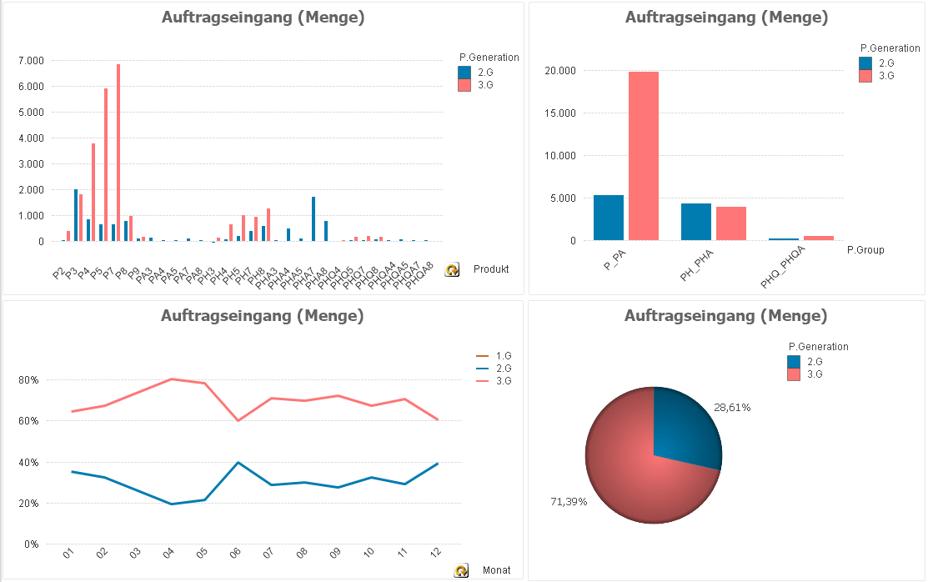
Change Statistik – Incoming Orders 2021

Slide 5
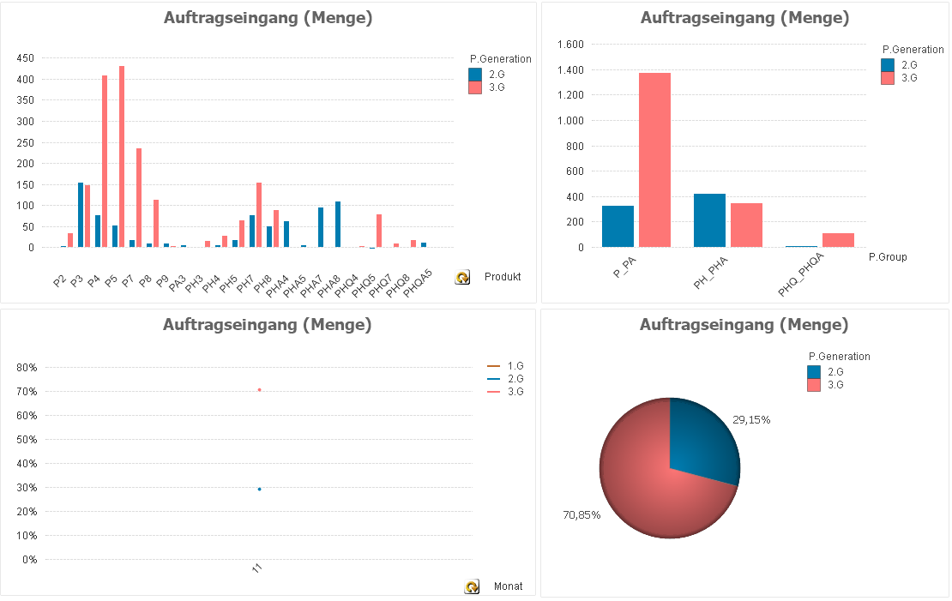
Change Statistik – Incoming Orders 2021-11
Notes:
No difference in the statistics → at buttom of change rate (with some exceptions)
G2 Gearbox incoming Orders since July 2021 have been 4350 pcs.
2350 of them is Amada, Trumpf, Hermle and Engel.
Without them the change rate is over 85%

Slide 6
Outlook change process
Amada
G3 is released
Stock and parts of G2 are used up in Q1 2022
Orders for G3 are already in SAP
Trumpf
Prototypes in G3 will be delivered in December 2021 and January 2022
Evaluation and release of G3 depending on machine in February and October 2022
Delivery of G3 depending on machine in July 2022 and April 2023
Hermle
Prototype in G3 will be delivered in January 2022
Evaluation and release of G3 in March 2022
Orders for G3 in April and delivery in 3rd Quarter 2022
Engel
P822 in old machine. P832 has collision. Evaluation of needed quantity and last order.

Slide 7
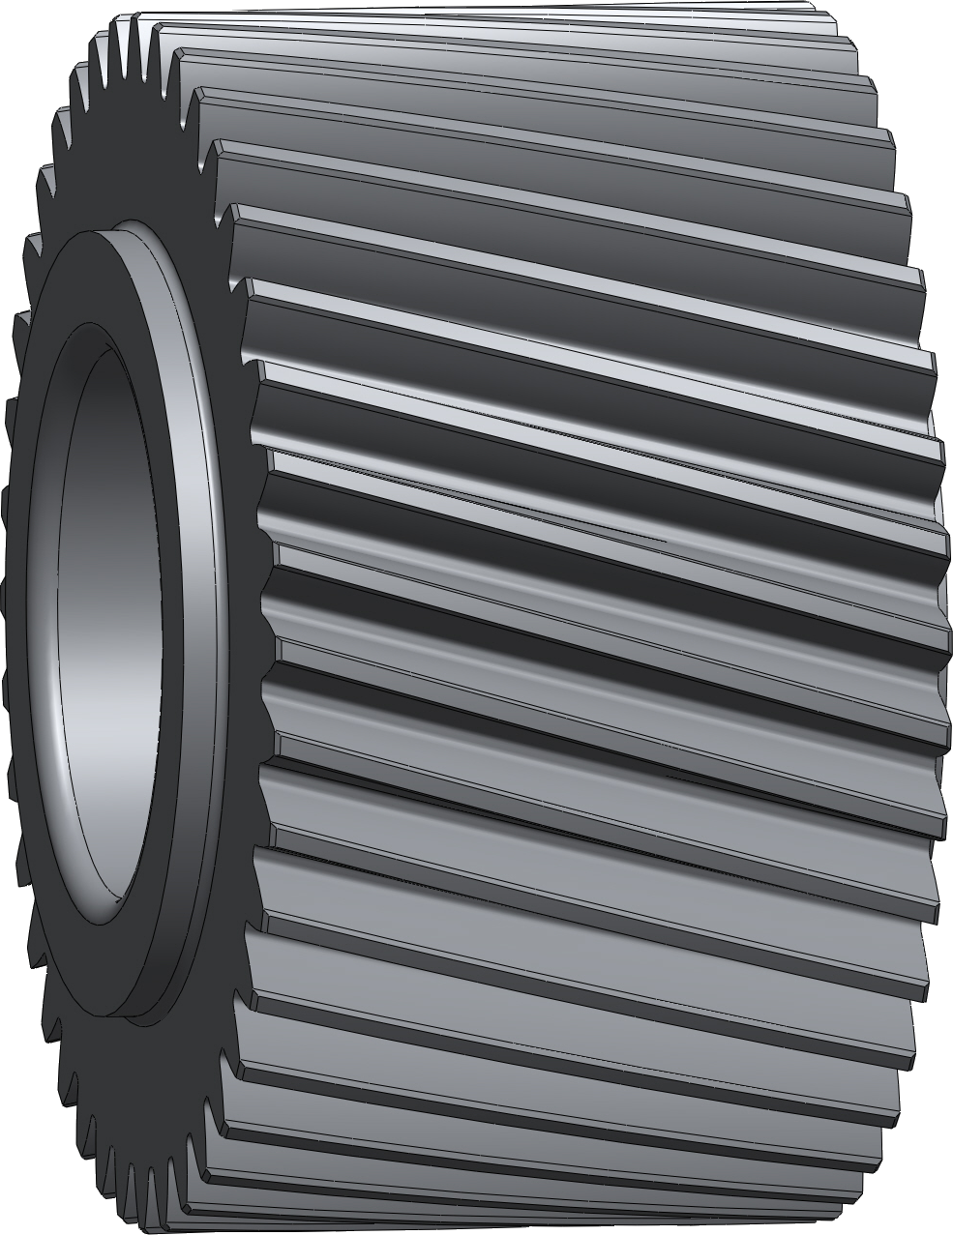
Discontinuation PE Generation 1
Upgrade to Generation 2
Greater precision and performance!
Standardization of interface to EZ motors and ME motor adapter!
High quality helical gearing!

Slide 8
Discontinuation PE Generation 1
Affected Product Groups
PE21 – PE51
With all input options like EZ, LM, ED, EK, ME,….
Discontinuation date: 31st July 2022
Nothing is more constant than change!

Slide 9
Discontinuation PE Generation 1
What is already done
Launch of Generation 2 April 01st 2021
In the Product Release Brief the discontinuation date is published from beginning
Since September we are printing on all offers, order acknowledgements, delivery bills and invoices a hint about the discontinuation.
„Please note that this is a discontinued product generation. The gear unit you have selected will be discontinued on 31.07.2022. Orders after the discontinuation date may include price increases and will only be available through our service departments. We will be pleased to make you an offer for the current generation, which is compatible on the output side and has improved performance.”
Discontinuation letter as official sales information is written and will be published this year.
Help us with the change to Generation 2

Slide 10
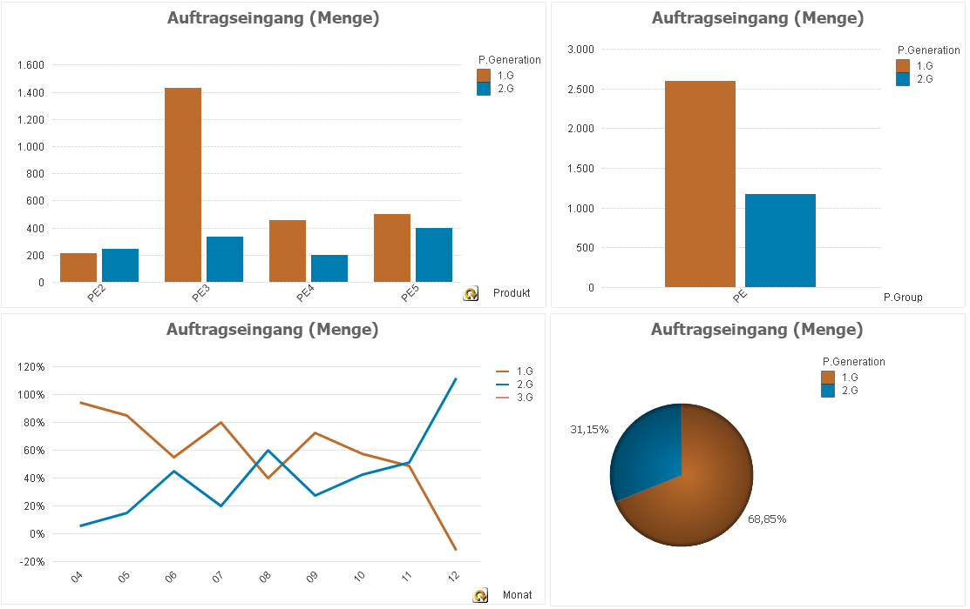
Change Statistik – Incoming Orders since April 01st 2021

Slide 11
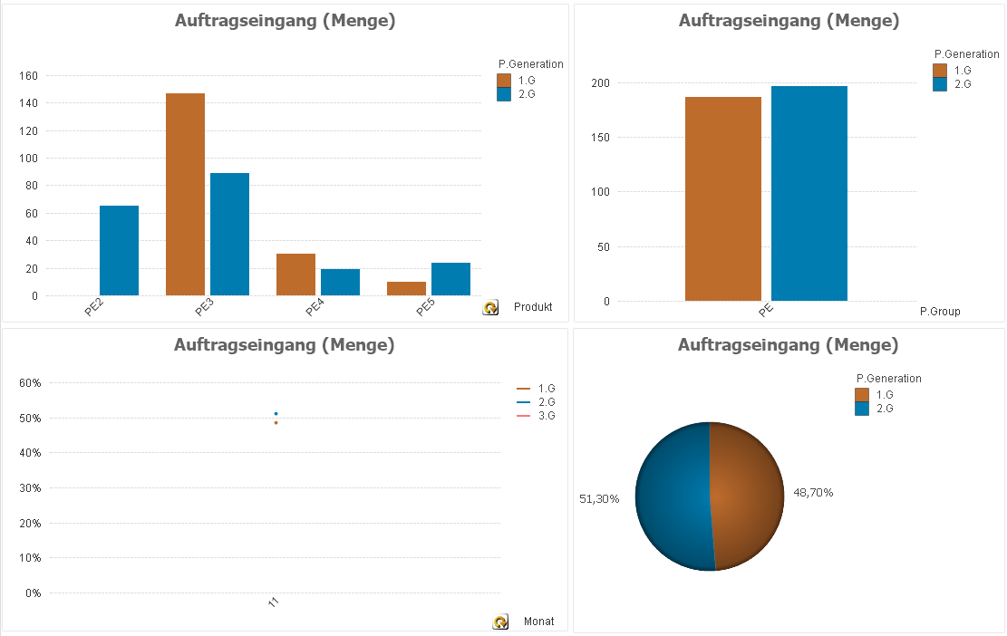
Change Statistik – Incoming Orders 2021-11
Notes:
Good Progress in Change.
G1 Gearbox incoming Orders since July 2021 have been 1550 pcs.
900 of them is Trumpf.
When Trumpf is changing to G2, then the change rate jumps to about 80%.

Slide 12
Outlook Change Process
Good Progress in Change.
G1 Gearbox incoming Orders since July 2021 have been 1550 pcs.
900 of them are Trumpf.
When Trumpf is changing to G2, then the change rate jumps to about 80%.

