Slide 1
PROFIdrive + PROFIsafe
Technical Meeting 2021 Part 1
16th november
For internal use only!
No release for public presentation.

Slide 2
Agenda
PROFIsafe
Requirements
Adjustment and Usage
Commissioning / Live Demo
After the presentation you get the TIA Portal V17 examples for PROFIsafe and PROFIdrive and the necessary DS6 files.
Before we start, please give me a feedback with the hand symbol if you have experience with PROFIsafe.

Slide 3
PROFIsafe – Requirements
1. Drive controller SI6 or SC6 (SD6 does not support PROFIdrive nor PROFIsafe)
2. At least firmware V6.5-D (TÜV)
3. TIA Portal 15 or newer
4. Additional software package - Step 7 Safety Advanced or Basic (depending on PLC)
5. Siemens Failsafe PLC (recognizable by the F in the name)

Slide 4
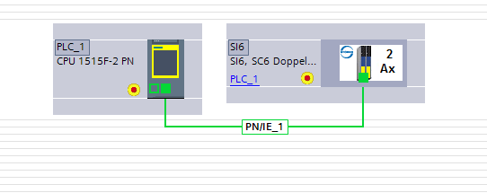
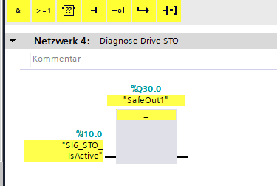
PROFIsafe – the facts
Safety telegram is transmitted via separate safety module
We support the XP safety module (V2.6.1. expanded)
And also the obsolete LP Safety module (V2.4) (S7-300/400)
PROFIsafe can be combined with all Stöber DS6 applications
Safety functions SS1 and STO can be activated via PROFIsafe
Status feedback SS1_active and STO_active via PROFIsafe Safety
characteristics SIL3 / Ple (Cat. 4) (HW identical SY6)

Slide 5
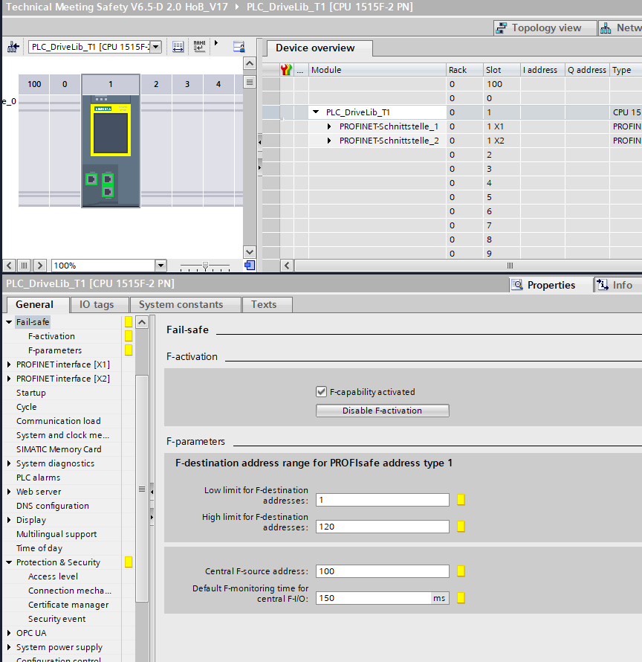
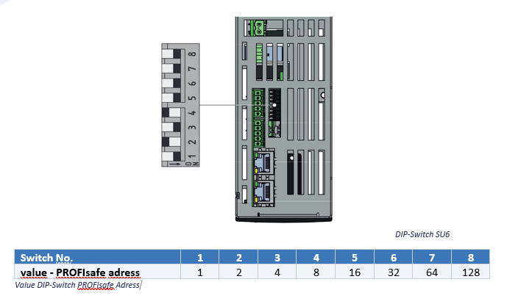
Adjust PROFIsafe adress
1. Activate safety in PLC
2. Check safety destination adress area (for slaves)
3. Check safety source adress (PLC)
5. Set the same safety source adress for every drive in TIA
4. Choose safety destination adress
for every drive (slaves)
(Here 2 + 8 = 10)
Restart drive controller !

Slide 6
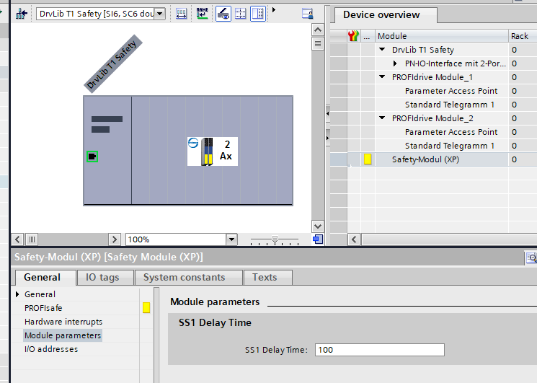
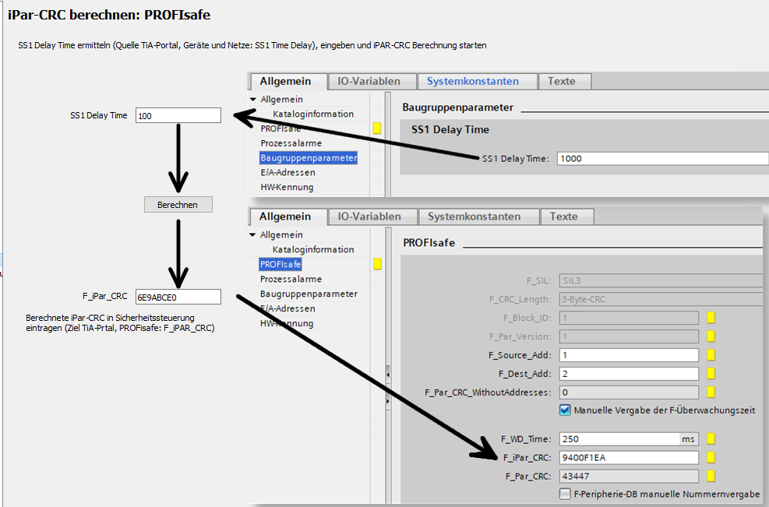
Adjust SS1 Time – DS6 and TIA Portal
2. Fill in SS1 time in DS6 assistant
1. Choose SS1 time in TIA Portal for the drive
Important: The SS1-time is given in multiples of 10ms, so for example the value 100 corresponds to 100*10ms = 1s.
3. Calculate F_iPar_CRC
and fill in TIA Portal

Slide 7
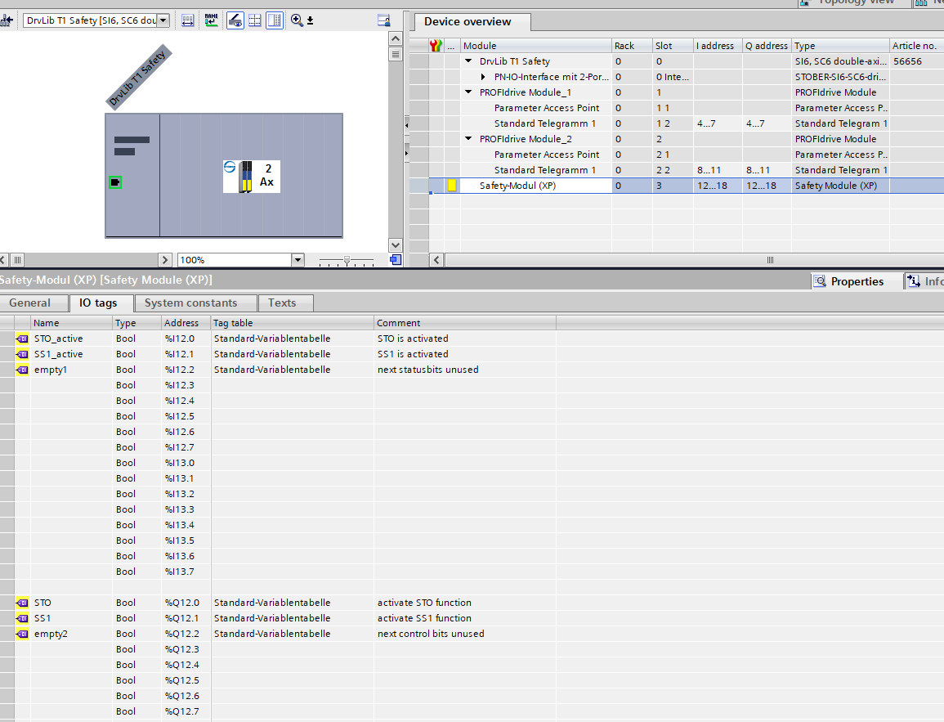
Connecting Safety Binary Signals – naming tags
PROFIsafe Telegramm 30
1. define variable names for the safety functions STO and SS1
Diagnostic Bits STO / SS1
Input adress area
Request Bits STO / SS1
Output adress area

Slide 8
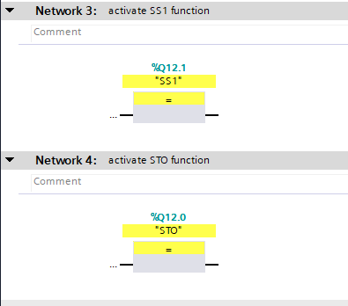
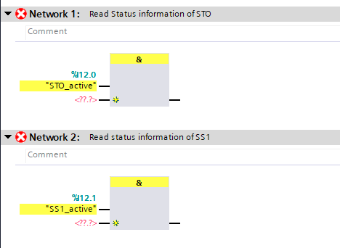
Usage of safety I/O‘s in safety program
Request Bits STO / SS1
Output adress area
Diagnostic Bits STO / SS1
Input adress area

Slide 9
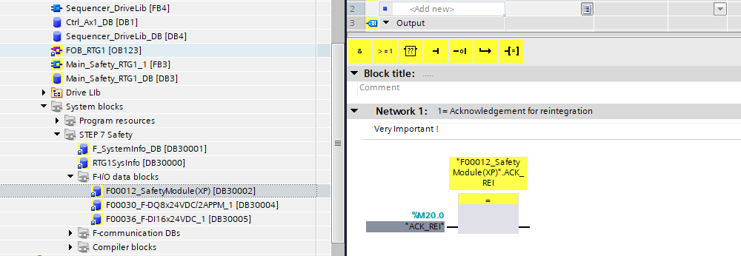
Acknowledgement for reintegration
Find more information at siemens
Industry online support:

Slide 10
Structure of Communication modules in HW Manager
Single / DoubleAxis
Device
Safety / No Safety
Module
Process Data Modules (since years)
M101–M107 all cons. 2W – 36W
(M111–M117 item cons. 2W – 36W)
Choice depending on the lenght
Content changeable
Safety Modul (LP, obsolete)
Safety Module (XP)
PROFIDRIVE Modules
Only available with Safety Device
New
Only available with Safety Device
New
Submodule
Telegram 1
Telegram 2
Telegram 3
Telegram 111
New
Defined content not changeable

Slide 11
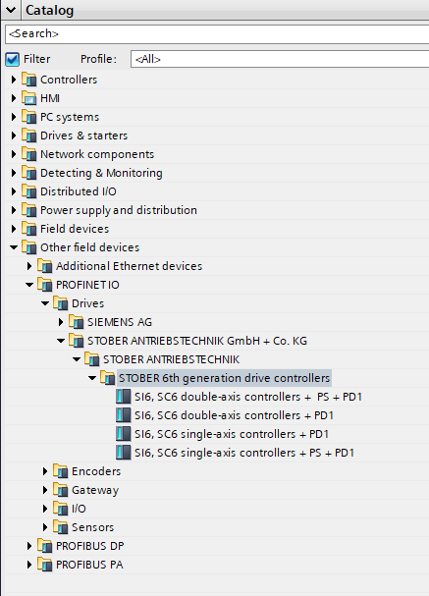
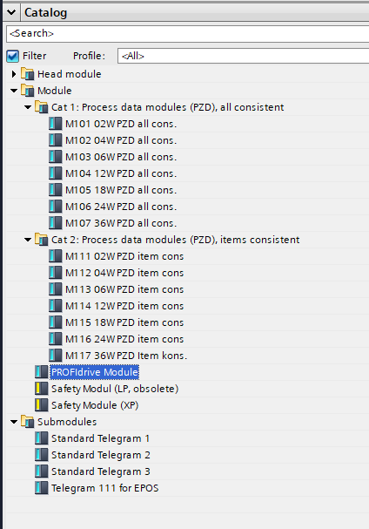
Possible Combinations in Hardwaremanager of Siemens
Devices
Modules and Submodules
The formerly known
Process data modules can be used
instead of PROFIdrive Module
PROFIdrive Module
Allows the usage of
Submodules Telegram1 to 111.
PS: PROFISafe
PD1: PROFIdrive V1
(PD2 will include
Isochronous Real Time
functionality IRT)
Safety Modules can only be used with PROFIsafe Devices (PS)

Slide 12
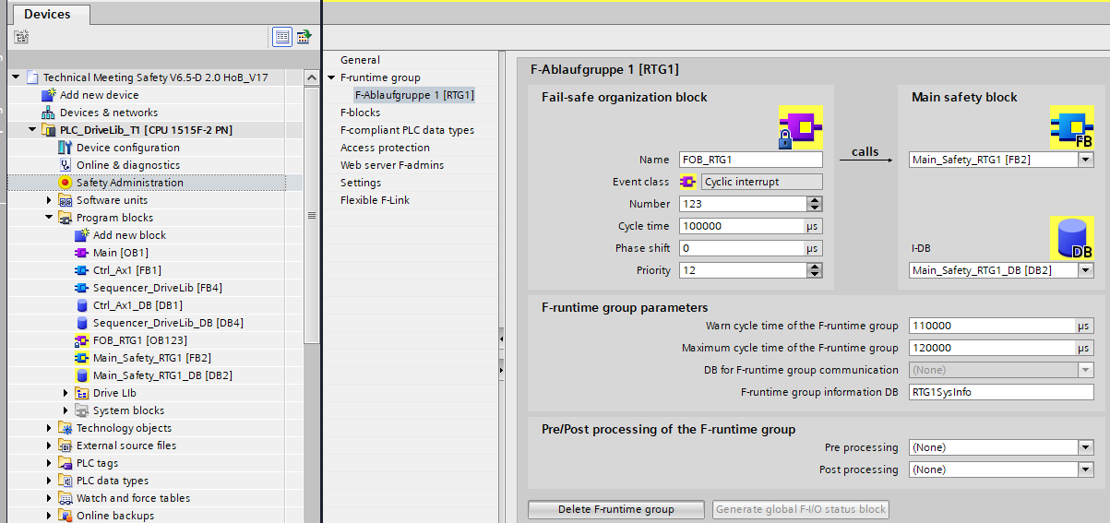
Safety cycle time
cycletime safety program
independend of plc task
Independend of bus cycle

Slide 13
Live Demo
Hardwaremanager / Possible Combinations
Naming of tags and usage in the safety program
Usage of status signals in the safety program
Reintegration safety program after safety error
If you have questions, please give me a feedback with the hand symbol.

Slide 14
Thank you for your attention !

Slide 15
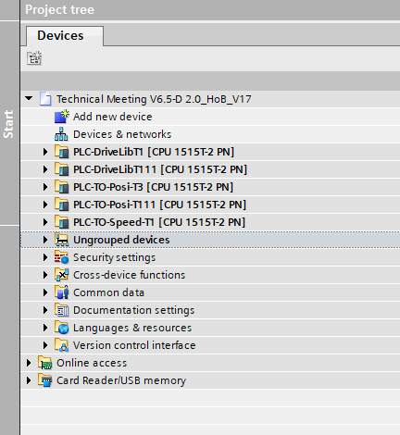
Outlook to part II
You get the 5 PROFIdrive Examples for DriveLib (T1, T11)
and Technology Objekts (T1, T3, T11).
Please have a look and see more details in part II
in december 7th 2021.

