Slide 1
The SI6 Drive Controller
SI6

Slide 2
The SI6 Drive Controller
SI6
Multi Axis
Drive System

Slide 3
The SI6 Drive Controller
SI6
Multi Axis
Drive System
Controls up
to two axes
(now four)

Slide 4
The SI6 Drive Controller
SI6
Multi Axis
Drive System
Controls up
to two axes
(now six)

Slide 5
The SI6 Drive Controller
SI6
Multi Axis
Drive System
Controls up
to two axes
(now eight)

Slide 6
The SI6 Drive Controller
SI6
Integrate STOBER SD6
stand-alone-unit
Control any number
of axes precisely

Slide 7
The SI6 Drive Controller
Integrate STOBER SD6
stand-alone-unit
Control any number
of axes precisely

Slide 8
The SI6 Drive Controller
Booksize

Slide 9
The SI6 Drive Controller
Booksize
Pocket book

Slide 10
The SI6 Drive Controller
Booksize
Pocket book
Save valuable space
in the control cabinet

Slide 11
The SI6 Drive Controller

Slide 12
The SI6 Drive Controller
One common
power supply
Connected via
Quick DC-Link modules

Slide 13
The SI6 Drive Controller
One common
power supply
Connected via
Quick DC-Link modules
No over-dimensioning
of the power supply

Slide 14
The SI6 Drive Controller
With the SI6 drive
controller, you save:
• Space
• Hardware costs
• Operating costs

Slide 15
The SI6 Drive Controller
Acceleration: in 10 ms from 0 to 3000 rpm

Slide 16
The SI6 Drive Controller
Positioning accuracy:
more than 33 million positions per revolution

Slide 17
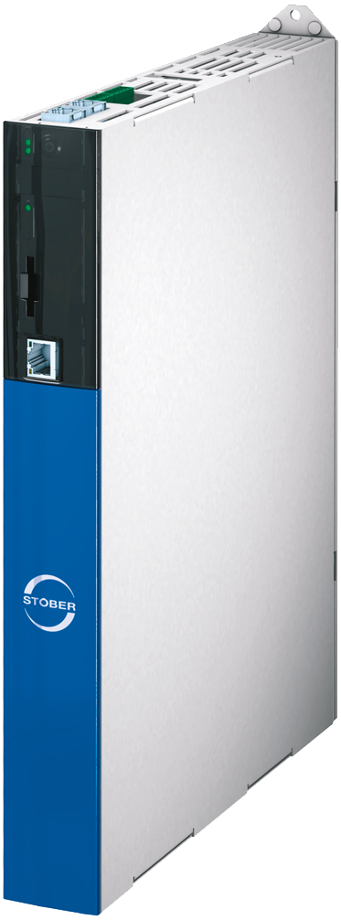
The SI6 Drive Controller
Installation:
just click in

Slide 18
The SI6 Drive Controller
Real single cable solution for encoder communication and power connection
HIPERFACE DSL® with electronic motor nameplate
alternative: EnDat 2.2® digital

Slide 19
The SI6 Drive Controller

Slide 20
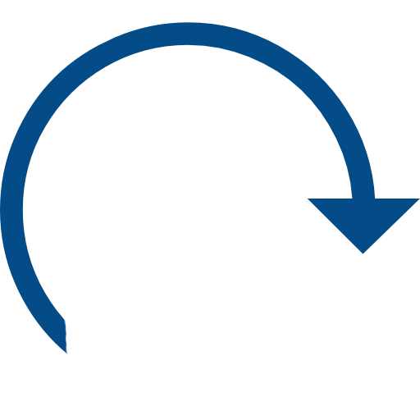
The SI6 Drive Controller
Wear-free
• no regular function tests
• small distances between system
and safety fence

Slide 21
The SI6 Drive Controller
Communication: EtherCAT® and PROFINET® fieldbus systems
CiA® 402 device profile for Controller Based and Drive Based Solutions

Slide 22
The SI6 Drive Controller
Integrated in the STOBER Engineering
Tools DriveControlSuite DS6 and
AutomationControlSuite AS6

Slide 23
The SI6 Drive Controller
No “language barriers“

Slide 24
The SI6 Drive Controller

Slide 25
The SI6 Drive Controller
The variants
Type
Frame size
I
(4 kHz)
I
(8 kHz)
2N, PU
2N, PU
Size [mm]

Slide 26
The SI6 Drive Controller
STOBER is involved!
• Concept development
• Installation
• 24/7 - Support

Slide 27
The SI6 Drive Controller
SI6
- the most important features:
• Compact design: only 45 mm wide
• Precise dimensioning of the
control capacities
• Common power supply for all units
• Peak values for acceleration and
positioning accuracy
• Simple installation thanks to Quick DC-Links and
a single cable solution
• Encoder systems with electronic
motor nameplate
• Reliable safety thanks to "Safe Torque Off"

Slide 28
The SI6 Drive Controller
The SI6 drive controller

