Slide 1
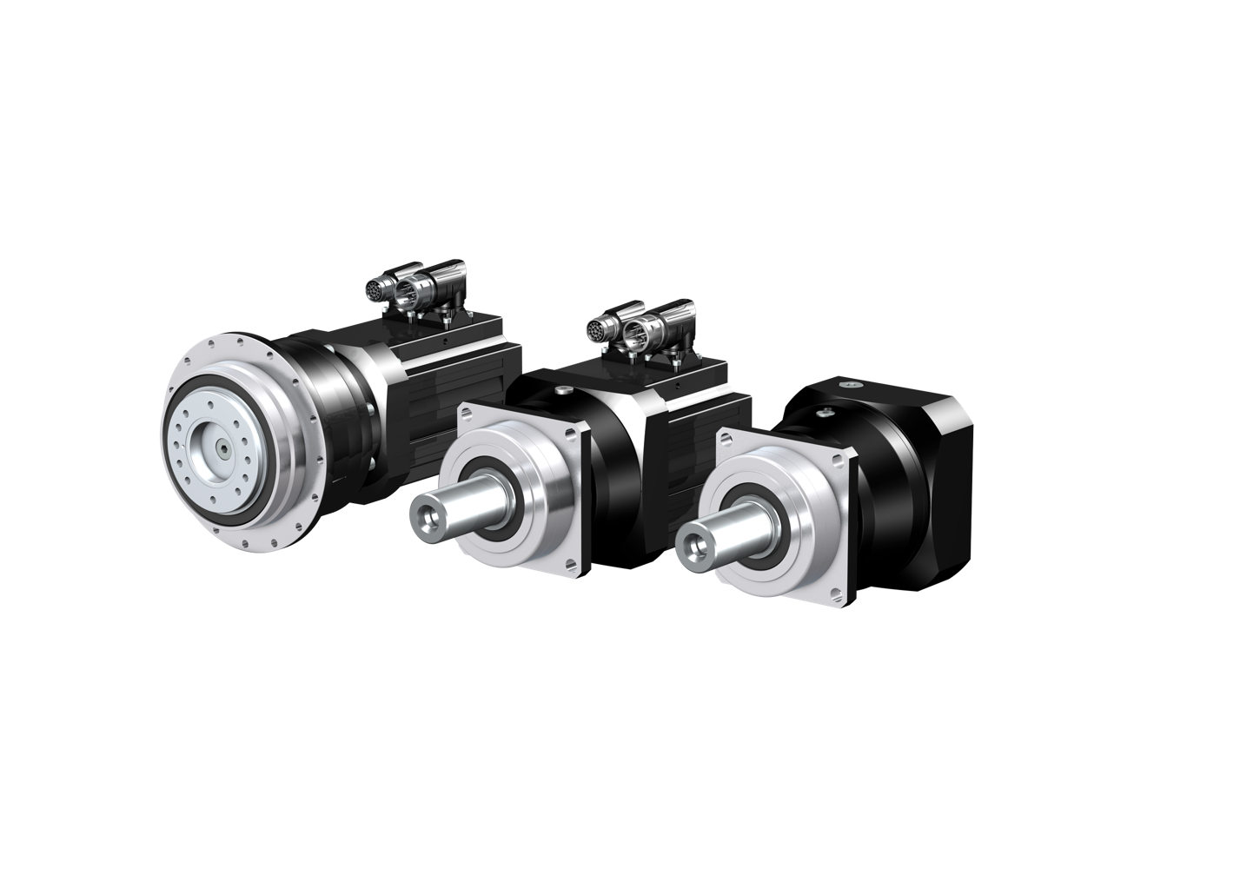
Planetary gear units from STOBER.
Your upgrade to generation 3.

Slide 2
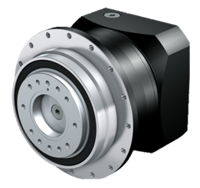
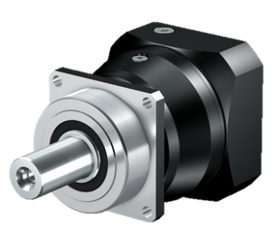
What an upgrade means for you:
Greater precision and performance!
More compact design to save space!
Guaranteed interface compatibility!
Attractive design!
Greater variety and flexibility for custom machine design!
And as always, everything is available from a single source!
Notes:
Interface compatibility: The mechanical output interfaces are almost 100% compatible with G2. With the exception of the P2, all G3 gear units have been reduced in length significantly. The length of the P2 size was not able to be reduced. This makes collisions with machine contours much less likely.
However, we do generally recommend conducting an interference contour check using the new 3D volume models (step files). These can either be obtained together with the offer from our order center or by configuring your product using the STOBER Configurator (https://configurator.stoeber.de/de-DE/?shop=SAT).
For detailed information, see the product release letter on the generation 3 planetary gear unit, SPG October 2019.

Slide 3
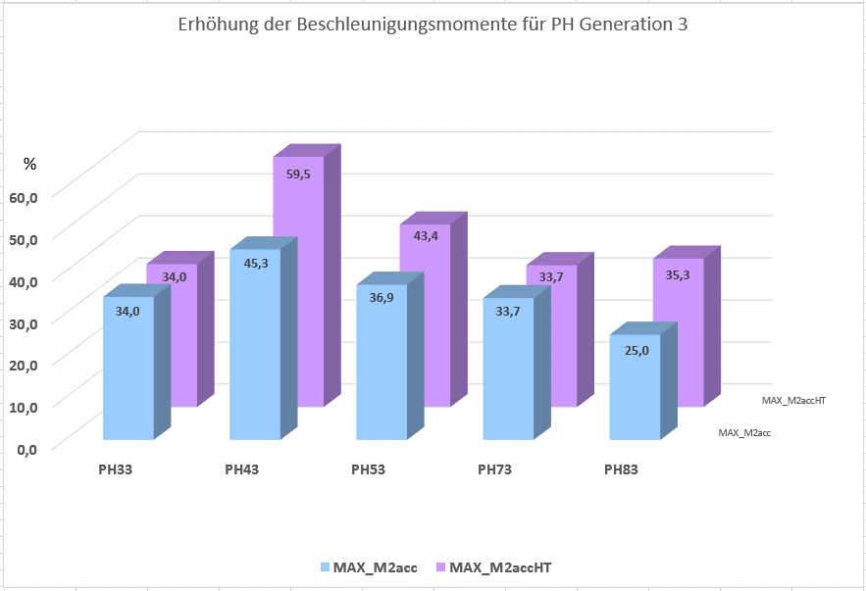
More PERFORMANCE: Acceleration torque
Up to 59.5% greater acceleration torque.
Notes:
Better acceleration torque thanks to
improved toothing quality,
state-of-the-art materials and hardening processes,
state-of-the-art precision machinery,
new, innovative manufacturing process for ring gear toothing (power skiving/hob peeling) in a machine chuck (i.e. no reclamping errors),
optimized gearing widths.
Reduced backlash means even higher quality toothing as well as further improved acceleration torques.
M_{2acc} refers to the standard backlash value, while M_{2accHT} is the value for reduced backlash.

Slide 4
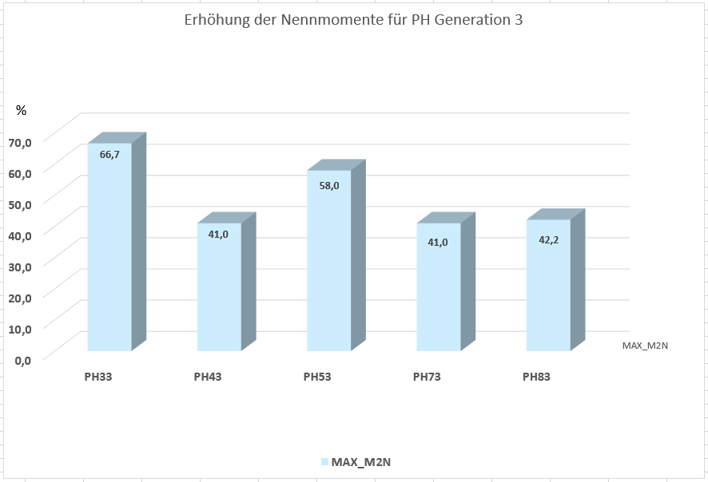
More PERFORMANCE: Nominal torque
Up to 66.7% higher nominal torque.
Notes:
Higher nominal torques thanks to a modified calculation basis in line with the latest findings and current state of the art.

Slide 5
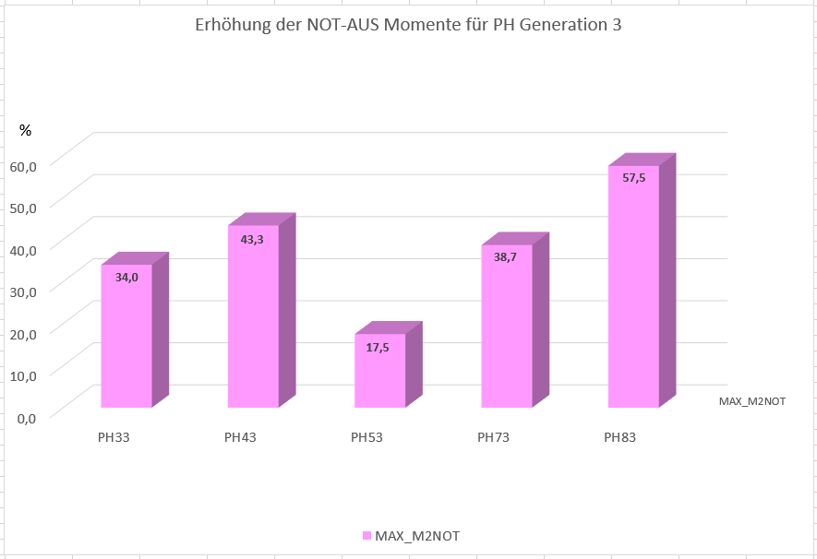
More PERFORMANCE: Emergency-off torque
Up to 57.5% higher emergency-off torque.
Notes:
Higher emergency-off torques as a result of
improved toothing quality,
state-of-the-art materials and hardening processes,
state-of-the-art precision machinery,
new, innovative manufacturing process for ring gear toothing (power skiving/hob peeling) in a machine chuck (i.e. no reclamping errors),
optimized gearing widths,
optimized shaft-hub connections.

Slide 6
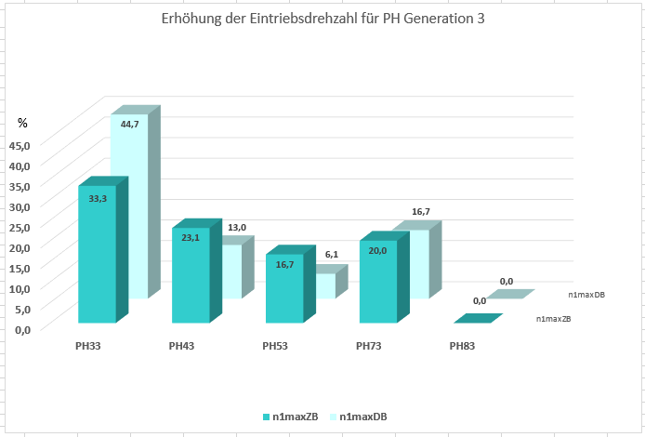
More PERFORMANCE: Input speed
Increased input speed
Up to 33.3% higher input speed during cyclic operation.
Up to 44.7% in continuous operation.
Notes:
Increased input speed thanks to
altered bearing arrangement for 2-stage backlash-reduced gear units,
narrower input toothing for 2-stage gear units,
comprehensive trial testing.

Slide 7
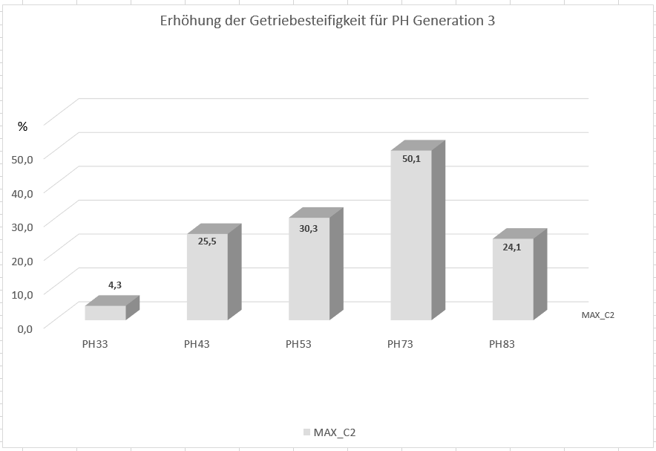
More PERFORMANCE: Torsional stiffness
Up to 50.1% greater torsional stiffness.
Notes:
Greater torsional stiffness thanks to
shortened design length,
modified toothing widths in the output stage.

Slide 8
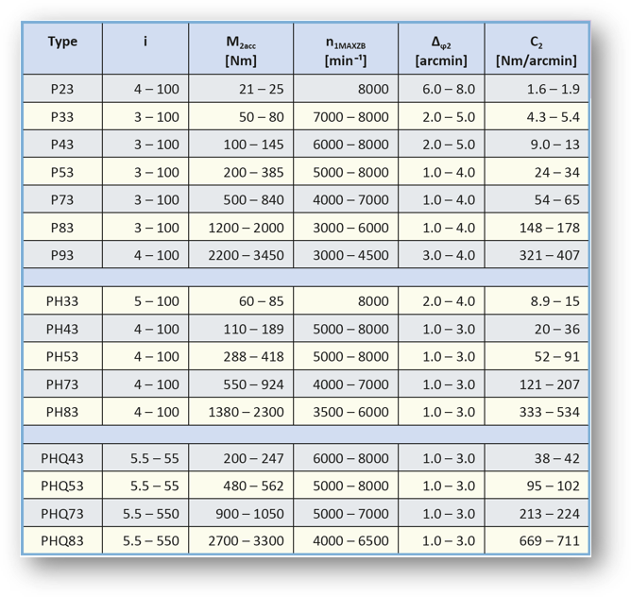
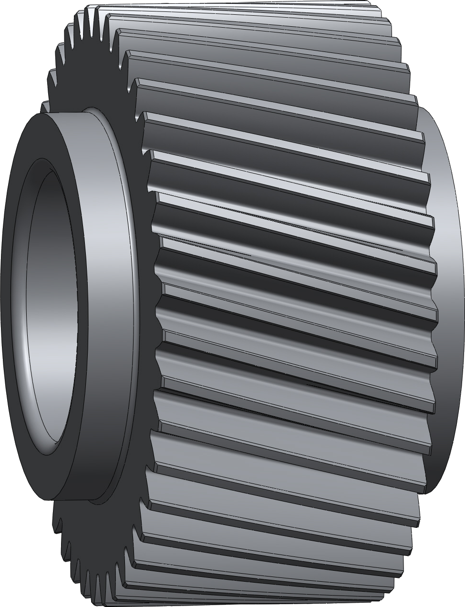
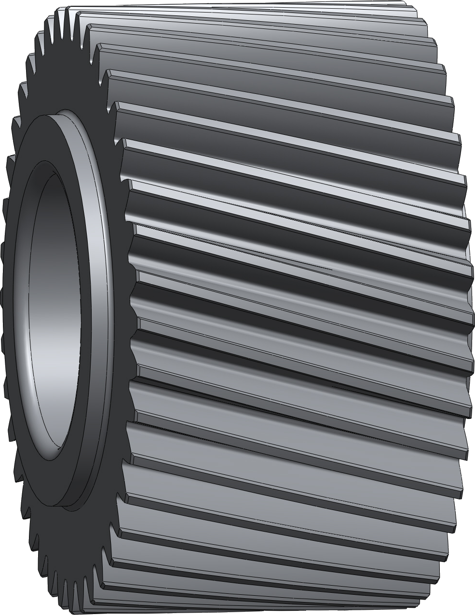
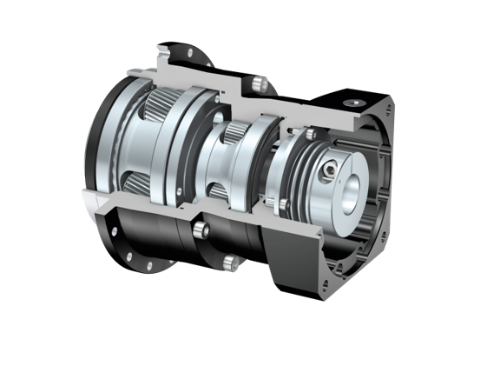
More PERFORMANCE for your machine!
Greater torque!
Greater torques with wider toothing.
Greater torques with nitride housing gearing (reduced backlash).
Notes:
The increased idler pin diameter and wider toothing in the output stage improve emergency-off torque as well as load capacity.

Slide 9
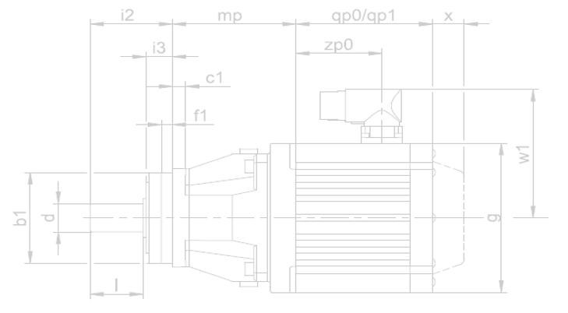
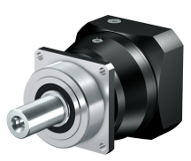
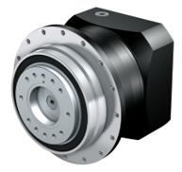
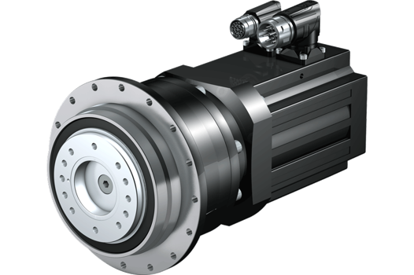
More PERFORMANCE for your machine!
P
Space-saving!
Smaller installation space.
Low weight.
High torque.
Leverage the benefits of direct attachment!
No motor adapter.
Low weight.
Maximum drive dynamics.
Power density improved by 65%.
Ready-to-install drive solution.
PH
L
L
The most compact planetary geared motors on the market
Notes:
Space-saving machine and installation concept thanks to an extremely compact design.
Maximum drive dynamics due to the very low mass moment of inertia in direct attachment. The elimination of a motor adapter guarantees maximum drive dynamics.

Slide 10
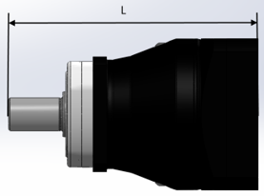
P: Comparison table of modified design lengths
 | G2 ME | G3 ME | Reduction | G2 MEL | G3 MEL | Reduction
 | L [mm] | L [mm] | [mm] | L [mm] | L [mm] | [mm]
P221 – P231 | 109.5 | 109.5 | 0.0 | 129.0 | 129.0 | 0.0
P222 – P232 | 141.5 | 141.5 | 0.0 | 161.0 | 161.0 | 0.0
P321 – P331 | 153.0 | 145.5 | 7.5 | 159.3 | 147.0 | 12.3
P322 – P332 | 173.5 | 163.0 | 10.5 | 193.0 | 182.5 | 10.5
P421 – P431 | 174.0 | 165.5 | 8.5 | 185.5 | 178.5 | 7.0
P422 – P432 | 218.5 | 202.5 | 16.0 | 224.8 | 204.0 | 20.8
P521 – P531 | 217.0 | 210.5 | 6.5 | 233.0 | 223.0 | 10.0
P522 – P532 | 263.5 | 239.5 | 24.0 | 275.0 | 252.5 | 22.5
P721 – P731 | 268.0 | 264.5 | 3.5 | 293.0 | 287.5 | 5.5
P722 – P732 | 318.0 | 302.5 | 15.5 | 334.0 | 315.0 | 19.0
P821 – P831 | 318.0 | 311.5 | 6.5 | 334.0 | 320.5 | 13.5
P822 – P832 | 376.5 | 356.5 | 20.0 | 401.5 | 379.5 | 22.0
P921 – P931 | 396.0 | 380.5 | 15.5 | - | - | -
P922 – P932 | 476.0 | 463.5 | 12.5 | 492.0 | 472.5 | 19.5
Notes:
There is no MEL adapter for P9!

Slide 11
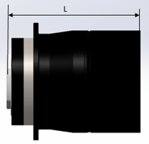
PH(Q): Comparison table of modified design lengths
 | G2 ME | G3 ME | Reduction | G2 MEL | G3 MEL | Reduction
 | L [mm] | L [mm] | [mm] | L [mm] | L [mm] | [mm]
PH321 – PH331 | 102.5 | 98.5 | 4.0 | 108.8 | 100.0 | 8.8
PH322 – PH332 | 119.0 | 116.0 | 3.0 | 138.5 | 135.5 | 3.0
PH421 – PH431 | 120.0 | 113.5 | 6.5 | 131.5 | 126.5 | 5.0
PH422 – PH432 | 164.5 | 150.5 | 14.0 | 170.8 | 152.0 | 18.8
PH521 – PH531 | 134.0 | 132.0 | 2.0 | 150.0 | 144.5 | 5.5
PH522 – PH532 | 180.5 | 161.0 | 19.5 | 192.0 | 174.0 | 18.0
PH721 – PH731 | 164.0 | 161.0 | 3.0 | 189.5 | 184.0 | 5.5
PH722 – PH732 | 214.0 | 199.0 | 15.0 | 230.0 | 211.5 | 18.5
PH821 – PH831 | 218.0 | 218.0 | 0.0 | 234.0 | 236.0 | -2.0
PH822 – PH832 | 277.0 | 263.0 | 14.0 | 303.0 | 286.0 | 17.0
Notes:
There is no MEL adapter for P9!

Slide 12
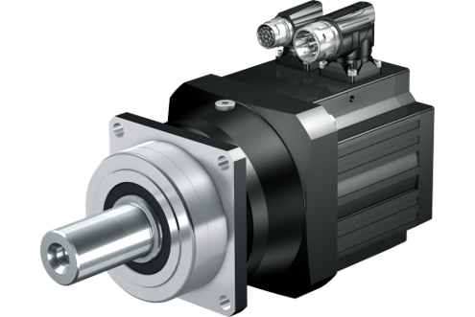
P direct attachment: Comparison table of modified design lengths
 | i2+mp |  | Reduction
 | G2 | G3 | [mm]
P221 – P231 EZ3 | 97.5 | 97.5 | 0.0
P222 – P232 EZ3 | 129.5 | 129.5 | 0.0
P321 – P331 EZ3 | 121.5 | 116.5 | 5.0
P321 – P331 EZ4 | 118.0 | 113.0 | 5.0
P322 – P332 EZ3 | 161.5 | 151.0 | 10.5
P421 – P431 EZ4 | 135.0 | 136.5 | - 1.5
P421 – P431 EZ5 | 137.5 | 136.0 | 1.5
P422 – P432 EZ3 | 187.0 | 173.5 | 13.5
P422 – P432 EZ4 | 183.5 | 170.0 | 13.5
P521 – P531 EZ5 | 169.0 | 168.5 | 0.5
P521 – P531 EZ7 | 175.0 | 171.5 | 3.5
P522 – P532 EZ4 | 224.5 | 210.5 | 14.0
P522 – P532 EZ5 | 227.0 | 210.0 | 17.0
P721 – P731 EZ7 | 210,0 | 212.5 | - 2.5
P721 – P731 EZ8 | 225.0 | 222.5 | 2.5
P722 – P732 EZ5 | 270.0 | 260.5 | 9.5
P722 – P732 EZ7 | 276.0 | 263.5 | 12.5
P821 – P831 EZ8 | 249.0 | 253.5 | - 4.5
P822 – P832 EZ7 | 318.5 | 304.5 | 14.0
P822 – P832 EZ8 | 333.5 | 314.5 | 19.0
P922 – P932 EZ8 | 407.0 | 405.5 | 1.5
The most compact planetary geared motors on the market
Notes:
Space-saving machine and installation concept thanks to an extremely compact design.
Maximum drive dynamics due to the very low mass moment of inertia in direct attachment. The elimination of a motor adapter guarantees maximum drive dynamics.

Slide 13
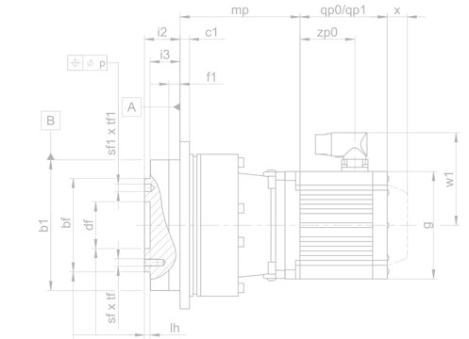
PH direct attachment: Comparison table of modified design lengths
 | i2+mp |  | Reduction
 | G2 | G3 | [mm]
PH321 – PH331 EZ3 | 70.5 | 70.5 | 0.0
PH321 – PH331 EZ4 | 67.5 | 67.0 | 0.5
PH322 – PH332 EZ3 | 107.0 | 104.0 | 3.0
PH421 – PH431 EZ4 | 81.0 | 84.5 | -3.5
PH421 – PH431 EZ5 | 83.5 | 84.0 | -0.5
PH422 – PH432 EZ3 | 133.0 | 129.0 | 4.0
PH422 – PH432 EZ4 | 129.5 | 125.5 | 4.0
PH521 – PH531 EZ5 | 86.0 | 91.0 | -5.0
PH521 – PH531 EZ7 | 92.0 | 93.0 | -1.0
PH522 – PH532 EZ4 | 141.5 | 133,0 | 8.5
PH522 – PH532 EZ5 | 144.0 | 132.5 | 11.5
PH721 – PH731 EZ7 | 106.0 | 109.0 | -3.0
PH721 – PH731 EZ8 | 115.0 | 119.0 | -4.0
PH722 – PH732 EZ5 | 166.0 | 157.0 | 9.0
PH722 – PH732 EZ7 | 172.0 | 160.0 | 12.0
PH821 – PH831 EZ8 | 149.5 | 160.0 | -10.5
PH822 – PH832 EZ7 | 219.0 | 211.0 | 8.0
PH822 – PH832 EZ8 | 234.0 | 221.0 | 13.0
PH932 – PH932 EZ8 | 315.5 | 315.5 | 0.0
PH1032 – PH1032 EZ8 | 332.0 | 332.0 | 0.0
The most compact planetary geared motors on the market
Notes:
Space-saving machine and installation concept thanks to an extremely compact design.
Maximum drive dynamics due to the very low mass moment of inertia in direct attachment. The elimination of a motor adapter guarantees maximum drive dynamics.

Slide 14
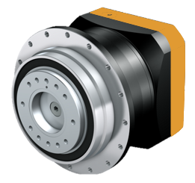
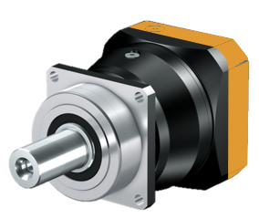
Motor connection flange: Comparison of square dimensions
Partially modified square dimensions attributed to standardization.
Size | Motor shaft d_{max} x l_{max} [mm] | G2 square [mm] | G3 square [mm]
P231, P232, P332, PH332 | 14 x 30 | 55 | 55
P331, P432, PH331, PH432 | 19 x 40 | 72/75 | 75
P431, P532, PH43, PH532 | 24 x 42 | 98/100 | 100
P53, P732, PH531, PH732 | 32 x 50 | 115 | 120
P731, P832, PH731, PH832 | 38 x 61 | 144/145 | 150
P831, P932, PH83, PH942, PH1042 | 48 x 80 | 190 | 204
P931 | 60 x 85 | 225 | 230
Notes:
The standardization of motor interfaces for P and PH have resulted in larger square dimensions. For detailed information, see the product release letter on the generation 3 planetary gear unit, SPG October 2019.
There is no MEL adapter for P9!

Slide 15
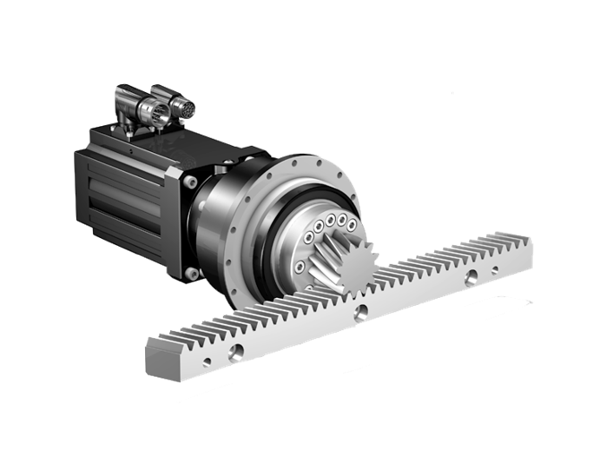
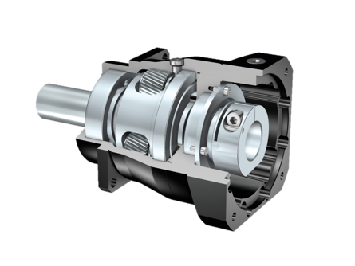
Greater PRECISION with planetary gear units from STOBER
Higher quality, greater precision!
Maximum positioning accuracy: Reduced backlash ≤ 1 arcmin.
High-quality housing and toothing.
High acceleration torques with maximum running accuracy and precision.
STOBER rack and pinion drives with a reduced radial runout of ≤ 10 μm.
Highly precise with low backlash!
Notes:
High-quality housing and toothing with innovative production technologies deliver maximum positioning accuracy with minimal backlash as low as ≤ 1 arcmin.
Result in high acceleration torques while ensuring maximum running accuracy and precision, such as the STOBER rack and pinion drive with a radial runout of ≤ 10 μm.

Slide 16
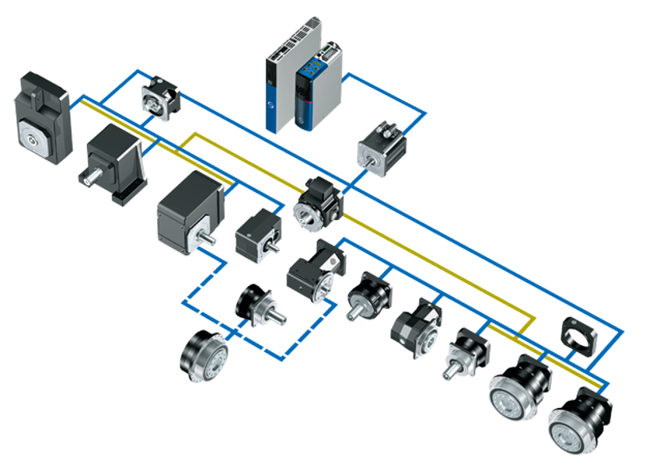
PERFECTLY ADAPTED to your individual requirements
All options are at your disposal!
Versatile machine design.
Exceptional variety of combinations and options.
Largest possible combination of gear units and motors with direct attachment.
Variable adapter designs.
SC6/SI6
SD6
ME
EZ/LM
F
C
MB
K
KL
KX
ME/MF
P
PE
KS
The right configuration for any requirement!
PH(Q)
P
PH/PHV
PHQ
Notes:
Unique interface technology for connecting motors of various sizes. STOBER motor adapters…
...are available in many different specifications, including a ServoStop variant with integrated brake,
...can be combined with standard or backlash-reduced gear units,
...in the large version with an extra-large motor plate can be connected to the most compact STOBER gear units with motors in large designs—a unique selling point!

Slide 17
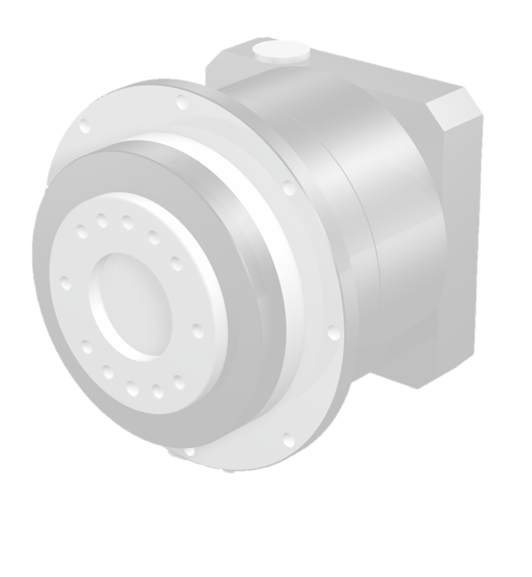
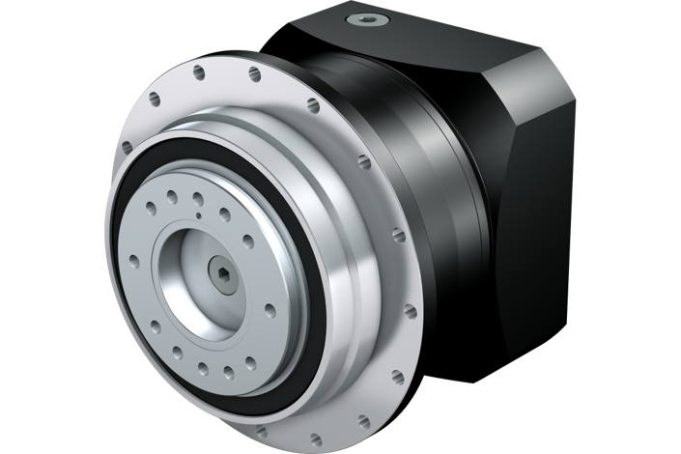
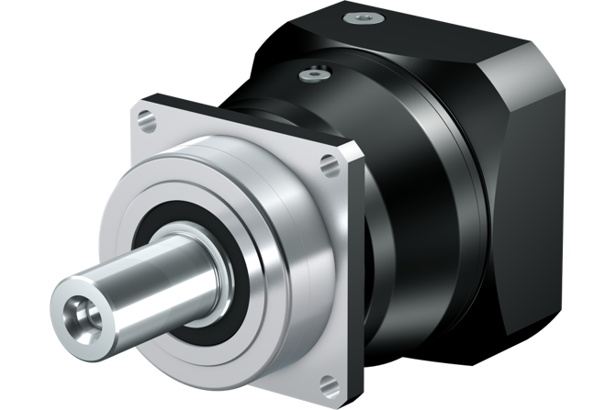
Attractive DESIGN
Notes:
Optimized design and standardization, i.e. the same input-side interface for P and PH. This means:
Use of identical motor adapters
Use of identical motor flanges in direct attachment

Slide 18
Planetary gear units from STOBER
High-performance. Precise. Perfect fit.
The most compact planetary geared motors on the market.
Superior precision and performance.
Exceptional variety of combinations and options.
Extreme ruggedness.
Ready-to-install drive solutions for machine tool and packaging machines as well as automation and robotics applications.

Slide 19
Make it yours! STOBER Configurator
Your right drive and automation solution
Quick configuration with just a few clicks.
Filter, compare, save and share.
Download 3D models, dimensional drawings or technical data sheets.
Request a quote directly!
configurator.stober.com

Slide 20
Timeline for your upgrade
MORE.
2019-10-01
2020-03-01
2020-05-01
THAN JUST A GEARBOX.
P2 – P4 PH(Q)3 – PH(Q)4
P5 – P7 PH(Q)5 – PH(Q)7
P8 – P9 PH(Q)8
The delivery times for the G3 planetary gear units are the same as for those of the G2.
When will you make the switch?

